Slide 1



NMR with Machine Learning
Devin Seay, Ishara Fernando, Dustin Keller

Slide 2
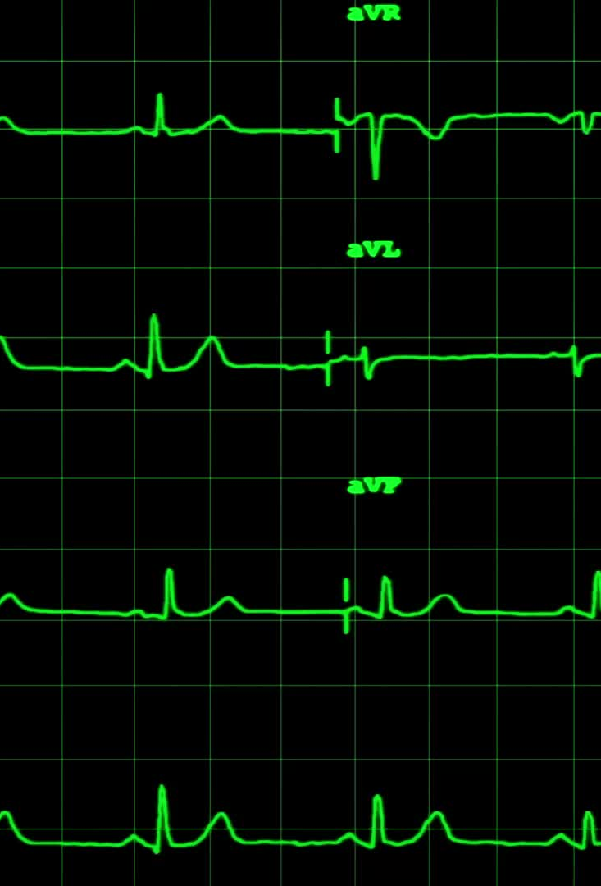
Outline
NMR Measurements w/ (Liverpool) Q-Meter
Deuteron lineshape and simulations
Why Artificial Neural Networks (ANN)?
Preliminary results
Observations & Outlook

Slide 3
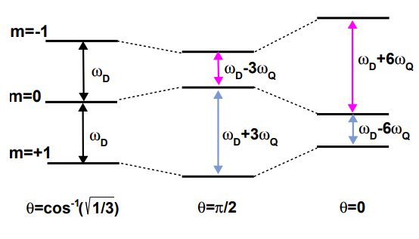
What is Nuclear Magnetic Resonance (NMR)?
Nuclear Magnetic Resonance, or NMR, is the physical phenomenon that occurs when a constant magnetic field is applied to nuclei at resonance which is perturbed by a weak oscillating magnetic field, which causes the nuclei to respond by producing an electromagnetic signal with a frequency characteristic of the magnetic field of the nuclei.
In the case of this project, we are using NMR to study the inner structure of the Deuterium nucleus (Deuteron).

Slide 4
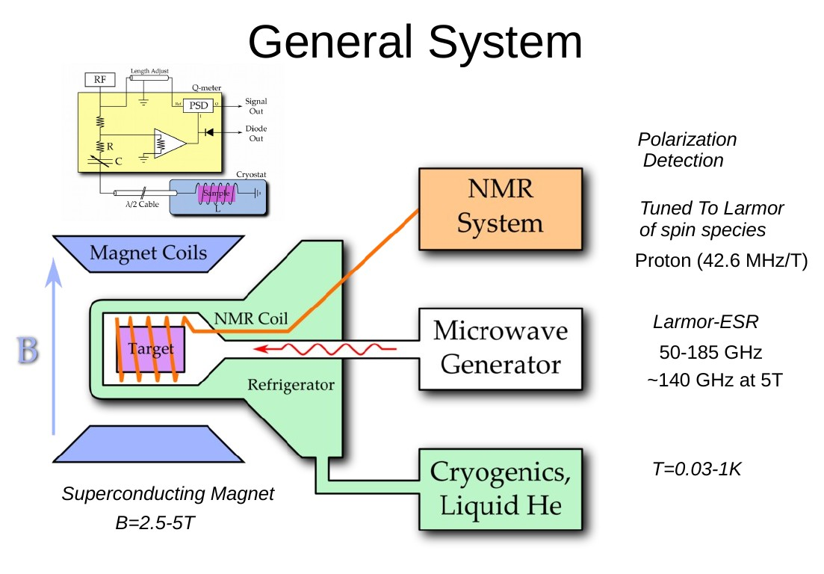
Q-Meter Based NMR
Using a non-destructive continuous wave
phase-sensitive detector
(ex., a Q-meter), is required to make accurate measurements of
polarization in scattering experiments

Slide 5
NMR Measurements with Q-Meter
Q-meter couples to the magnetic susceptibility of target material ( e.g. Solid Ammonia)
  Signal passes through λ/2 length cable (358.0 cm for 5T), so the continuous wave NMR signal has a tuning range of λ/2 to 7λ/2
  With a frequency range of 3-300 MHz
Within these limits, we expect a linear relationship between Polarization and scale (ideal settings gives 2% relative error)

Slide 6
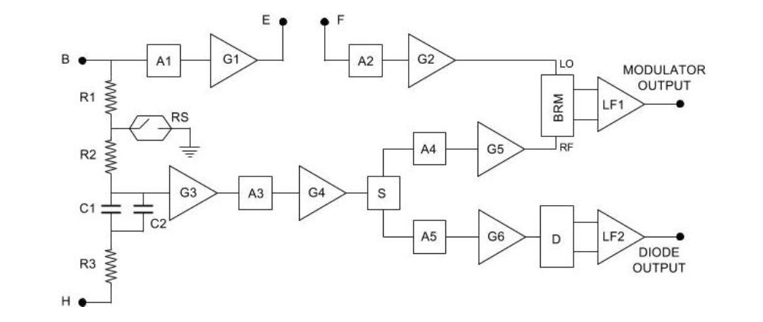
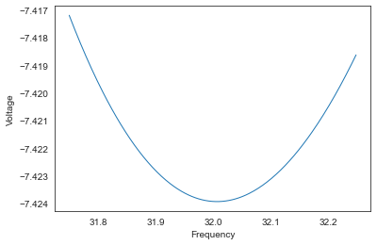

Q-Meter Design
Q-meter parameters:
  U, the input voltage (V), calculating using: $V\left(\text{ω}\right)=IZ\left(\text{ω}\right)e^{\text{iφ}(\text{ω})}$
  $C_{knob}$, the tuning capacitance
  $n/2$, the trim, is the half-integer length of the ${\text{λ}}/2$ such that each full-length segment of a cable is ${\text{n}\text{λ}}/2$
  η, the filling factor of the coil, is the level of coupling of spins in the target material to the sampling coil
  φ, the phase offset, expressed in the form: φ(ω) =a${\text{ω}}^{2}$+bω+φ
  $C_{stray}$, is the stray capacitance, including parasitic capacitance
    True C calculated as C(ω) = (20*${10}^{−12}$)* $C_{knob}$
Q-meter circuitry
NMR circuitry
Figure reference: Nuclear Instruments and Methods in Physics Research A324 (1993)

Slide 7

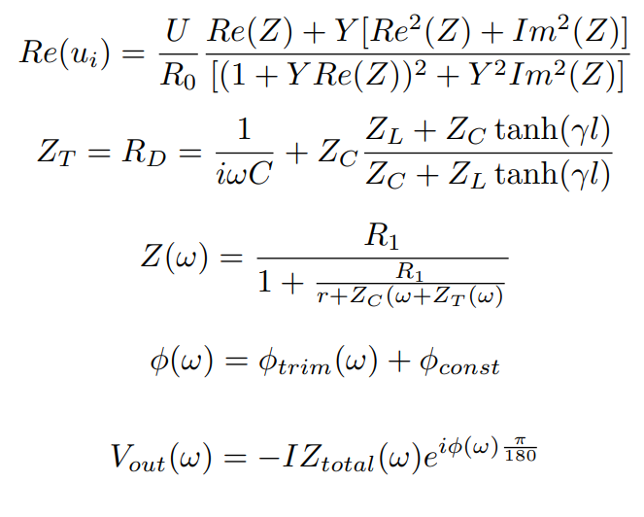

Q-meter Equations
7

Slide 8
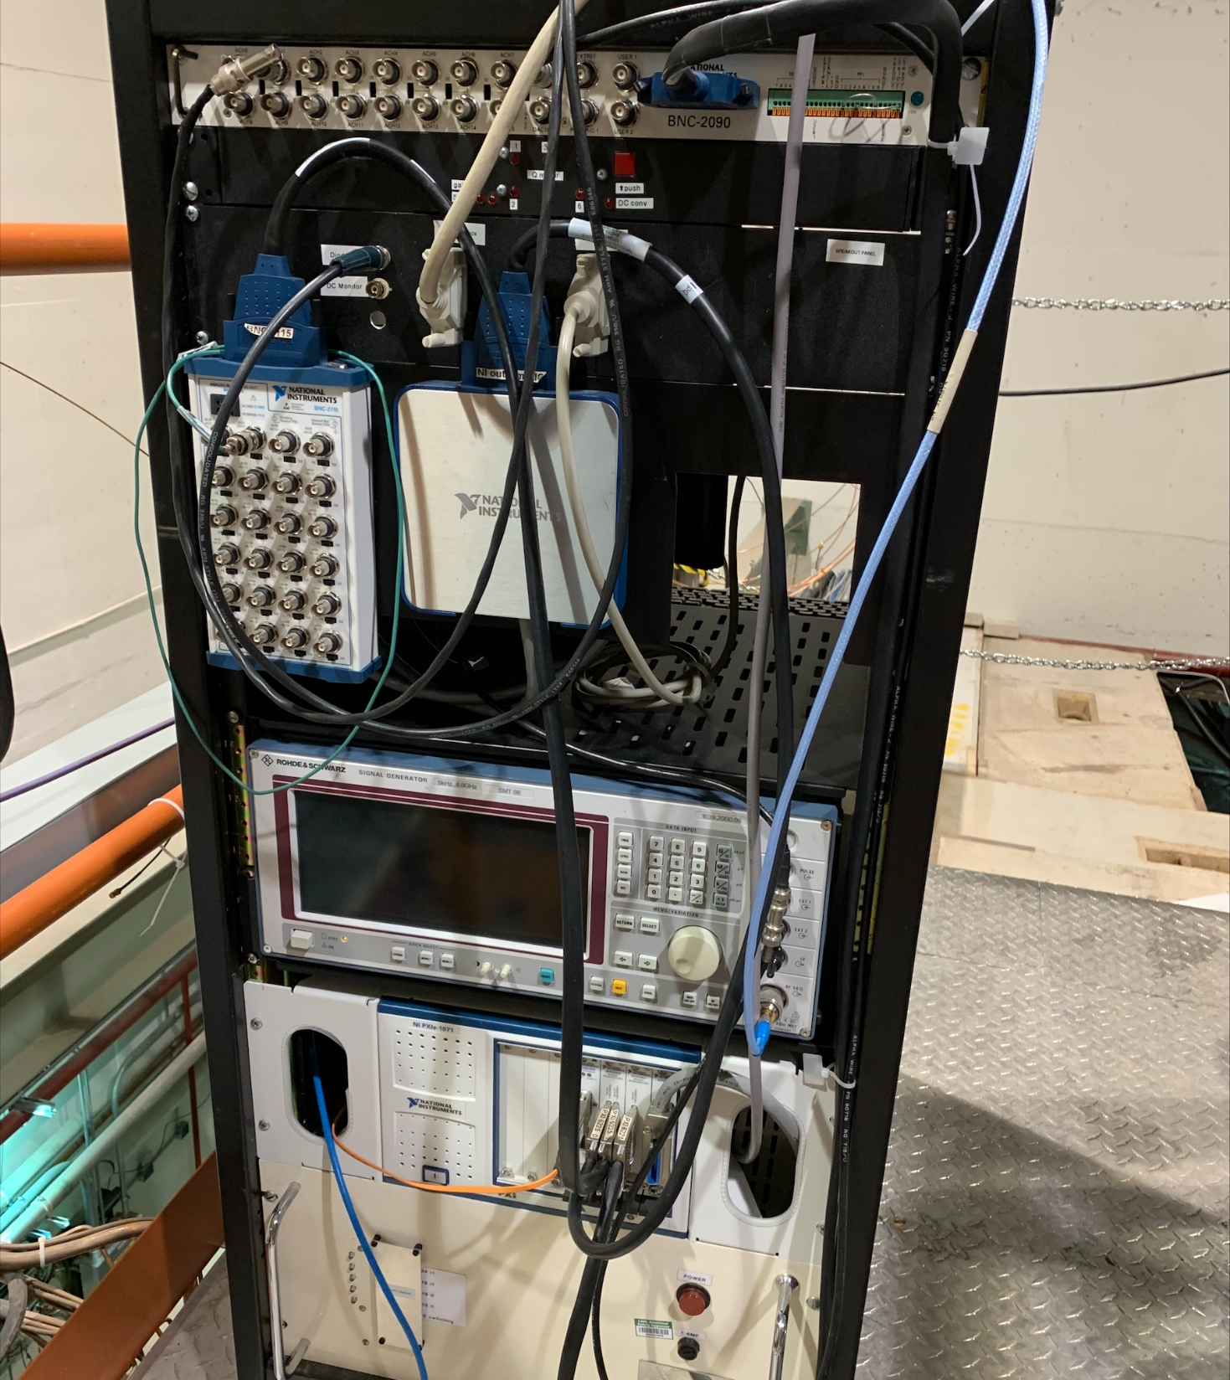
NMR System

Slide 9
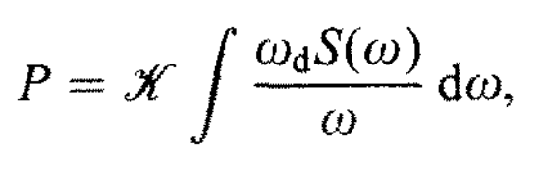
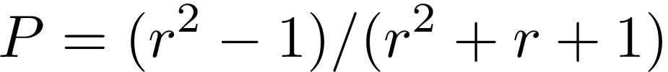
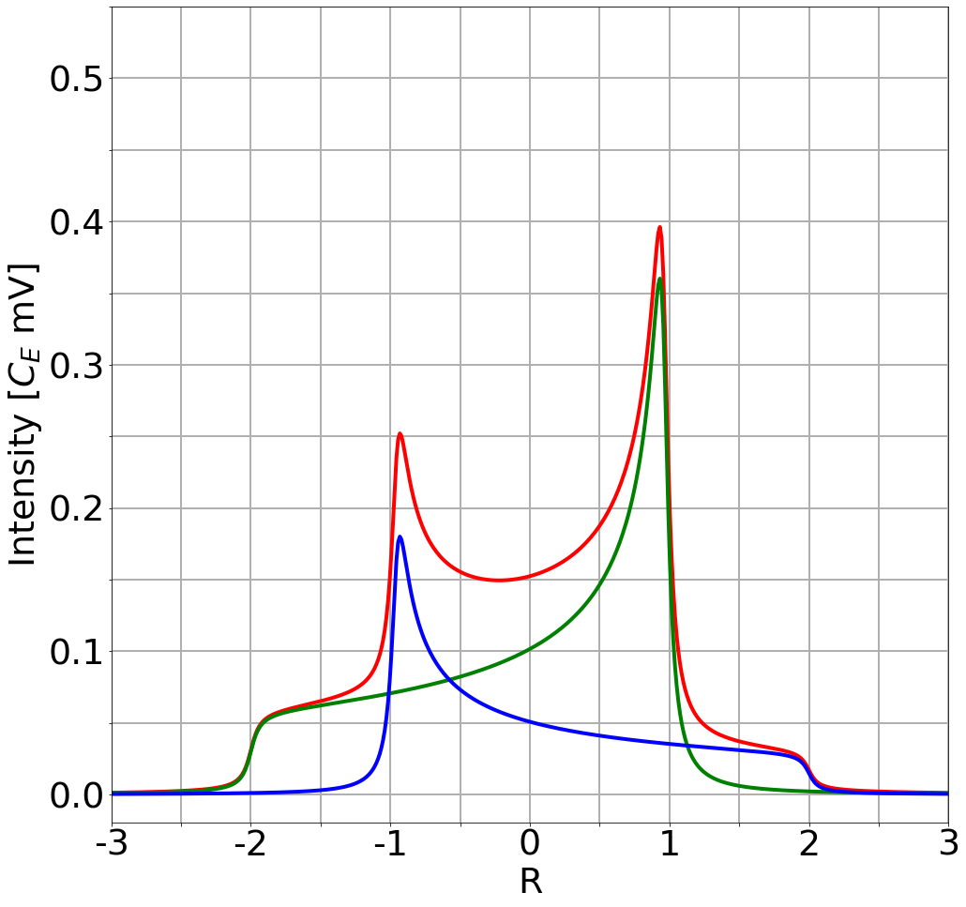

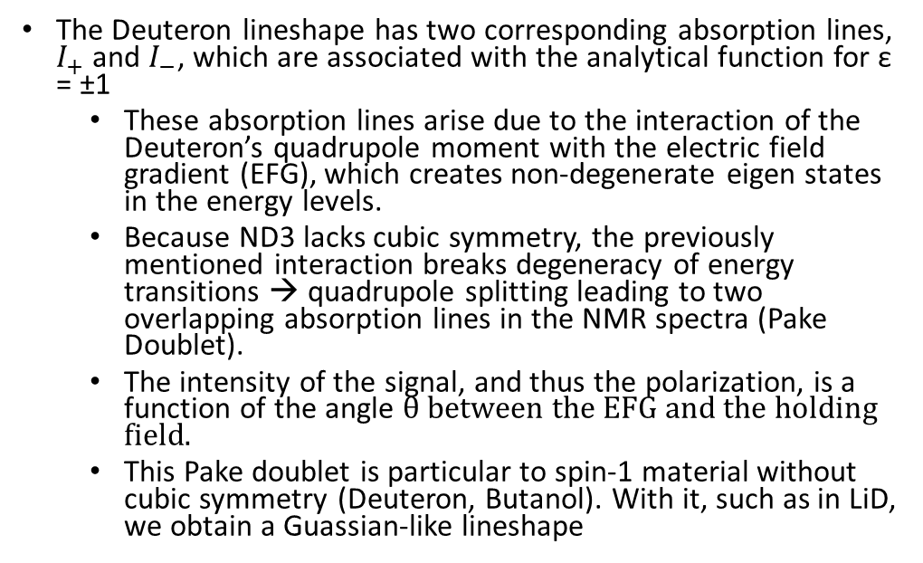

Deuteron Lineshape
The Deuteron lineshape has two corresponding absorption lines, $I_{+}$ and $I_{−}$, which are associated with the analytical function for ε = ±1
  These absorption lines arise due to the interaction of the Deuteron’s quadrupole moment with the electric field gradient (EFG), which creates non-degenerate eigen states in the energy levels.
  Because ND3 lacks cubic symmetry, the previously mentioned interaction breaks degeneracy of energy transitions → quadrupole splitting leading to two overlapping absorption lines in the NMR spectra (Pake Doublet).
  The intensity of the signal, and thus the polarization, is a function of the angle θ between the EFG and the holding field.
  This Pake doublet is particular to spin-1 material without cubic symmetry (Deuteron, Butanol). With it, such as in LiD, we obtain a Guassian-like lineshape
$$r= {I_{+}}/{I_{−}}$$
Green: $I_{+}$
Blue: $I_{−}$
Red: Lineshape
https://doi.org/10.1016/S0168-9002(97)00317-3

Slide 10
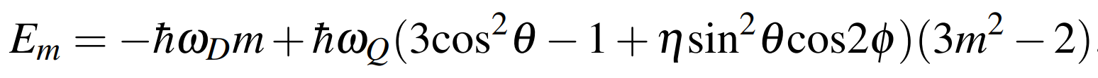
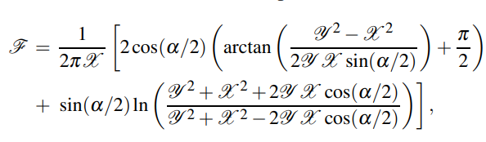



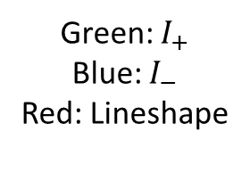
Deuteron Lineshape
The Pake Doublet is mathematically described by the energy levels:
The peaks correspond to the principal axis of the coupling interaction being perpendicular (θ = π/2) to the magnetic field.
The opposing end (the pedestal) corresponds to the configuration when the principal axis of the coupling interaction is parallel (θ = 0) to the magnetic field
Green: $I_{+}$
Blue: $I_{−}$
Red: Lineshape

Slide 11
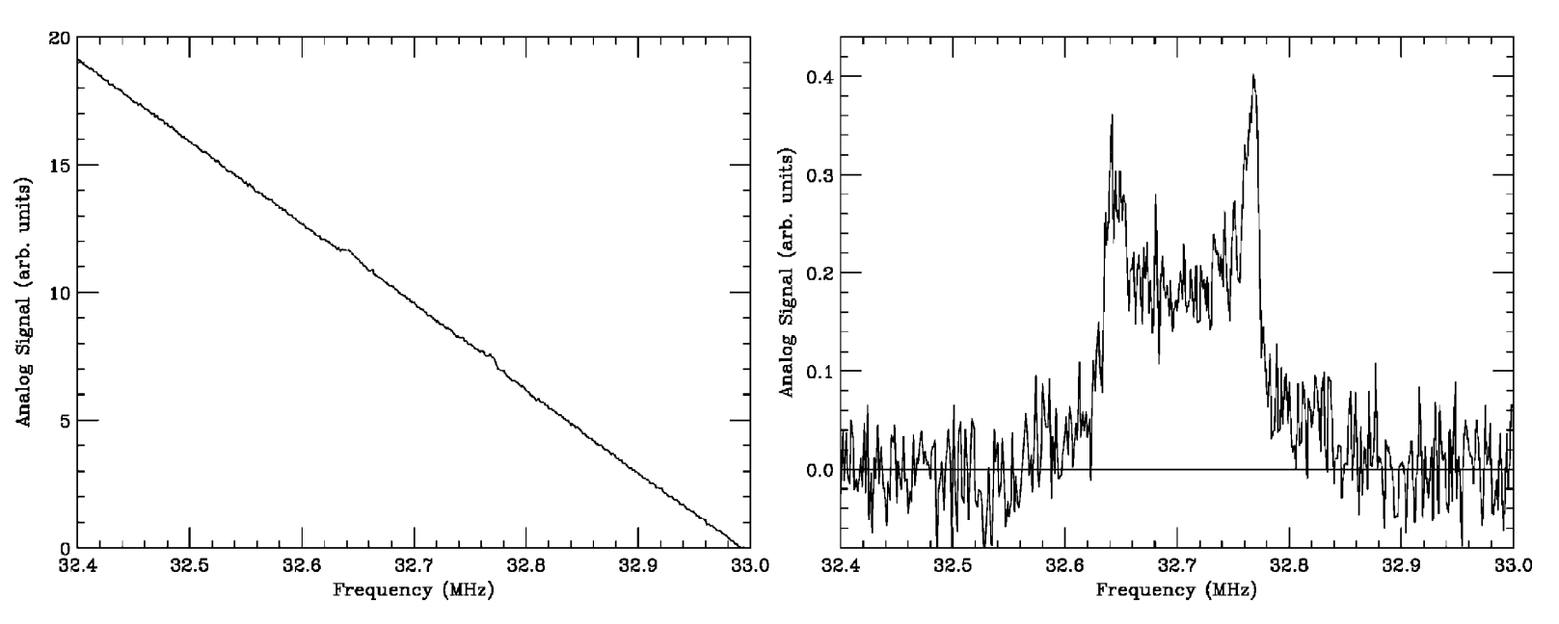

Real Example of Deuteron Signal
$$P_{TE}= \frac{4}{3}tanh⁡({ℏω_{d}}/{2kT)}$$
Court, G.R. & Houlden, Michael & Bültmann, S. & Crabb, D.G. & Day, Day & Prok, Y.A. & Penttila, S.I. & Keith, Christopher. (2004). High precision measurement of the polarization in solid state polarized targets using NMR. Nuclear Instruments and Methods in Physics Research Section A: Accelerators, Spectrometers, Detectors and Associated Equipment. 527. 253-263. 10.1016/j.nima.2004.02.041.
Notes:
There are still challenges with noise even with best techology

Slide 12
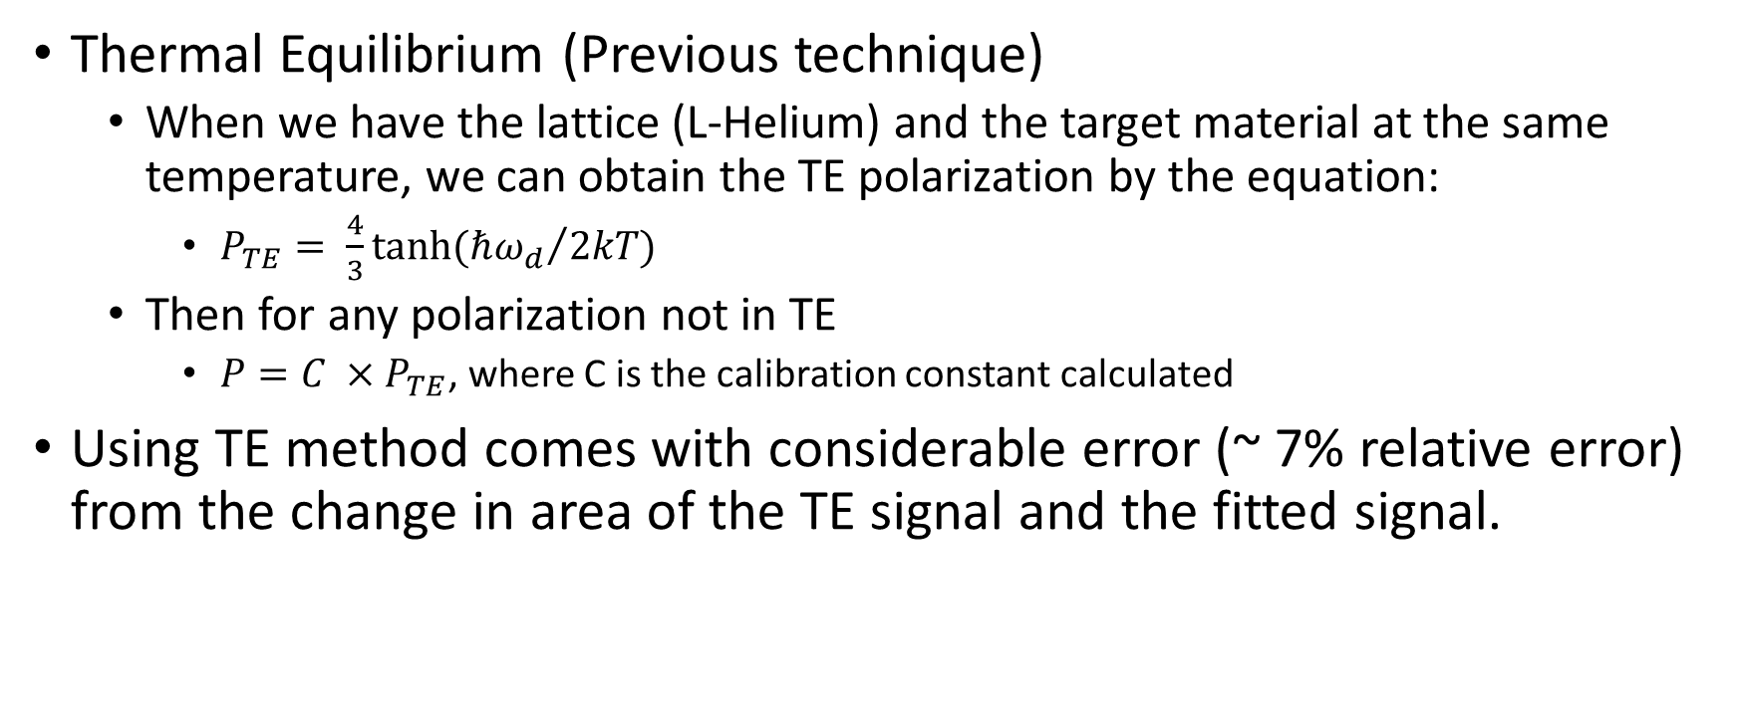
Measuring Polarization
Thermal Equilibrium (Previous technique)
  When we have the lattice (L-Helium) and the target material at the same temperature, we can obtain the TE polarization by the equation:
    $P_{TE}= \frac{4}{3}tanh⁡({ℏω_{d}}/{2kT)}$
  Then for any polarization not in TE
    $P=C ×P_{TE}$, where C is the calibration constant calculated
Using TE method comes with considerable error (~ 7% relative error) from the change in area of the TE signal and the fitted signal.
https://doi.org/10.1016/j.nima.2013.06.103

Slide 13
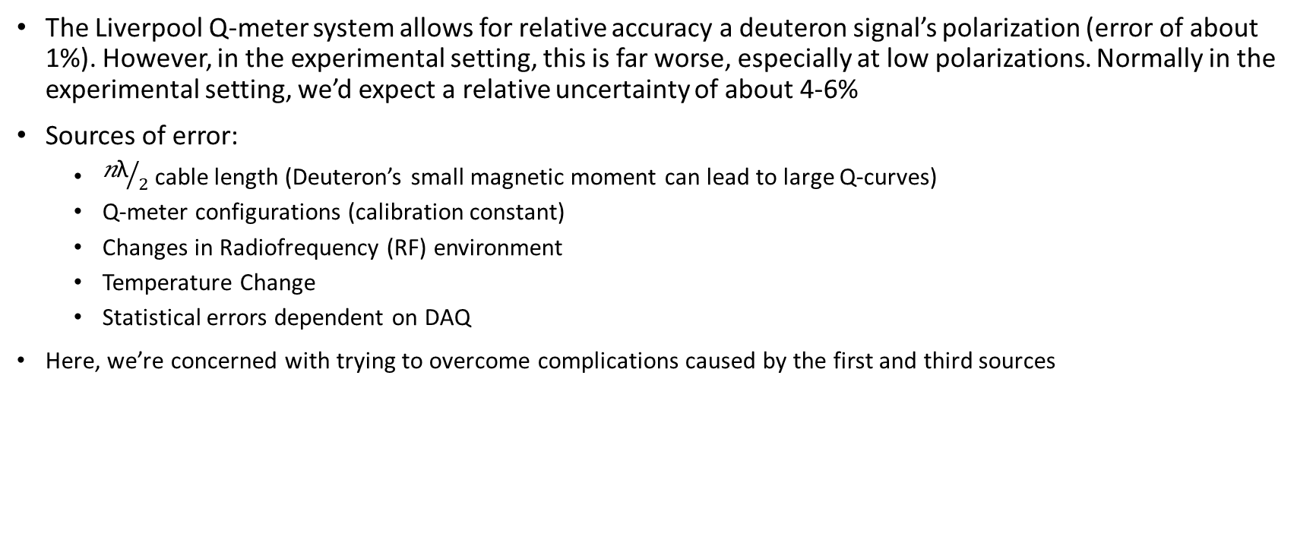
Limitations for Deuteron polarization determination
The Liverpool Q-meter system allows for relative accuracy a deuteron signal’s polarization (error of about 1%). However, in the experimental setting, this is far worse, especially at low polarizations. Normally in the experimental setting, we’d expect a relative uncertainty of about 4-6%
Sources of error:
  ${\text{n}\text{λ}}/2$ cable length (Deuteron’s small magnetic moment can lead to large Q-curves)
  Q-meter configurations (calibration constant)
  Changes in Radiofrequency (RF) environment
  Temperature Change
  Statistical errors dependent on DAQ
Here, we’re concerned with trying to overcome complications caused by the first and third sources
https://doi.org/10.1016/j.nima.2013.06.103.

Slide 14
Why Artificial Neural Networks (ANN)?

Slide 15
What is ANN?
Neural networks learn (or are trained) by processing examples, each of which contains a known "input" and "result," forming probability-weighted associations between the two, which are stored within the data structure of the net itself.
The training of a neural network from a given example is usually conducted by determining the difference between the processed output of the network (often a prediction) and a target output. This difference is the error.
The network then adjusts its weighted associations according to a learning rule and using this error value. Successive adjustments will cause the neural network to produce output which is increasingly like the target output.

Slide 16
Benefits of ANN in NMR
Allows us to operate outside the Q-meter design parameters and accurately extract polarization measurements (Around 1-2% relative error)
Even with added Gaussian noise to make the deuteron signal less discernable, ANN can be trained to filter out the noise and measure the true polarization of a signal by noise that has an SNR of 10 and below

Slide 17
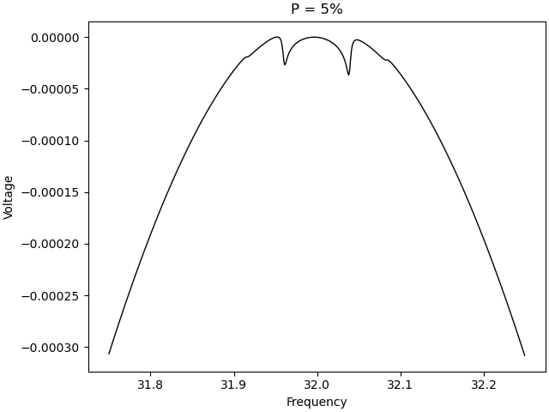
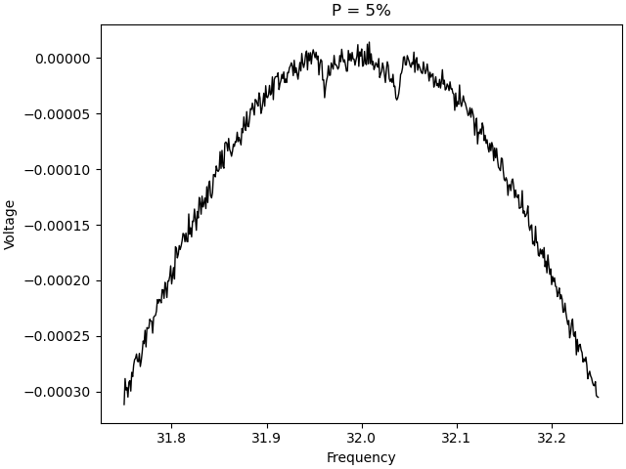
Neural Networks: A Possible Solution
By training a neural network (NN) on sample data that replicates experimentally accurate noise levels that evolve through time, we can go beyond the capability of the Q-meter and make up for where it lacks.
Using to optimize precision and accuracy, regardless of Signal-to-Noise Ratio (SNR)
SNR: ratio of maximum of amplitude of signal to maximum of amplitude of noise, represents how overwhelming the noise is
In our case, we simulate and extract the signal over 500 data bins
By training an NN to associated a specific polarization with its associated signal over 500 data bins, we can accurately predict polarization for a given noisy signal

Slide 18
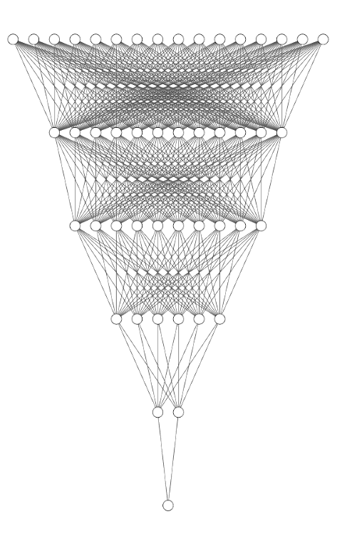
NN Architecture
Input layer: 500 nodes (each input node is one of 500 frequency bins of a sample signal)
5 Hidden layers (varying node sizes)
Output layer: 1 node → polarization!
Optimizer used: Adam, a popular optimizer for most general purposes
Relu6 is used as an activation for layer up until the output layer
  Sigmoid is used in output layer to return a value between 0 and 1.
Regularizer L2 is used on each layer
Trained for 1000 epochs
Not to scale

Slide 19
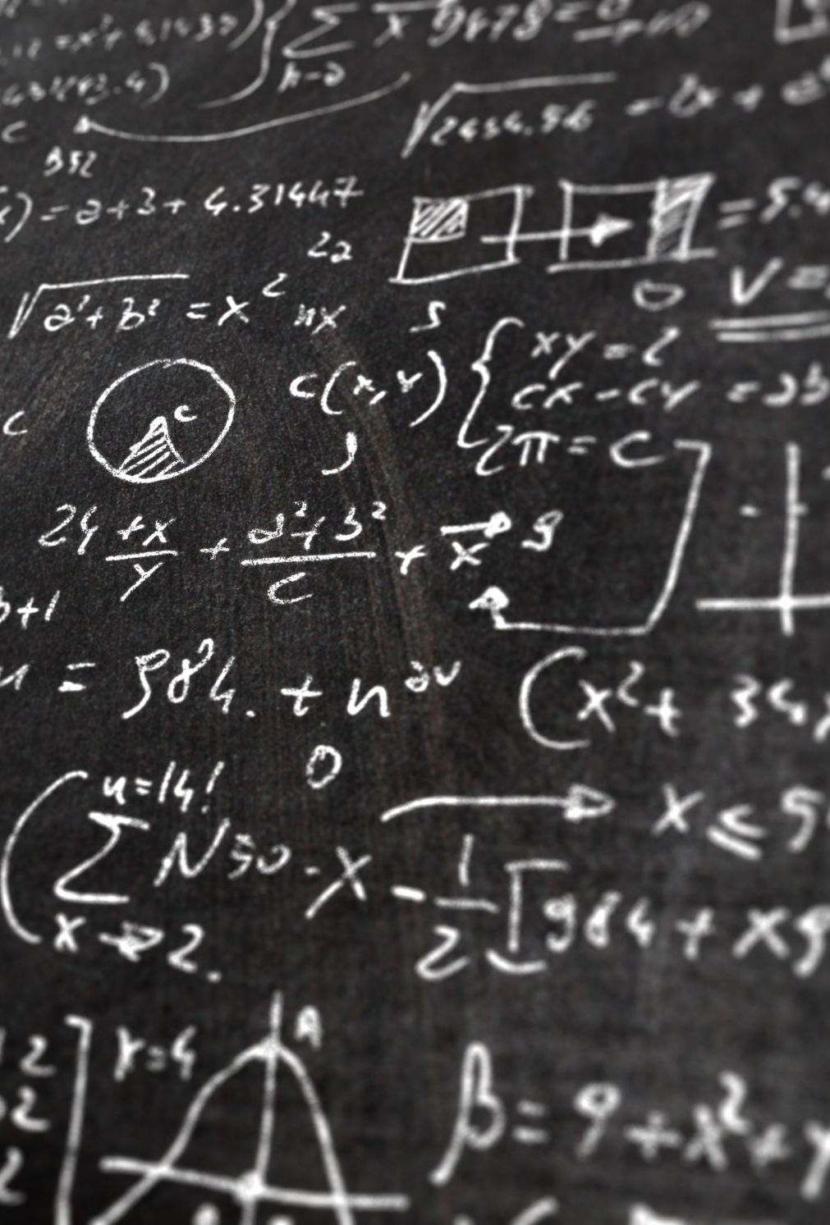

Sample Data Creation
NN is trained on sample data that varies P from 0-1
  Noise is generated as a Gaussian distribution with standard deviation
    Standard deviation is varied from 0 to roughly ${10}^{−3}$, a deviation well above the size of the signal
  4 Million events are created to train on

Slide 20
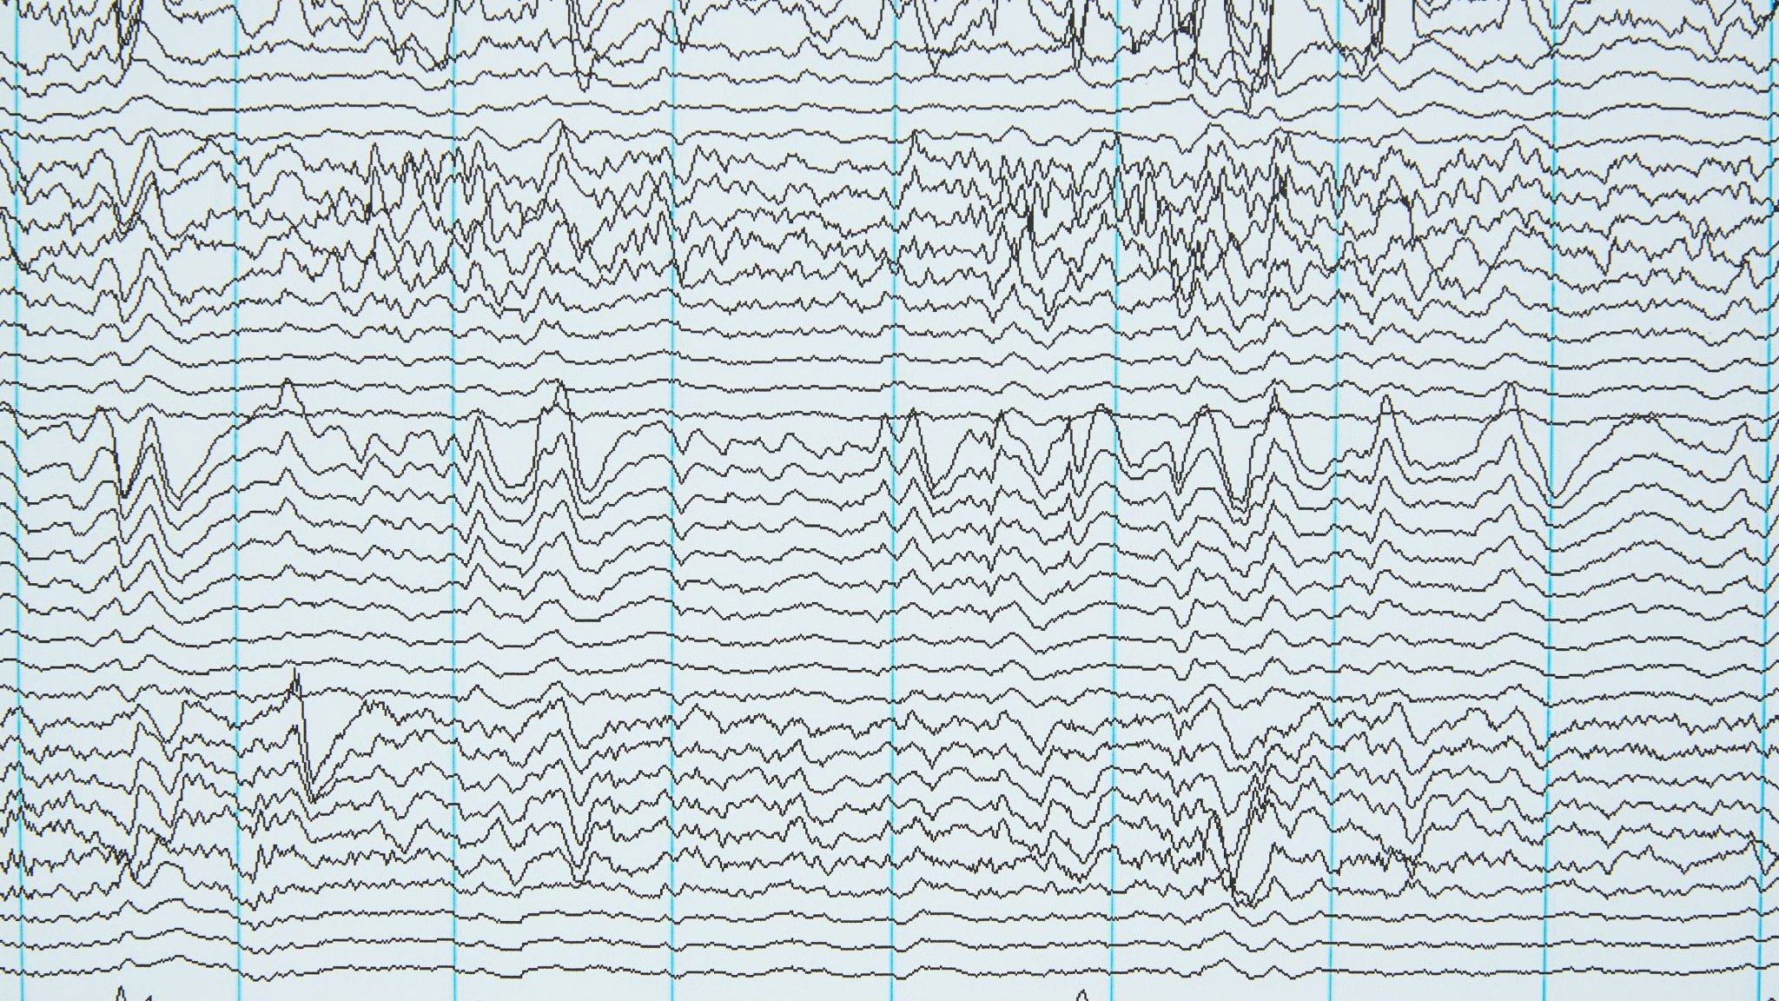
Preliminary Results

Slide 21
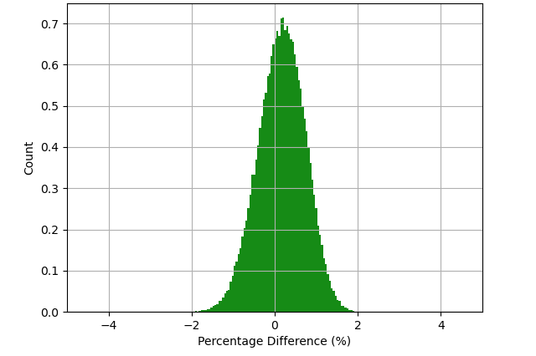
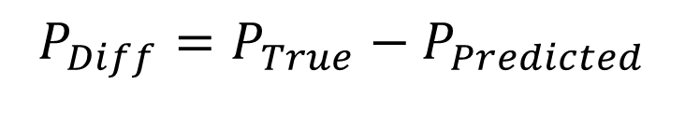

Training the Neural Network & Preliminary predictions
$$SNR=\frac{\left|Signal_{Max}\right|}{\left|Noise_{Max}\right|}$$
Histogram of Percentage Difference: μ=.165%, σ=0.562%
Sample data is created with noise added for a given cable length n and level of polarization P between 0 and 1. NN is then trained to recognize lineshape of particular P within the noise over 500 epochs
Histogram of percentage difference (%) predicted by NN for 100K sample events between 0%-100% polarization
SNR: 15-40
Accuracy, how close sample data is to true value : 99.835%
Precision, how much sample data varies from true value: 99.438% (width of predicted P's)
$$P_{Diff}=P_{True}−P_{Predicted}$$

Slide 22
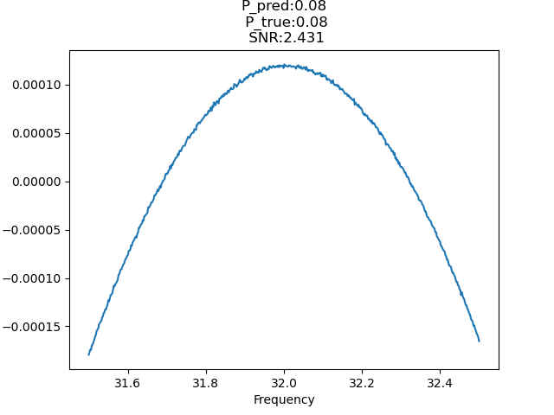
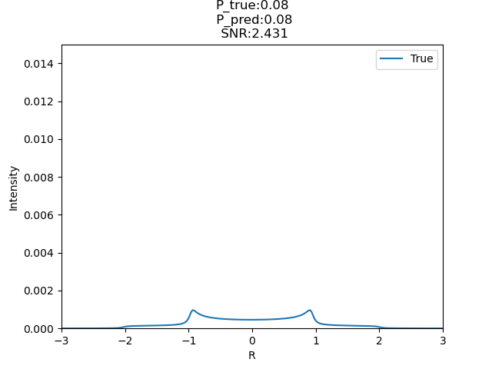

Voltage
$$R=\frac{ω_{D}−ω}{3ω_{D}}$$
Notes:
Predicted polarization is regraphed via the analytic lineshape function across R, a dimensional parameter expressed as $\frac{ω − ω_{D}}{ω_{D}}$, where $ω_{D}$is the Lamour frequency for the Deuteron

Slide 23
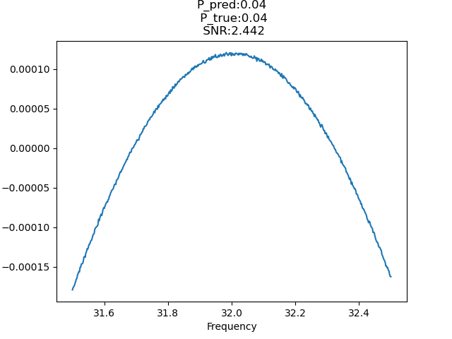
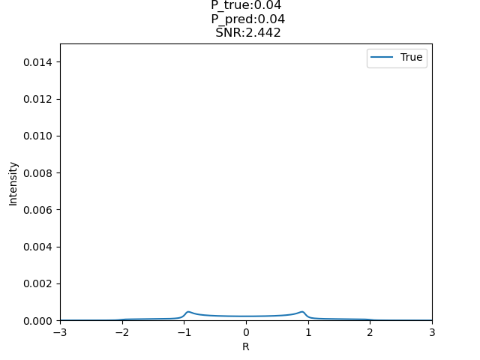

Voltage
$$R=\frac{ω_{D}−ω}{3ω_{D}}$$

Slide 24
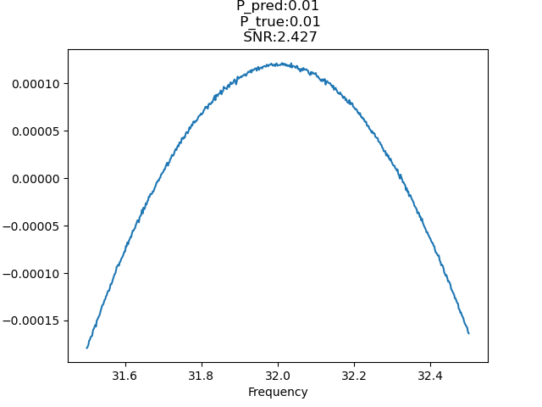
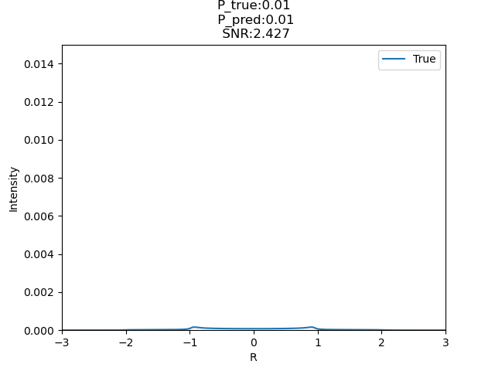
Voltage
$$R=\frac{ω_{D}−ω}{3ω_{D}}$$

Slide 25

Prospective Outlook and Future Plans
ANN can allow for the efficient filtering of background noise from deuteron signal (could also be applied to any NMR signal)
The adaptability of the ANN allows for changes in baseline and scanning range of an NMR to quickly and easily be considered
For the future: optimize the ANN for smaller polarizations to increase precision and accuracy

Slide 26
Thank you!
This work was supported by DOE contract DE-FG02-96ER40950

