Slide 1
Testing the cable extension for the mercury ITC
There are two cables from the MercuryITC. The first one is to measure the liquid Helium level and the second one is to measure the liquid nitrogen level
The cable to measure the liquid helium level is DB9 to 9 pin circular
The cable to measure the liquid nitrogen level is DB9 to 3 pin circular
Both cables are around 6 meter long and should be in the magnet rack

Slide 2
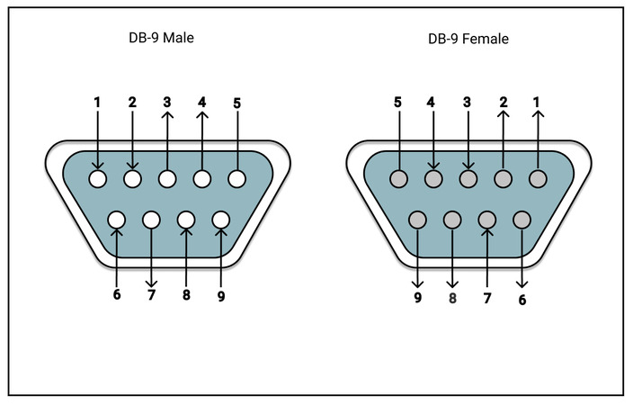
Testing the liquid nitrogen cable
Get the Nitrogen cable (DB9 to 3 pin circular)
Have a look into the image about the circular-pin assignment for both probes on the top right and the DB9 assignment on the bottom right
Following the nitrogen probe assignment, Give the voltage difference between pin number 7 and pin number 4 to the DB9. For example, give 0 volt to pin number 7 and (0-12 V) to pin number
Read the output voltage on 3-pin circular
Give the 12 Voltage on DB9 pin number 8 (20mA maximum)
Read the output voltage on 3-pin circular
Redo the step but with the cable extension connected. This time give the voltage to the DB9 on the extension cable

Slide 3
Testing the liquid helium cable
Get the Helium cable (DB9 to 9 pin circular)
Have a look into the image about the circular-pin assignment for both probes on the top right and the DB9 assignment on the bottom right
Following the helium probe assignment, Give the voltage difference between pin number 1 and pin number 2 to the DB9. For example, give VHIGH=3 volt to pin number 1 and VLOW=0 to pin number 2
Read the corresponding output voltage on 9-pin circular
Redo the step but with the cable extension connected. This time give the voltage to the DB9 on the extension cable
Additional: give the current to pin 6 & 7 (Ihigh & Ilow) but very small (max 10 mA)

Slide 4
What is switch heater
Magnet Coils
Magnet Coils
Heater off
Become superconductor
Heater On
Become conductor
Power-Supply
Power-Supply

Slide 5
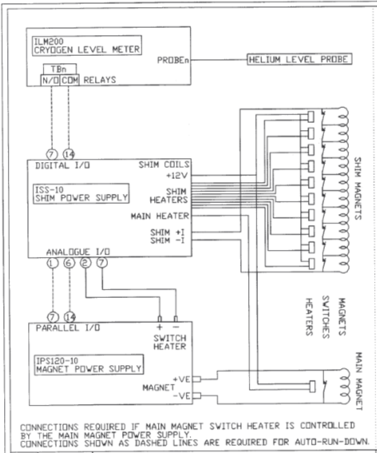
The main magnet Power Supply only provide the switch (connect or disconnect the circuit)

Slide 6
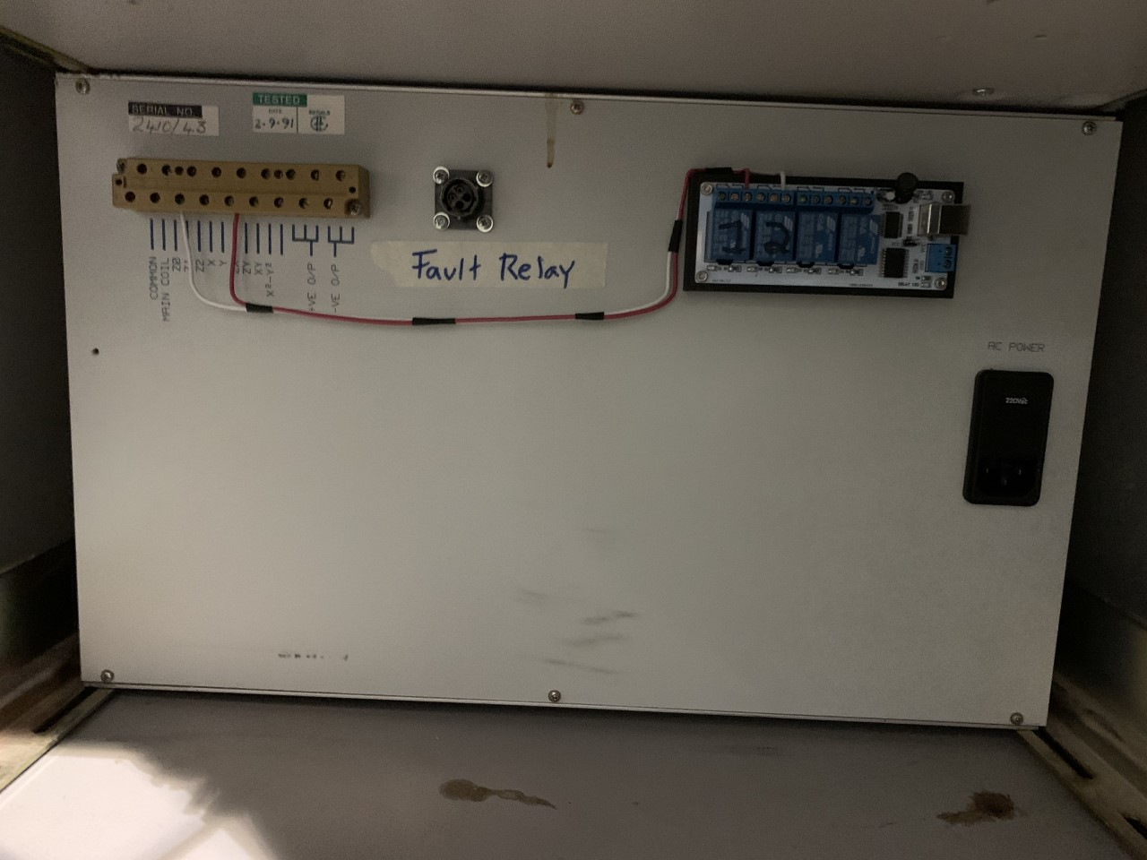
Outputs from the Back-Panel
Main-Supply power (current)
10 switch-heaters for shim coils (z0, z1, zy, x, ….. )
Connection to Magnet power supply(?)

Slide 7
Switch heater connections
In my understanding, the (persistent) switch heater for the main magnet could be powered (& controlled) by the Shim-power supply or directly from the magnet power supply

Slide 8
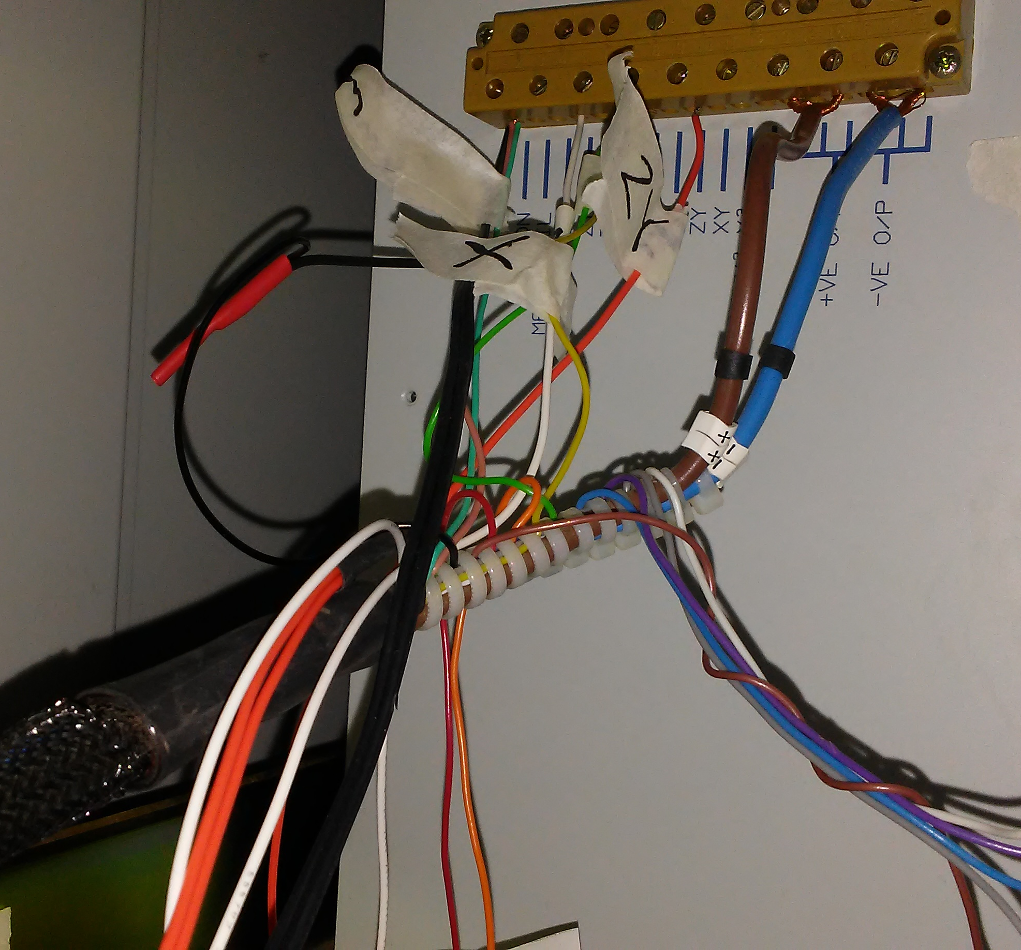
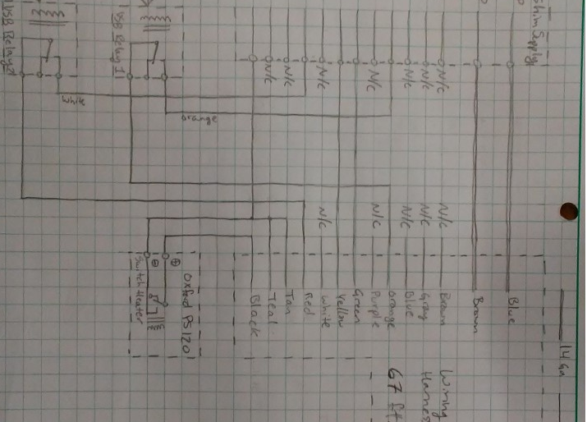
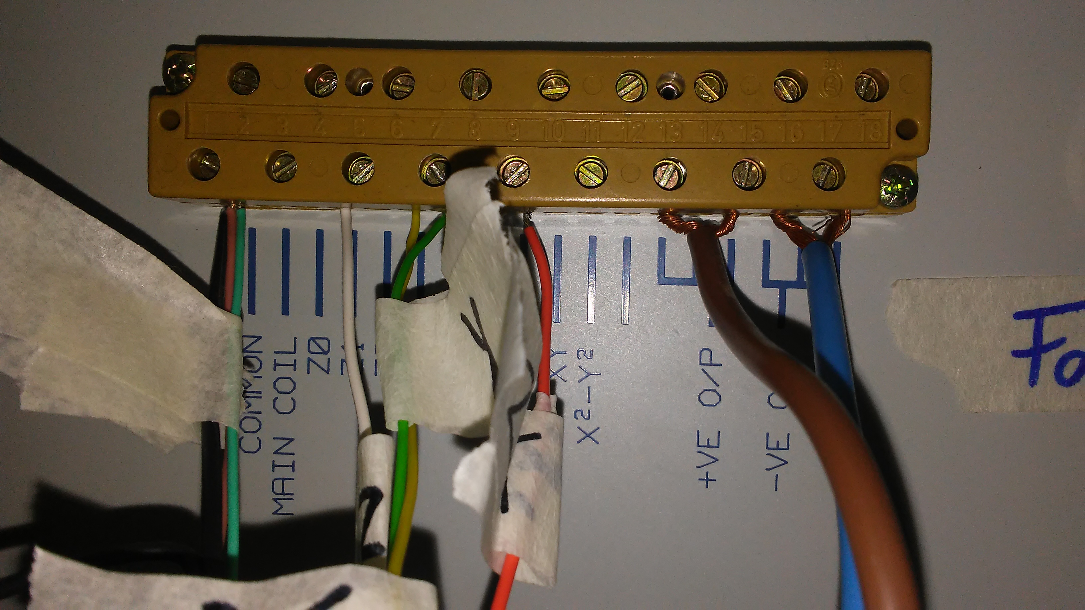

Slide 9
Original connection
Main supply (Brown & Blue)
It seems that 4 shims are wired (x, y, z1, zy)
But are there only 2 which are energized? Are x & y are wired but are they powered? See next slide

Slide 10
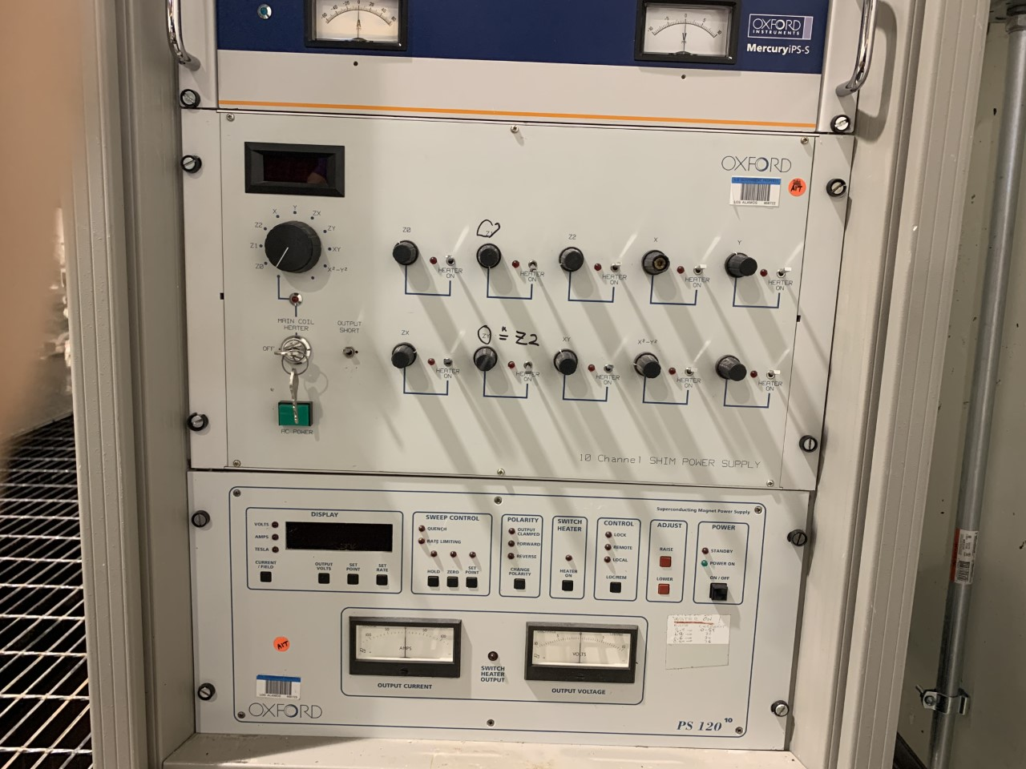

Slide 11
Relay connections
X and Y shims (if they are energized) are connected directly
Z1 & ZY are connected via Relay
So the wire with label Z1 and ZY now should be connected to Relay instead of the (original) back panel connections

Slide 12
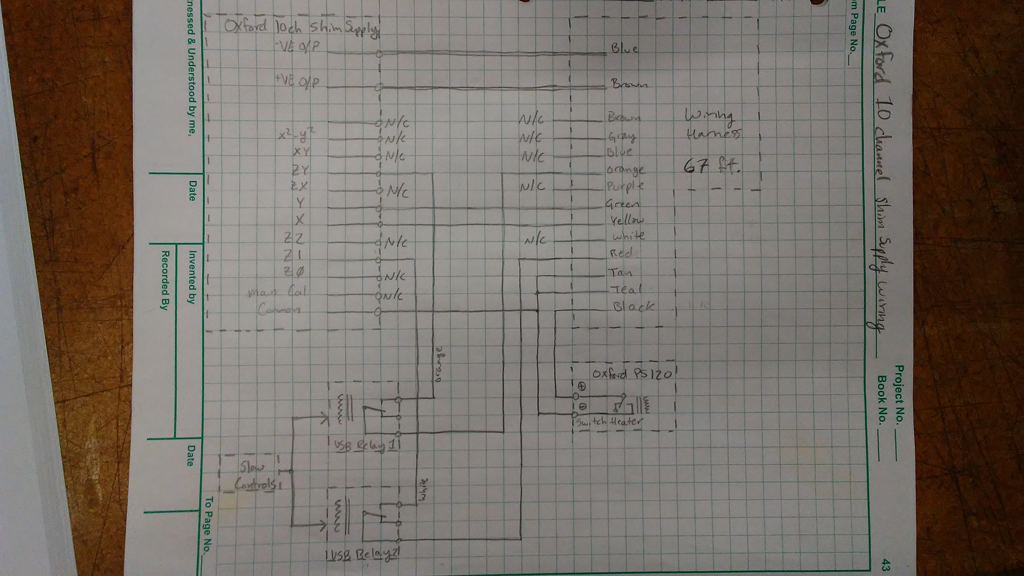

Slide 13
Shim PS
Rear Panel
Relay
Magnet PS

Slide 14
Step
Restore the original connection + Relay
Connect the disconnect cable to make it look neat and clean
There are only two shims that we use
Don’t change the key

Slide 15
Shim
Z1
ZY
White cable
Relay
1
2
ZY
Z1
Black Cables
Cut to shorter length

Slide 16
