Slide 1

Magnet Rack & Cryo Rack
ORC Update – 3/4/2021

Slide 2
Outline
Magnet Rack
Cryo-Rack

Slide 3
Magnet Rack: Remaining issue
Cable list: Most cable has been specified. But the ITM10 & Shim-PS cables have not been specified since they are covered by the shielding. See the following couple of slides for the new setup dan cable list
Possible solution:
1. See/guess the type of the shielding
2. Open the connector to see how many gauge wire inside
3. Measure the diameter (AWG size)
Terminal issue from Rick: The 208V 3 phase distribution in Figure 3 does not have sufficient detail. Looking at the terminal block where the distribution occurs, the diagram is wrong (not enough wires on the output side going to the power strips). Also, I think this construction will not pass because the 208V looks to be a 10AWG wire and the wires going into the power strips look to be 18 AWG (this is asking to start a fire without fusing).
Solution: Waqar, could you please draw a new terminal-block diagram? Thank you
Next step: Could you please show the new terminal-block diagram (after Waqar finish the drawing) along with the cable list and schematics shown in the following slides to Rick?

Slide 4




Root-pumps area
EC0
BPS1
EC0
RS1
RS4
RS3
Water-flow Sensor
Kobold
Pressure Sensor
PV-TPR280
PSR1
RS2
BPS0
PSR0
CSR0
CSR1
CSS1
CSS0
CSS2
MS1
MS0
+
-
Target & Magnet Dewar
Busbar
Magnet Rack
OI = Oxford Instrument
PV = Pfeiffer Vacuum
MS2
USB1
SPS0
SPS1
Target-cave area
Ground

Slide 5
Cable | Description
EC0 | AC power cord
EC0 | AC power cord
PSR0 | AC power cord
PSR1 | Factory made sensor cable (Pfeiffer Vacuum, catalog number PT448252- T)
BPS0 | AC power cord
BPS1 | AWG 18-gauge wire
SPS0 | AC power cord
CSR0 | AC power cord
CSS0 | AC power cord
MS0 | AC power cord
MS1 | Factory-made power cable (Eland cable: BS 638:PART 4 H.O.F.R 85 DEG.C 25 MM2 ELAND)
MS2 | AC power cord
SPS1 | ?
CSR1 | ?
CSS1 | Helium probe sensor cable (Oxford Inst. : 7-2-4C P46339 CNC6700 HE ) with extension of AWM 2464 cable
CSS2 | Nitrogen probe sensor cable (Oxford Inst. : 7-2-4C IEC60332.1 CNC6600 N2 ) with extension of AWM 2464 cable

Slide 6
Cable | Description
USB1 | USB cable
RS1 | RS232 cable
RS2 | RS232 cable
RS3 | RS232 cable
RS4 | RS232 cable

Slide 7
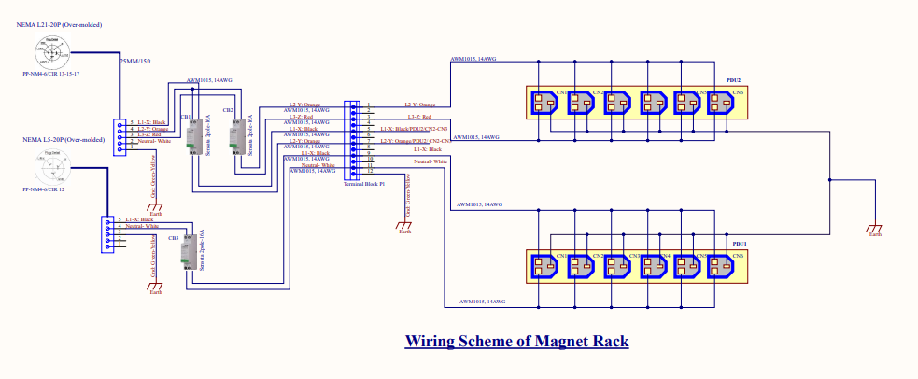
Cryo Rack: Power distribution
In the following slides, I make summaries of:
Power consumption, maximum current, 120/240 VAC requirement, Neutral requirement for each subsystem that will sit on the Cryo rack: Cryo control, lifter control, Microwave system, slow control & other system.
Total power consumption and current
Power consumption & current for devices that require 120 VAC, single-phase, and require Neutral
Power consumption & current for devices that require 240 VAC, single-phase, and NO neutral
Power consumption & current for devices that could work both with 120 & 240 VAC, single-phase, and require Neutral
Next step: Waqar, based on these information (also following slides), could you please draw the terminal-block diagram like the diagram for the magnet rack below

Slide 8
Cryo Control | Max Power (Watt) | Max Current (Amp) | Work with 120 VAC | Work with 240 VAC | Need Neutral?
MKS 670BD21 | 40 | 0.3 | YES | YES | YES
MKS 670BD21 | 40 | 0.3 | YES | YES | YES
MKS 670BD21 | 40 | 0.3 | YES | YES | YES
TPG 361 | 45 | 0.38 | YES | YES | YES
DCU 600 | 590 | 3.8 | YES | YES | YES
Lakeshore 218 | 18 | 0.15 | YES | YES | YES
Lakeshore 218 | 18 | 0.15 | YES | YES | YES
Lakeshore 218 | 18 | 0.15 | YES | YES | YES
Lakeshore 218 | 18 | 0.15 | YES | YES | YES
Keithley 2000 | 30 | 0.25 | YES | YES | YES
THCD 400 | 72 | 0.6 | YES | YES | YES
AMI 1700 | 264 | 2.2 | YES | YES | YES
TOTAL | 1193 | 8.73

Slide 9
Lifter Control | Max Power (Watt) | Max Current (Amp) | Work with 120 VAC | Work with 240 VAC | Need Neutral?
Motor Power Supply | 312 | 2.6 | YES | YES | YES
ADC | USB Powered | USB Powered
Precision voltage | USB Powered | USB Powered
TOTAL | 312 | 2.6

Slide 10
Microwave system | Max Power (Watt) | Max Current (Amp) | Work with 120 VAC | Work with 240 VAC | Need Neutral?
CPI Power Supply | 1650 | 8 | NO | YES | NO
Power measurement | 104 | 0.5 | YES | NO | YES
EIP freq. counter | 100 | 0.48 | YES | YES | YES
DC Power supply | 220 | 1.8 | YES | NO | YES
TOTAL | 2074 | 10.78

Slide 11
Slow Control | Max Power (Watt) | Max Current (Amp) | Work with 120 VAC | Work with 240 VAC | Need Neutral?
USB to Ethernet | 10 | 0.4 | YES | NO | YES
USB to Ethernet | 10 | 0.4 | YES | NO | YES
USB to Ethernet | 10 | 0.4 | YES | NO | YES
USB to Ethernet | 10 | 0.4 | YES | NO | YES
USB to Ethernet | 10 | 0.4 | YES | NO | YES
RS232 to Ethernet | 6.03 | 0.19 | YES | NO | YES
RS232 to Ethernet | 6.03 | 0.19 | YES | NO | YES
TOTAL | 62.06 | 2.38

Slide 12
Other system | Max Power (Watt) | Max Current (Amp) | Work with 120 VAC | Work with 240 VAC | Need Neutral?
Fridge valve | 55 | 0.46 | YES | NO | YES
Microwave interlock
TOTAL | 55 | 0.46-
Notes: Carlos estimation

Slide 13
Total Consumption
System | Max Power (Watt) | Max Current (Amp)
Cryo Control | 1193 | 8.73
Lifter Control | 312 | 2.6
Microwave system | 2074 | 10.78
Slow Control | 62.06 | 2.38
Other | 55 | 0.46
TOTAL | 3696.06 | 24.95

Slide 14
Devices that require 120 VAC, single phase and require neutral
Devices | Max Power (Watt) | Max Current (Amp)
RF-Power measurement | 104 | 0.5
DC Power supply | 220 | 1.8
USB to Ethernet | 10 | 0.4
USB to Ethernet | 10 | 0.4
USB to Ethernet | 10 | 0.4
USB to Ethernet | 10 | 0.4
USB to Ethernet | 10 | 0.4
RS232 to Ethernet | 6.03 | 0.19
RS232 to Ethernet | 6.03 | 0.19
TOTAL | 386.06 | 4.68

Slide 15
Devices that require 240 VAC, single phase and NO neutral
devices | Max Power (Watt) | Max Current (Amp)
CPI Power Supply | 1650 | 8

Slide 16
Devices that could work both on 120 VAV & 240 VAC, require 1-phase & Neutral
Devices | Max Power (Watt) | Max Current (Amp)
MKS 670BD21 | 40 | 0.3
MKS 670BD21 | 40 | 0.3
MKS 670BD21 | 40 | 0.3
TPG 361 | 45 | 0.38
DCU 600 | 590 | 3.8
Lakeshore 218 | 18 | 0.15
Lakeshore 218 | 18 | 0.15
Lakeshore 218 | 18 | 0.15
Lakeshore 218 | 18 | 0.15
Keithley 2000 | 30 | 0.25
THCD 400 | 72 | 0.6
AMI 1700 | 264 | 2.2
Motor Power Supply | 312 | 2.6
EIP freq. counter | 100 | 0.48
TOTAL | 1605 | 11.81

