Slide 1
Slow-Control Meeting
Zulkaida Akbar
07/08/2020

Slide 2
Background
I am beginner on LabView
Misha’s templates are very helpful (we don’t need to build the VI Lib from scratch)
I want to share my experiences on implementing the templates for my particular instrument

Slide 3
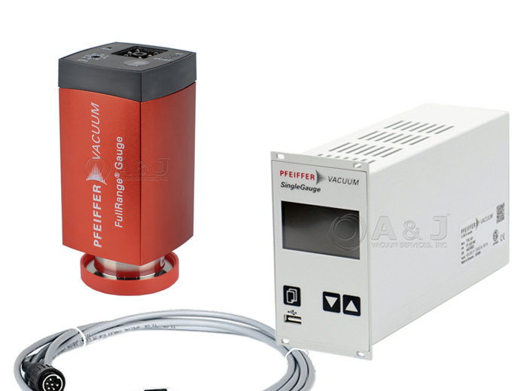
Instrument
Pressure sensor for the outer vacuum of the magnet-dewar
Sensor: Pfeiffer-PKR 361
Read out/Controller: Pfeiffer-TPG 361
Single Channel

Slide 4
VI Library
The instrument manual provides many commands for “setting” and “getting” (Reading the pressure, set/read the working gauge, unit of the measurement, etc..)
Today I just show one basic functionality which is reading the pressure
The library consist of Visa initialization, Visa close, get pressure

Slide 5
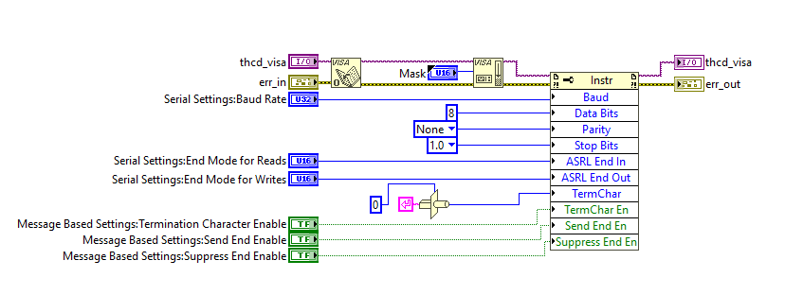
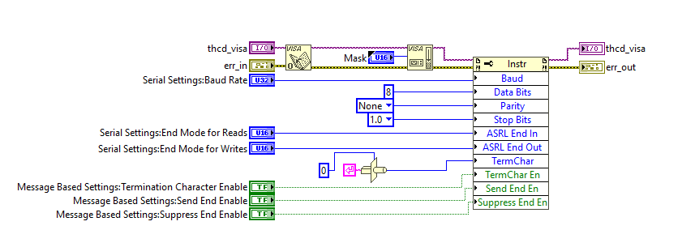
VISA Initialization
Misha’s template: thcd_visa_init.vi
My instrument: tpg361_visa_init.vi
COM Protocol: RS485

Slide 6
VISA Close
My instrument: tpg361_visa_close.vi

Slide 7
Main VI (Get Measurement)
Misha’s template: thcd_get_uom.vi
My instrument: tpg361_get_p.vi

Slide 8
Command
Get measurement flow
Transmit command (contacting the device)
Receive acknowledgment from the device
Transmit command to get the measurement value
Receive measurement value

Slide 9
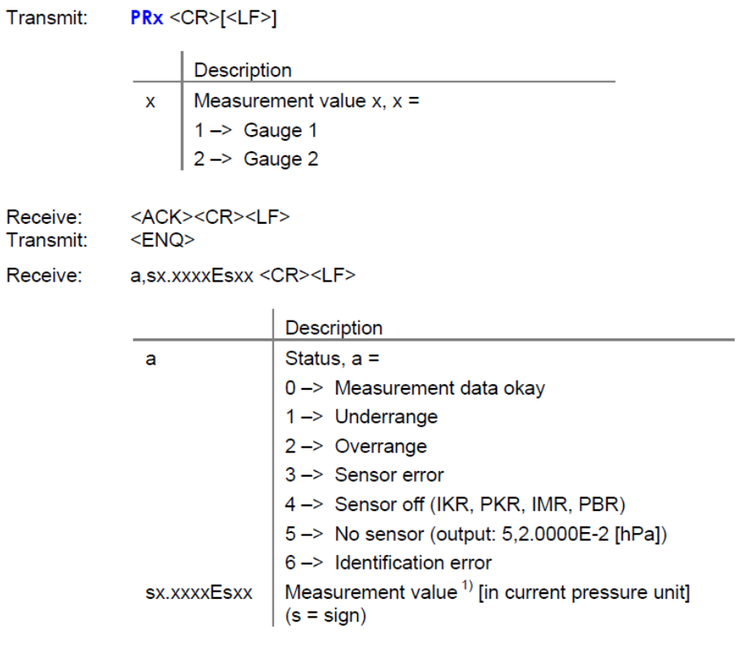
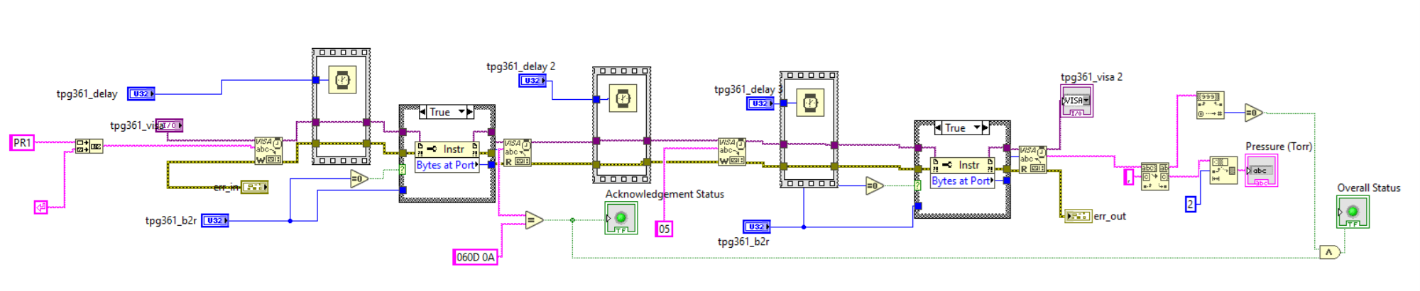
Transmit Command
String manipulation to get the pressure value & overall status indicator
Transmit Command
Acknowledgment status indicator

Slide 10
Front panel

Slide 11
Summary
Start with one basic functionality (get pressure reading)
See Misha’s example (thcd_get_uom.vi)
Read the device’s manual
Build (modify) the VI following Misha’s example (In my case a lot of works are string manipulation)
Use NI Max to establish the connection with the device

Slide 12
Comment
Remember to save in 2018 version
USB comm vs RS 485
There is ethernet protocol -> explore because better
How to make sure it is in the correct setting (unit, etc, …)
Type of working gauge (pirani/cold cathode)
Status indicator if its wrong -> Implemented!!

