Slide 1
Topography of UUXS Fit Space

Slide 2
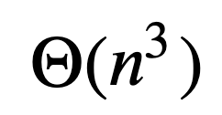
Topography.C
The Topography.C file is a root macro that calculates goodness of fit of UUXS for a set of kinematic variables across a specified range of values for the Compton form factors. Its runtime is where n is the range of possible values for each Compton form factor.
It takes parameters ChunkNum (the set of kinematics), lb (lower bound of cffs), ub (upper bound of cffs), and delta (step size of cffs).
For people unfamiliar with root, it can be run in the root interpreter with command:
  .x Topography.C(ChunkNum, lb, ub, delta)

Slide 3
Topography.C
Currently operates on the DVCS_cross_const.csv file, but can trivially be adapted for other datasets.
Outputs the results into a file called results.txt

Slide 4
DVCS_cross_const.csv
Same as DVCS_cross except with dvcs const of 0.0149 appended as a final column, in line with the formatting of more recent datasets.

Slide 5
TopographyVis.ipynb
Visualization code for the results.txt. It creates a “plots” folder within the current directory the first time it is run where all plots will be stored.
In order to create a visualization, the dimension of the function needs to be brought down to 3 -- accomplished by fixing the value of ReH to produce a hyperplane of the 4d space. Thus the user must specify an ReH value within lb-ub that is a multiple of delta.

Slide 6
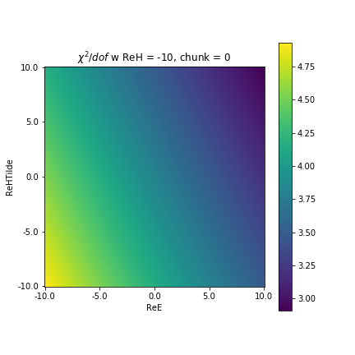
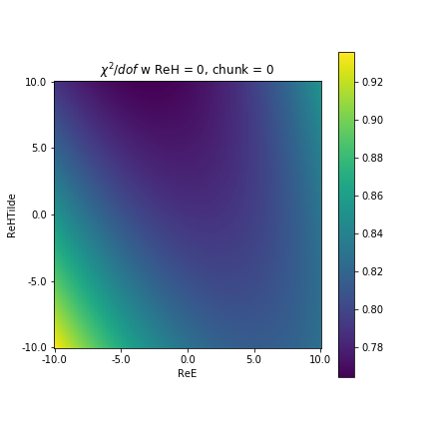
Selected Plots

Slide 7
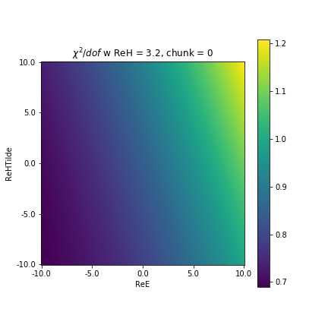
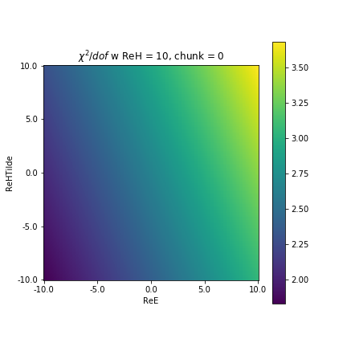
Selected Plots

