Slide 1
Group Meeting
6/26/2020
Zulkaida Akbar

Slide 2
Fun4Sim.C
Remove this tracking module:

Slide 3
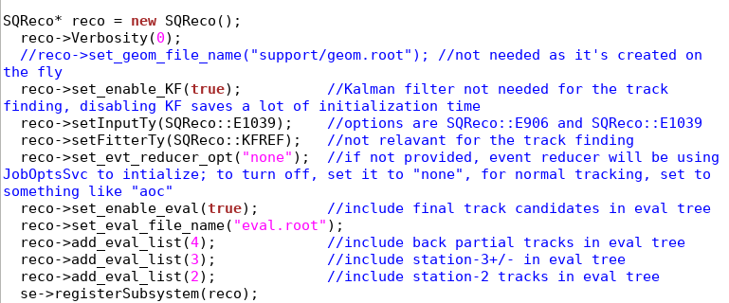
/e906/app/users/zakbar/Nov20/e1039-analysis/SimChainDev/Fun4Sim_orig.C
Use this tracking module:

Slide 4
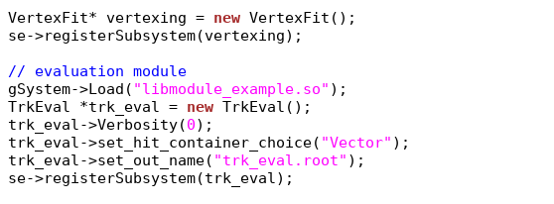
/e906/app/users/zakbar/Nov20/e1039-analysis/SimChainDev/Fun4Sim_orig.C
Add this evaluation module:

Slide 5
/e906/app/users/zakbar/Nov20/e1039-analysis/SimChainDev/gridrun.sh
Add this source:

Slide 6
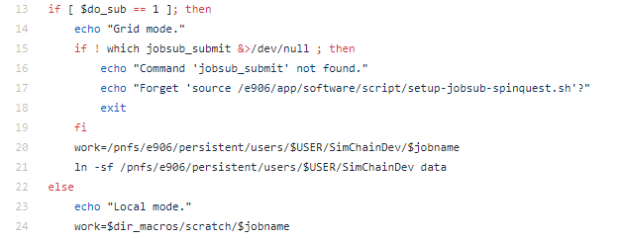
Goal -> Successfully run the simulation with both local & grid option and do simple analysis
The output location:

Slide 7
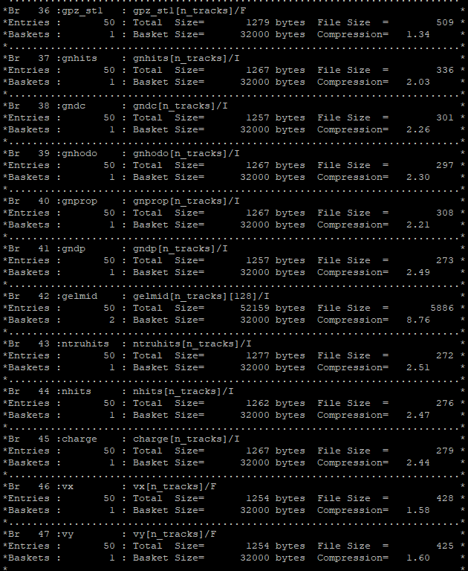
Main output: TrkEval.root
Under “Truth” tree
g – generated
Withour g means reconstructed

Slide 8
Example analysis code with the input of Trk_eval.root
https://confluence.its.virginia.edu/display/twist/Z+Akbar%2C+Sivers-asymmetry+code
Suggestion: Start with plotting some basic distribution: Mass, xf, phi, etc..

