Slide 1
A brief Introduction

Slide 2
Introduction (Some Basics for ANN ML fitting)
DVCS (Deeply Virtual Compton Scattering)
GitHub page : https://github.com/uva-spin/DNN-CFFs
Steps:
Generate pseudodata with ‘known’ or ‘True’ Compton Form Factors (CFFs)
Perform a ‘Fit’ and obtain the fitted CFFs and compare with the ‘True’ CFFs
https://arxiv.org/pdf/1903.05742.pdf

Slide 3
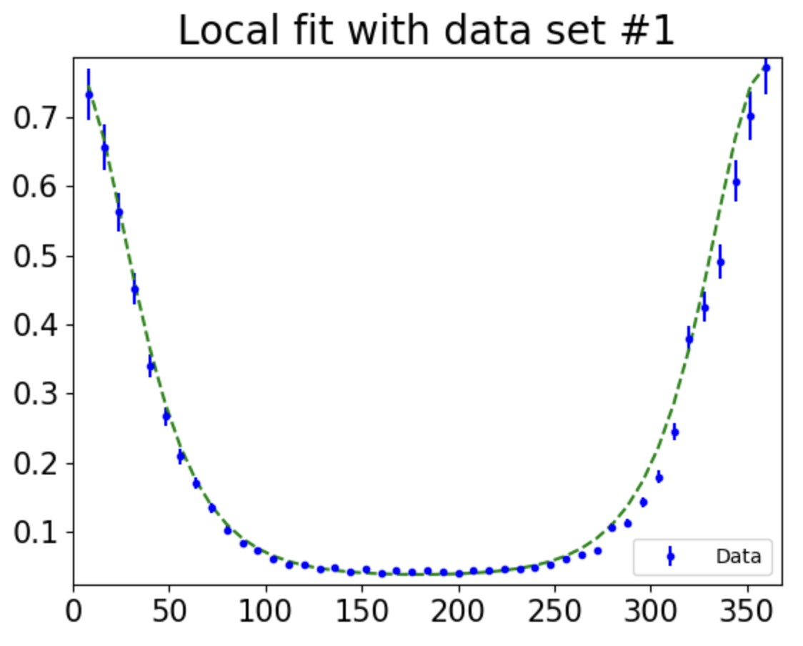
Local multivariate Inference (LMI) Method
Use F2VsPhi to make plot for F
Formalism
N+2 ^{nd} layer
x
Architecture
with ‘N’ layers
ReH
t
ReE
Kinematics
ReHt
F
Cross-section
Q2
C1/dvcs
k
phi
Inputs to the “Framework/Formalism” : Kinematics
Output from the “Framework/Formalism”: Total Cross-Section (F)
Compton Form Factors (CFFs) are considered as outputs (4) from a DNN that takes only ‘x’, ‘t’, and ‘Q2’ as inputs.
A typical data set can be represented as F vs phi while rest of the all kinematics are fixed.
In the LMI method, we will use multiple data sets with a sparse kinematic phase-space to train the DNN.
See https://confluence.its.virginia.edu/display/twist/The+DNN+Extraction+Approach for more details.

Slide 4
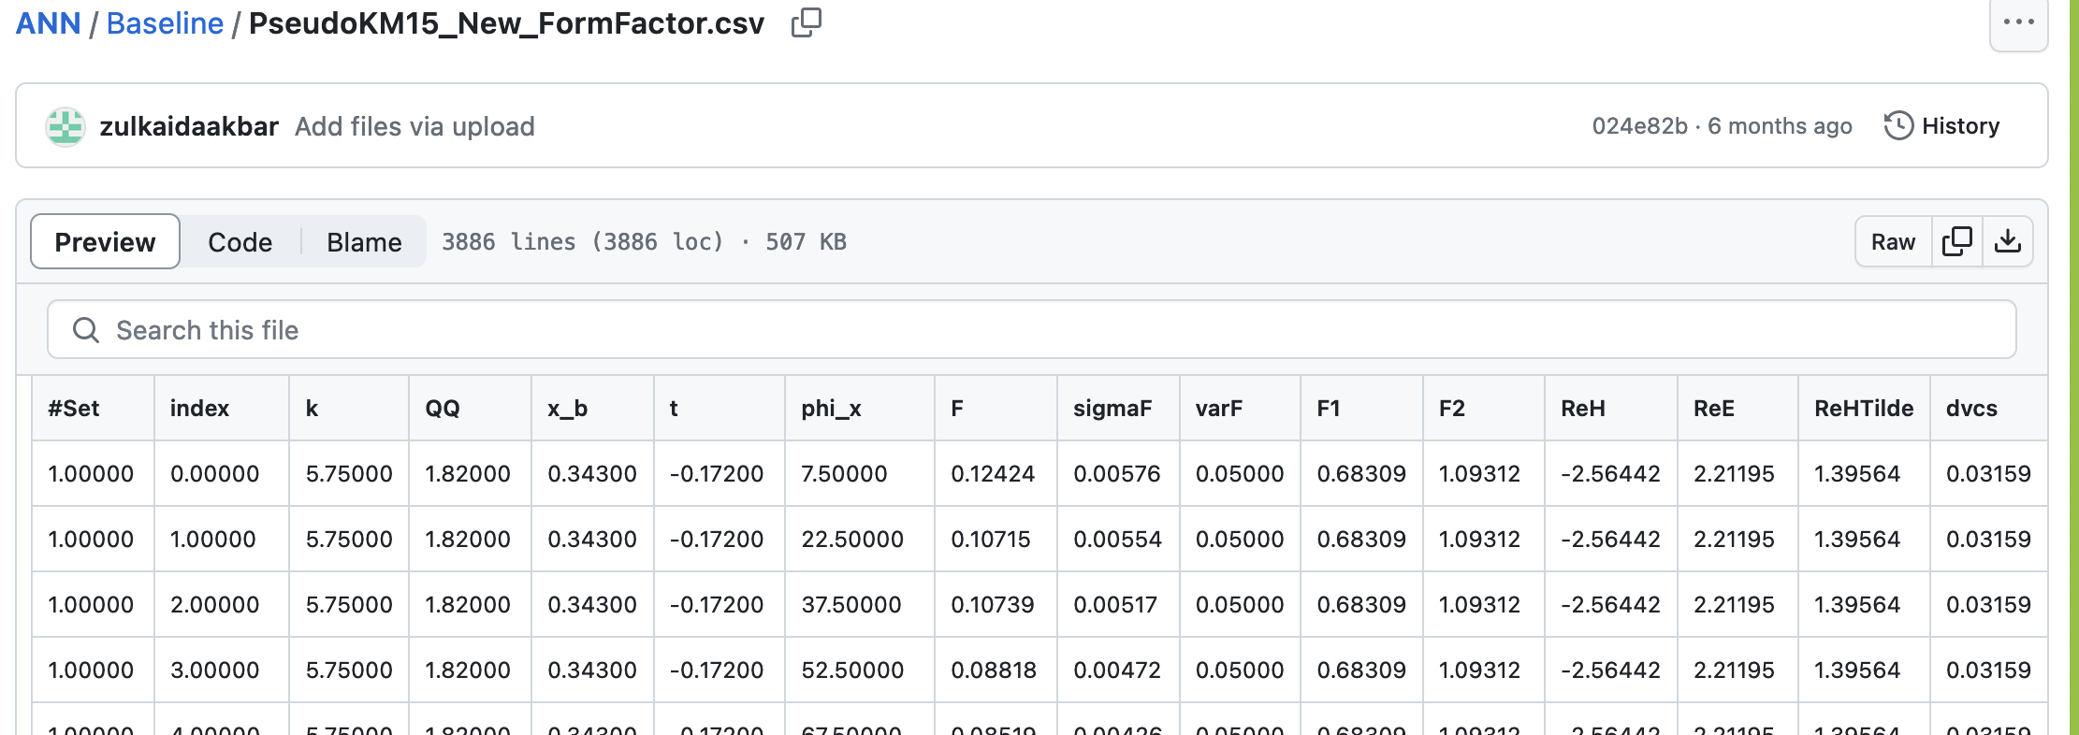
Data file structure (generic)
F
phi_x
Kinematics
Compton Form Factors (CFFs)

Slide 5
Generate Pseudo-data
Using the code ‘generate_pseudodata.py’ you can generate a single file of pseudodata
(as a .csv file) for a given set of CFFs and kinematic variables.
You can also vary the number of ‘phi’ bins as a user input in the code so it will
determine how many ‘rows’ (or data points) of ‘F’ (total cross-sections) with respect to
the angle (‘phi’).
Similarly, you can generate multiple pseudodata files (.csv files), mimicking
multiple experiments.
For the error/uncertainty of ‘F’ (cross-section), it is better to use values in the order of
real experimental measurements.

Slide 6
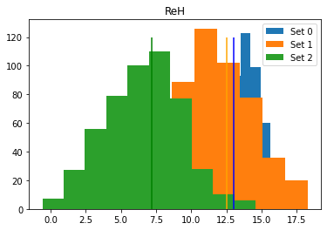
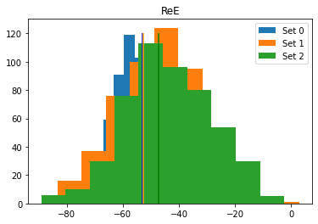
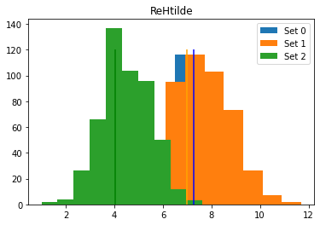
Generate replicas for the statistical uncertainty
Data set #N
Data set #N
Data set #N
Data set #0
Data set #N
Data set #N
Replica #500 of data set #0
Data set #1
Data set #N
Data set #N
Data set #N
Data set #N
Data set #N
Replica #500 of data set #1
.
.
.
.

Slide 7
Training Process for LMI method
In the training process, we need to ensure to feed all ‘data sets’
that cover a sparce kinematic range.
Note: If you use only one set of kinematics, then it is called the ‘Local Fit’
Each data set file contains uncertainty column for ‘F’ (total cross-section)
Generating replicas = sampling the ‘F’ value in each row within its
uncertainty range. Therefore, you can generate a replica set by dynamically samply ‘F’ within ‘sigmaF’.
Each ‘replica’ can be treated as a ‘job’ and each training of a replica
will provide a trained DNN model with evaluated training loss and validation loss. Save those replica DNN models.
Once you have multiple replica DNN-models, then you can evaluate the statistical uncertainty from the replicas which propagated the uncertainty to the CFFs from ‘sigmaF’.

Slide 8
Accuracy
Definition:
How far away the mean of the replicas from the “truth” value ?
$$Accuracy=\left(1−\frac{|True −Mean| }{True} \right)100\%$$
Accuracy is a “quantity” that you can use to evaluate the “improvement” of your
architecture (or the configuration of hyperparamters that you ran with)
You can calculate the “Accuracy” of each CFF for a given set (kinematic-set)
You can be creative to develop a code to compare Accuracy of CFFs between kinematic sets, within the kinematics (with respect to angle), etc. Think… and propose you ideas..

Slide 9
Precision
Definition:
How precise the extracted CFF is (standard deviation of the CFFs from all replicas)?
$$Precision=\frac{1}{N_replicas}\sum_{n=1}^{N_replica}{{(Replica(i) −Mean)}^{2}}$$
Precision is a “quantity” that you can use to evaluate the “improvement” in terms of
the statistical uncertainty of your architecture
(or the configuration of hyperparamters that you ran with)

Slide 10
Some resources
Introduction from Professor Keller https://confluence.its.virginia.edu/display/twist/Introduction
Running jobs on Rivanna https://confluence.its.virginia.edu/display/twist/Running+ANN+jobs+in+UVA-Rivanna
Overleaf
Discord channel
Running on ‘Shannon’ (with the options of parallelizing jobs)

