Slide 1
GitHub Steps
01-11-2023
References
1) https://git-scm.com/book/en/v2/
2) https://jarv.is/notes/how-to-pull-request-fork-github

Slide 2
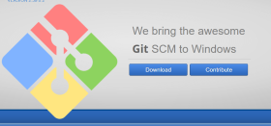
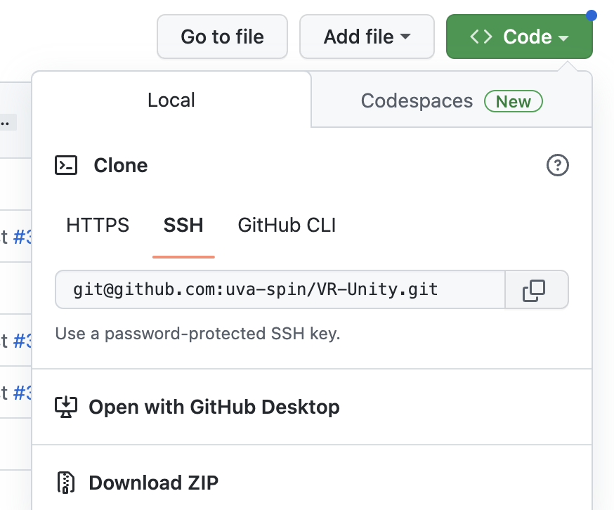
Some basics
Windows users:
Install Git on Windows and make sure that you have
“GitBash” option available when right click
Mac & Linux users: Just use the terminal
VR-Unity Repository
Main branch
Branch #1
Branch #2
How to get the files?
1) Downloading the .zip file: recommended for quick/temporary tests
2) Cloning : recommended if you want to make direct changes to the mother repository
(You can do it through your fork and also through any branch)
$ git clone <copy>paste from the SSH tab on the repository>
How to check where you are?
Once you cloned the repository then implement the following command
$ git branch –a
How to create a branch? $ git branch <branch_name> or create and switch at the same time $ git checkout -b <branchname>
How to copy a branch? $ git branch <new_branch_name> <old_branch_name>
How to change your branch?
$ git checkout <branch_name>

Slide 3
Some basics
How to rename a branch?
$ git branch –m <oldname> <newname>
VR-Unity Repository
Remote
VR-Unity Repository
Local
Main branch
Branch #1
Branch #2
Main branch
Branch #1
Branch #2
You can modify the files locally but will not be sync with the ”remote” repository
How to check the current status of your local working branch?
$ git status (I would recommend this to do be done frequently)
How to update the remote branch?
$ git add <file_name> (same if you deleted/modified a file)
$ git commit –m “write something meaningful about your modification”
$ git push

Slide 4
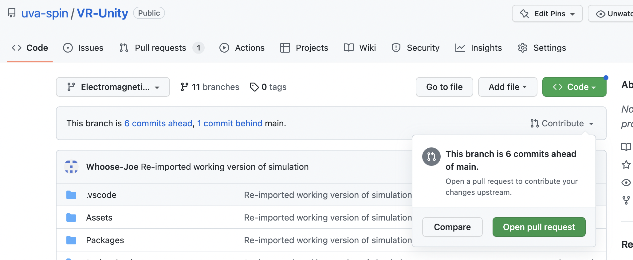
Pull Requests from a branch
Once you are ready to merge to the main branch in the mother repository, then you can do it quickly via
the web browser (you will have to login to your GitHub account).
If there are ”conflicts” between the main branch files and the new one, it will complain and show the conflicts.
You will have to fix those before the pull-request.

Slide 5
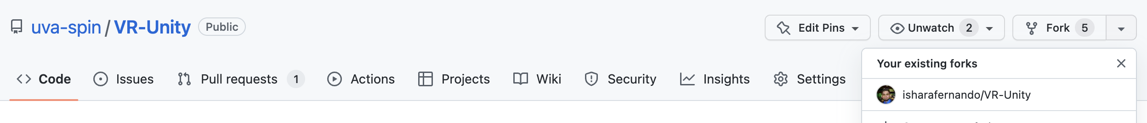
Working with Forks
Creating your fork: login on your GitHub account -> Click on this “Fork” button -> Confirm
Important facts regarding this fork
The fork (repository) is unique to you and it has its own “main” branch
You will have to clone your fork separately (if you cloned from the mother repository) to a different location on your
computer.
The best practice is to have your forked “main” branch always sync with the “main” branch of the mother repository.
You can have any develop branches in your fork and would not affect to the mother repository at all unless you make
a pull request.
In any branch $ git pull command is highly recommend before modifying any file.
If you are unsure, you can copy this file to a different location on your computer and copy it back to the place where
the git files are located at and then implementing $ git status will show you that you updated that file(s).
i.e you can check your code without affecting either to your fork or to the mother repository.

Slide 6
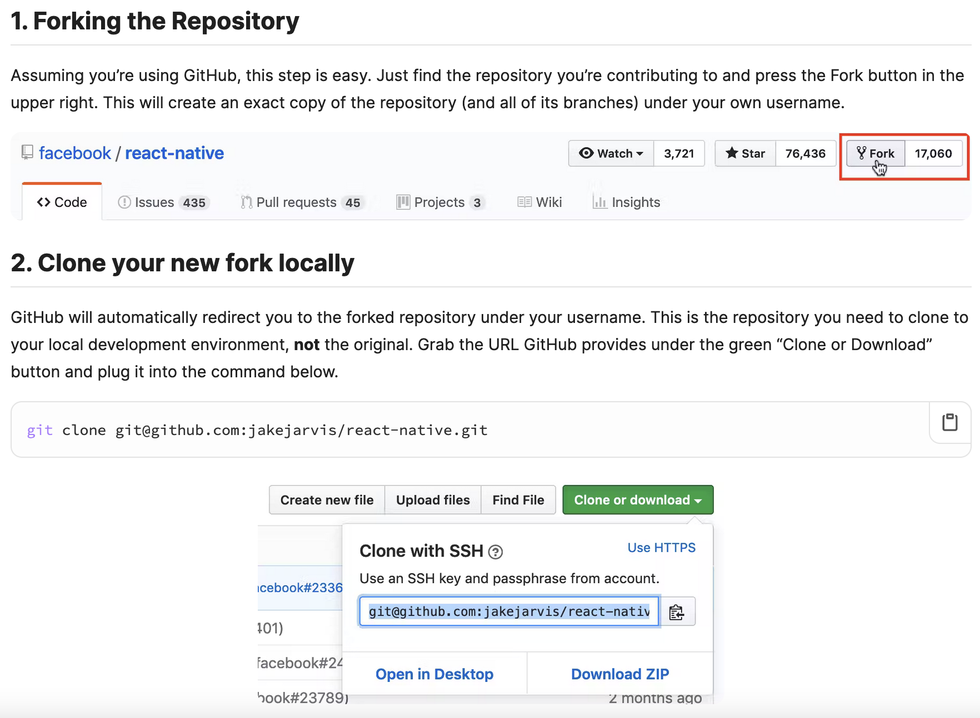
Reference
https://jarv.is/notes/how-to-pull-request-fork-github/

Slide 7
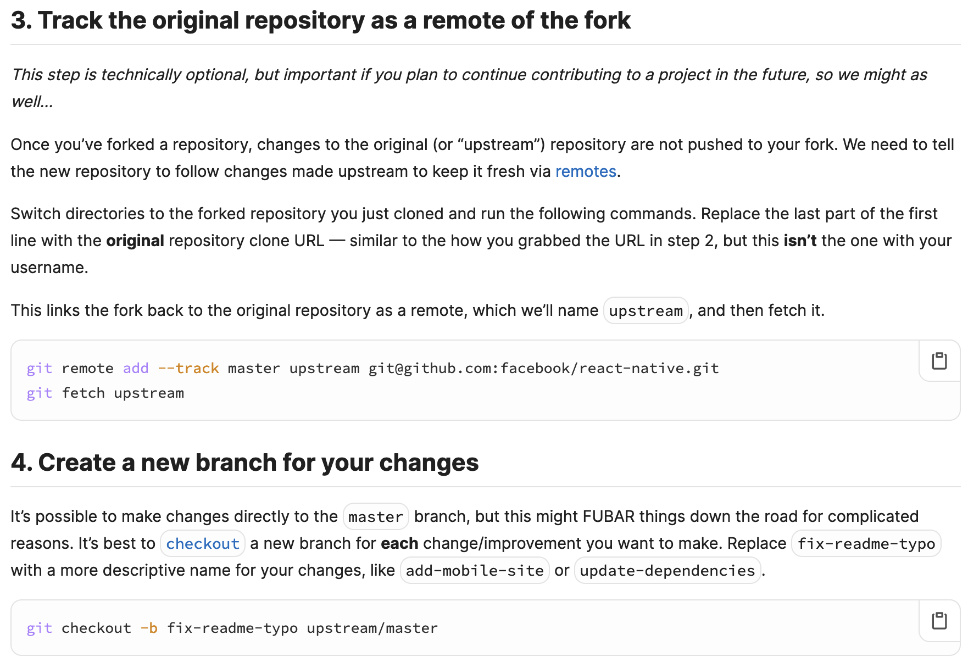
Reference
https://jarv.is/notes/how-to-pull-request-fork-github/

Slide 8
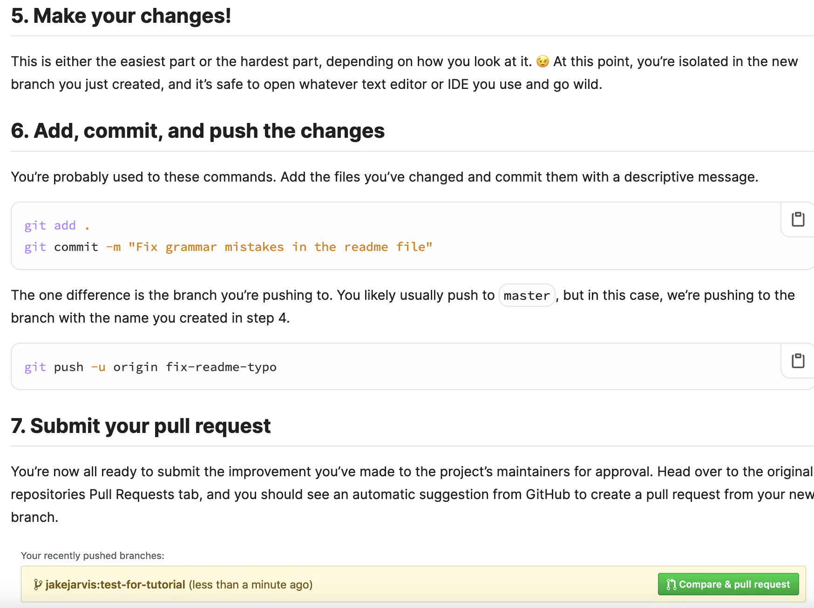
Reference
https://jarv.is/notes/how-to-pull-request-fork-github/

