Slide 1
Two scenarios triggering new Change Job processes
Scenario One:
Current position has role assignments and the change job results in same manager
Scenario Two:
New position has role assignments and change job results in new manager

Slide 2

SCENARIO
ONE

Slide 3
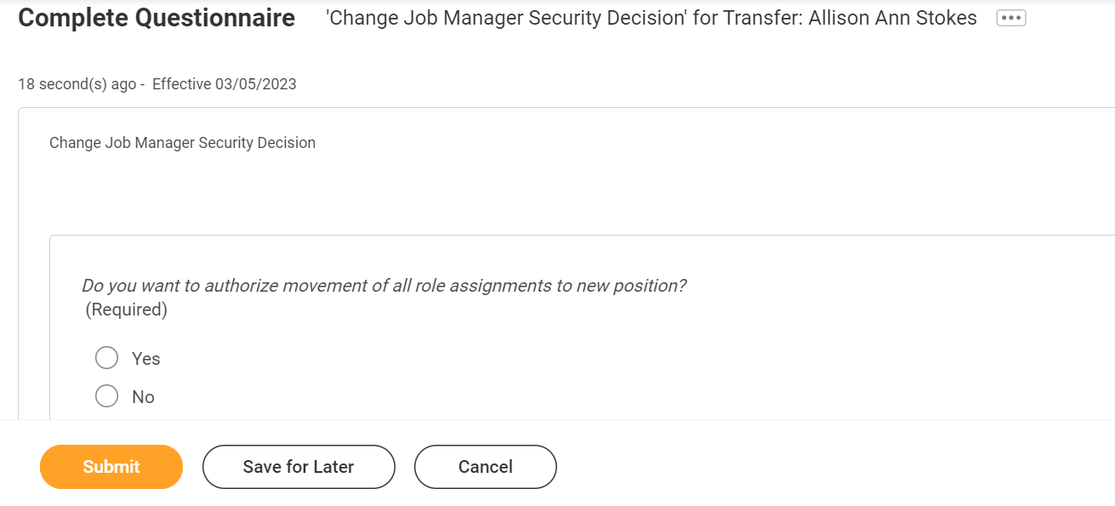
If current position has role assignments and job change results in the same manager, then Manager is asked via questionnaire if they would like Security Admin to transfer all role assignments to new position

Slide 4
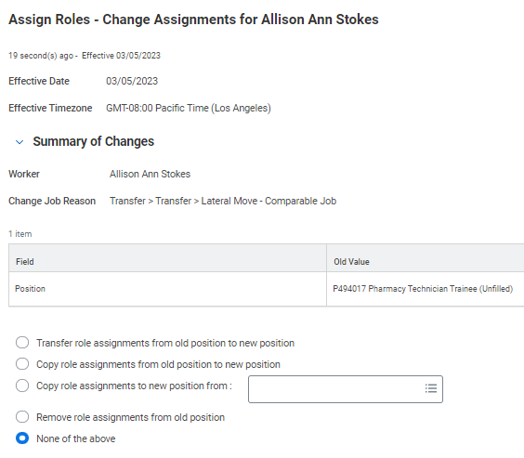
If the Manager answers yes…
Security Admin receives Workday-delivered inbox task:

Slide 5
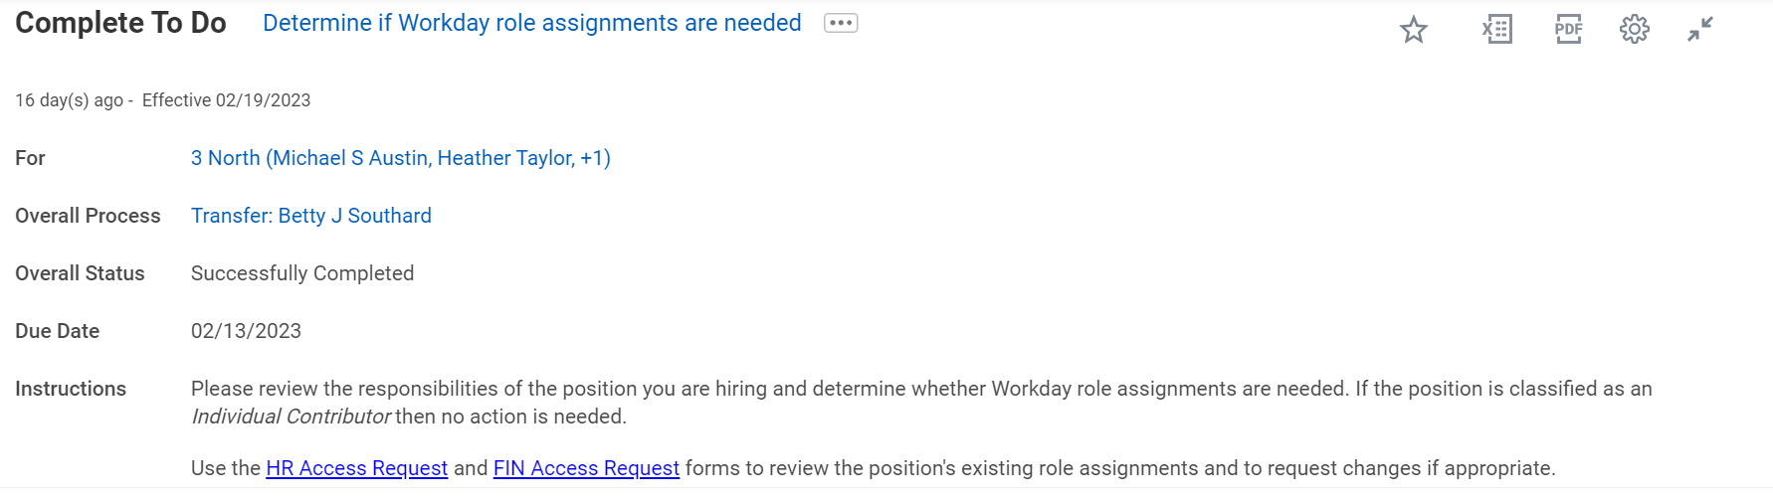
If the Manager answers no…
Manager receives To-Do encouraging them to use RBA forms if needed:

Slide 6
SCENARIO
TWO

Slide 7
If new position has role assignments and job change results in a new manager, then questionnaire isn’t needed and BP proceeds straight to To-Do linking to RBA forms, asking new Manager to consider whether changes to position’s security are needed:

Slide 8
We are also considering directing Managers to the RBA forms during Hire and Termination if the affected position has role assignments

