Slide 1
Power distribution
Instrument | Note | Power (Watt) | Current (Amp)
Pfeiffer DCU 600 | Turbo Pump Controller | 590 | 3.8
Pfeiffer TPG 361 | Pressure-sensor readout | 45 | 0.38
Pfeiffer ACP 15 | IVC turbo Backing pump | 550 | 4.58
Fan (2 fans) | IVC turbo pump Air cooling fan | 20 | 0.36
HiCube | Back-up for IVC | 270 | 2.25
UPS 2: Power=635 Watts Current=4.18 Amps
UPS 1: Power=840 Watts Current=7.19 Amps
Total Power=1475 Watts Total Current=11.37 Amps

Slide 2
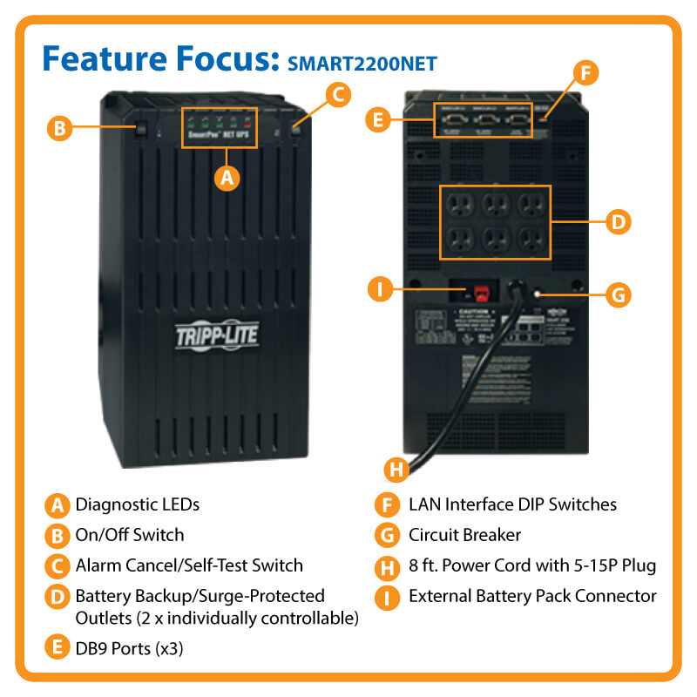
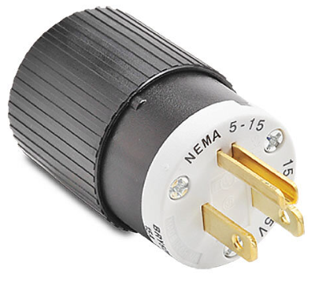
Back-up Plan
UPS: ($1106.09)
  https://tripplite.eaton.com/smartpro-120v-2.2kva-1.7kw-line-interactive-ups-tower-extended-run-3-db9-ports~SMART2200NET
Input
  Nominal Input Voltage(s) Supported= 120V AC
  Recommended Electrical Service=20A 120V
  UPS Input Cord Length (ft.)= 8
  Input Phase= Single-Phase
  UPS Input Connection type=5-15P
Output
  Output Capacity (Watts)= 1700
Battery
  Runtime Full Load (min.)= 11
  Runtime Half Load (min.)= 27
Standard & Compliance
  Product Certifications= CSA (Canada); NOM (Mexico); UL 1778
  Product Compliance= RoHS; FCC Part 15 Class A (USA)
  NEMA 5-15P input, 6 NEMA 5-15R outlets
UPS 1 & UPS 2 next to the low-noise power under the SCR
We need two 20A power outlets

Slide 3
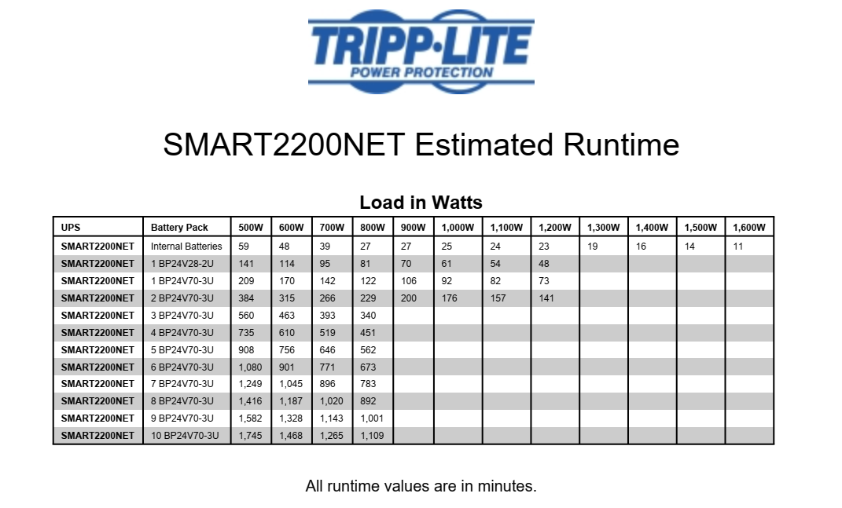
Internal Battery
  Runtime Full Load (min.)= 11
  Runtime Half Load (min.)= 27
External Battery
  Even with one external battery (including the internal one), we can increase the run-time to 70 minutes.
  By increasing the external batteries (including the internal battery), we can increase the run-time as needed. (See Above table)

Slide 4
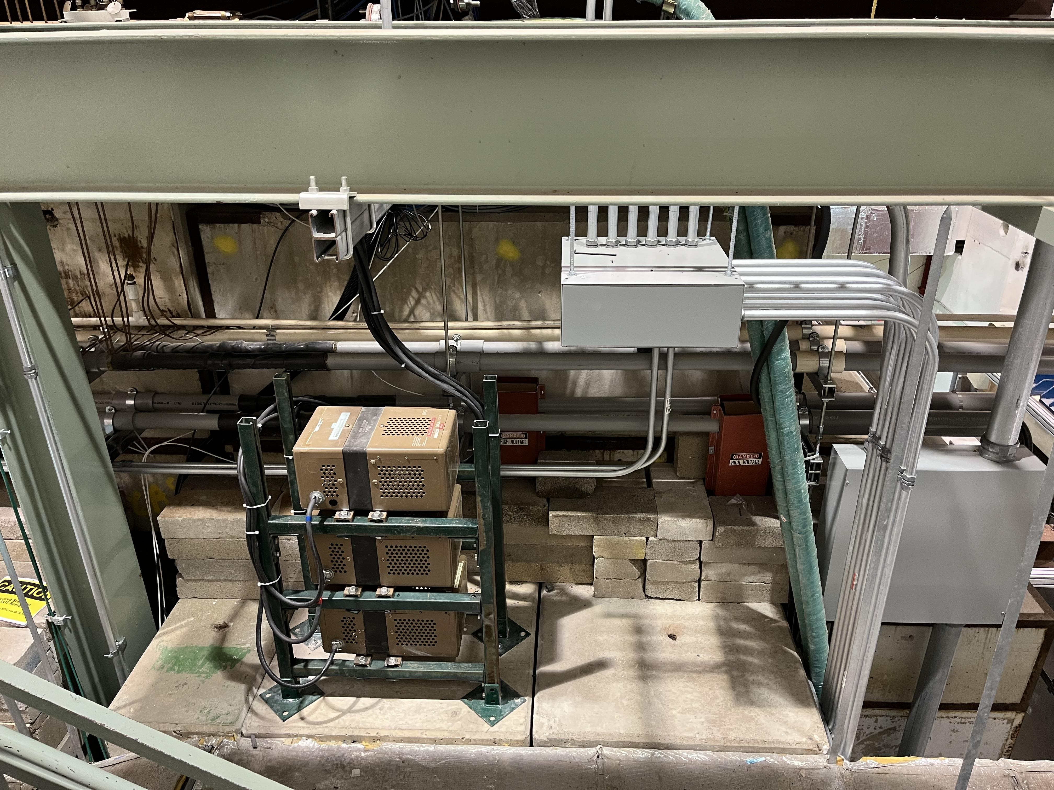
Place for UPS
Low-noise power supply
We can put two UPS near the low-noise power supply with racks like the power supply.

Slide 5
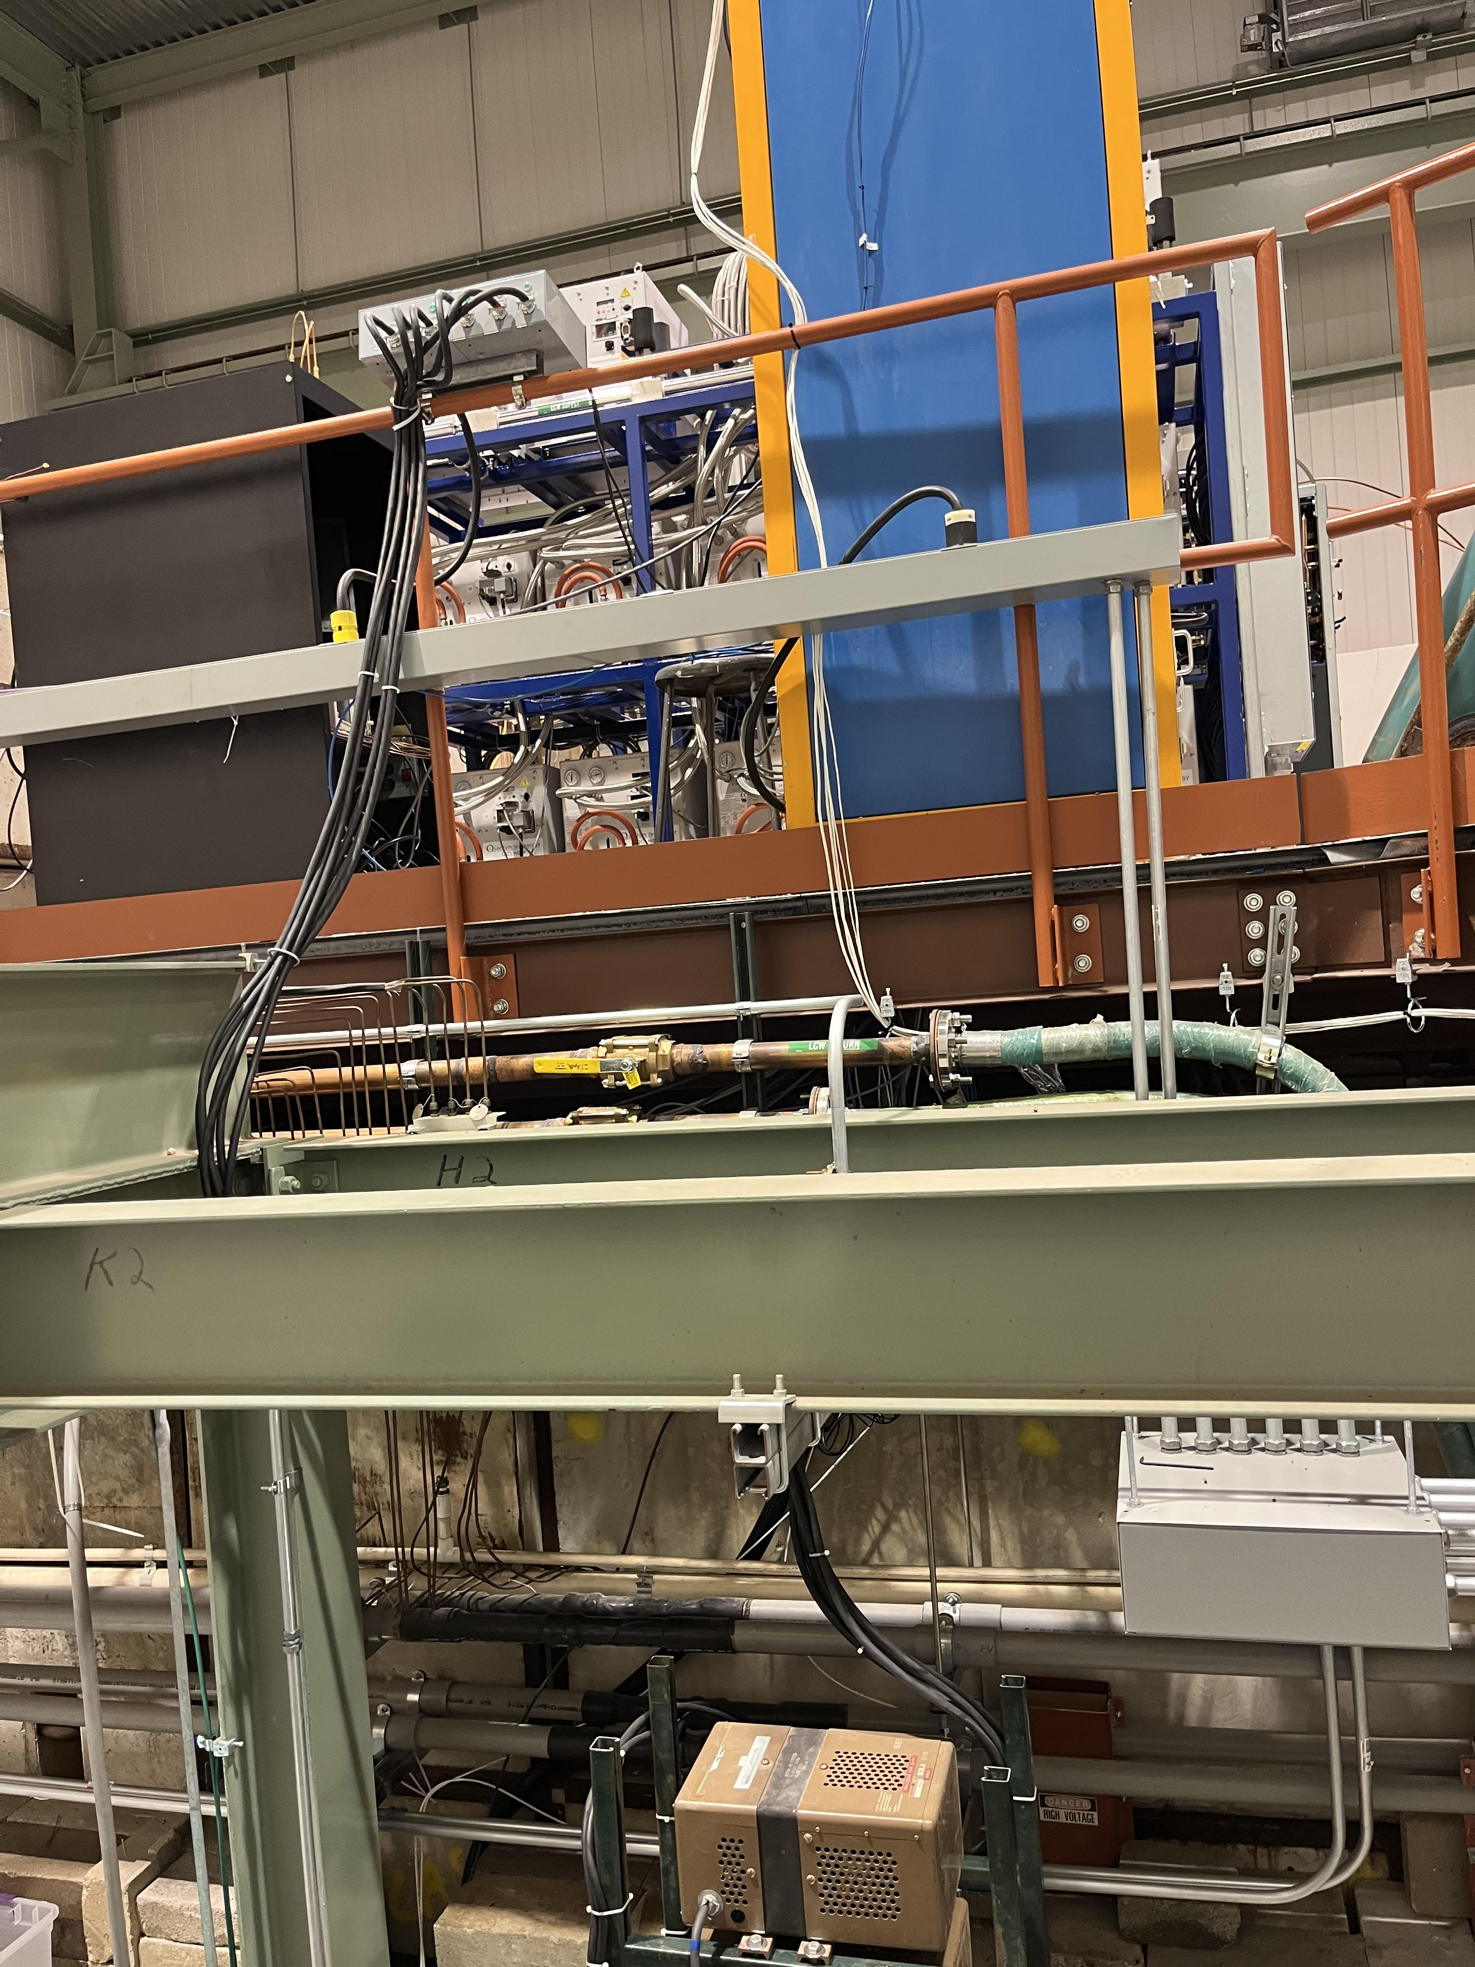
20A 3-Phase Used for SCR
PP-NM4-6 (CIR 13/15/17)
20A 3-Phase Used
PP-NM4-6 (CIR 19/21/23)
20A 1-Phase Used Microwave
PP-NM4-6 (CIR 3/5)

Slide 6
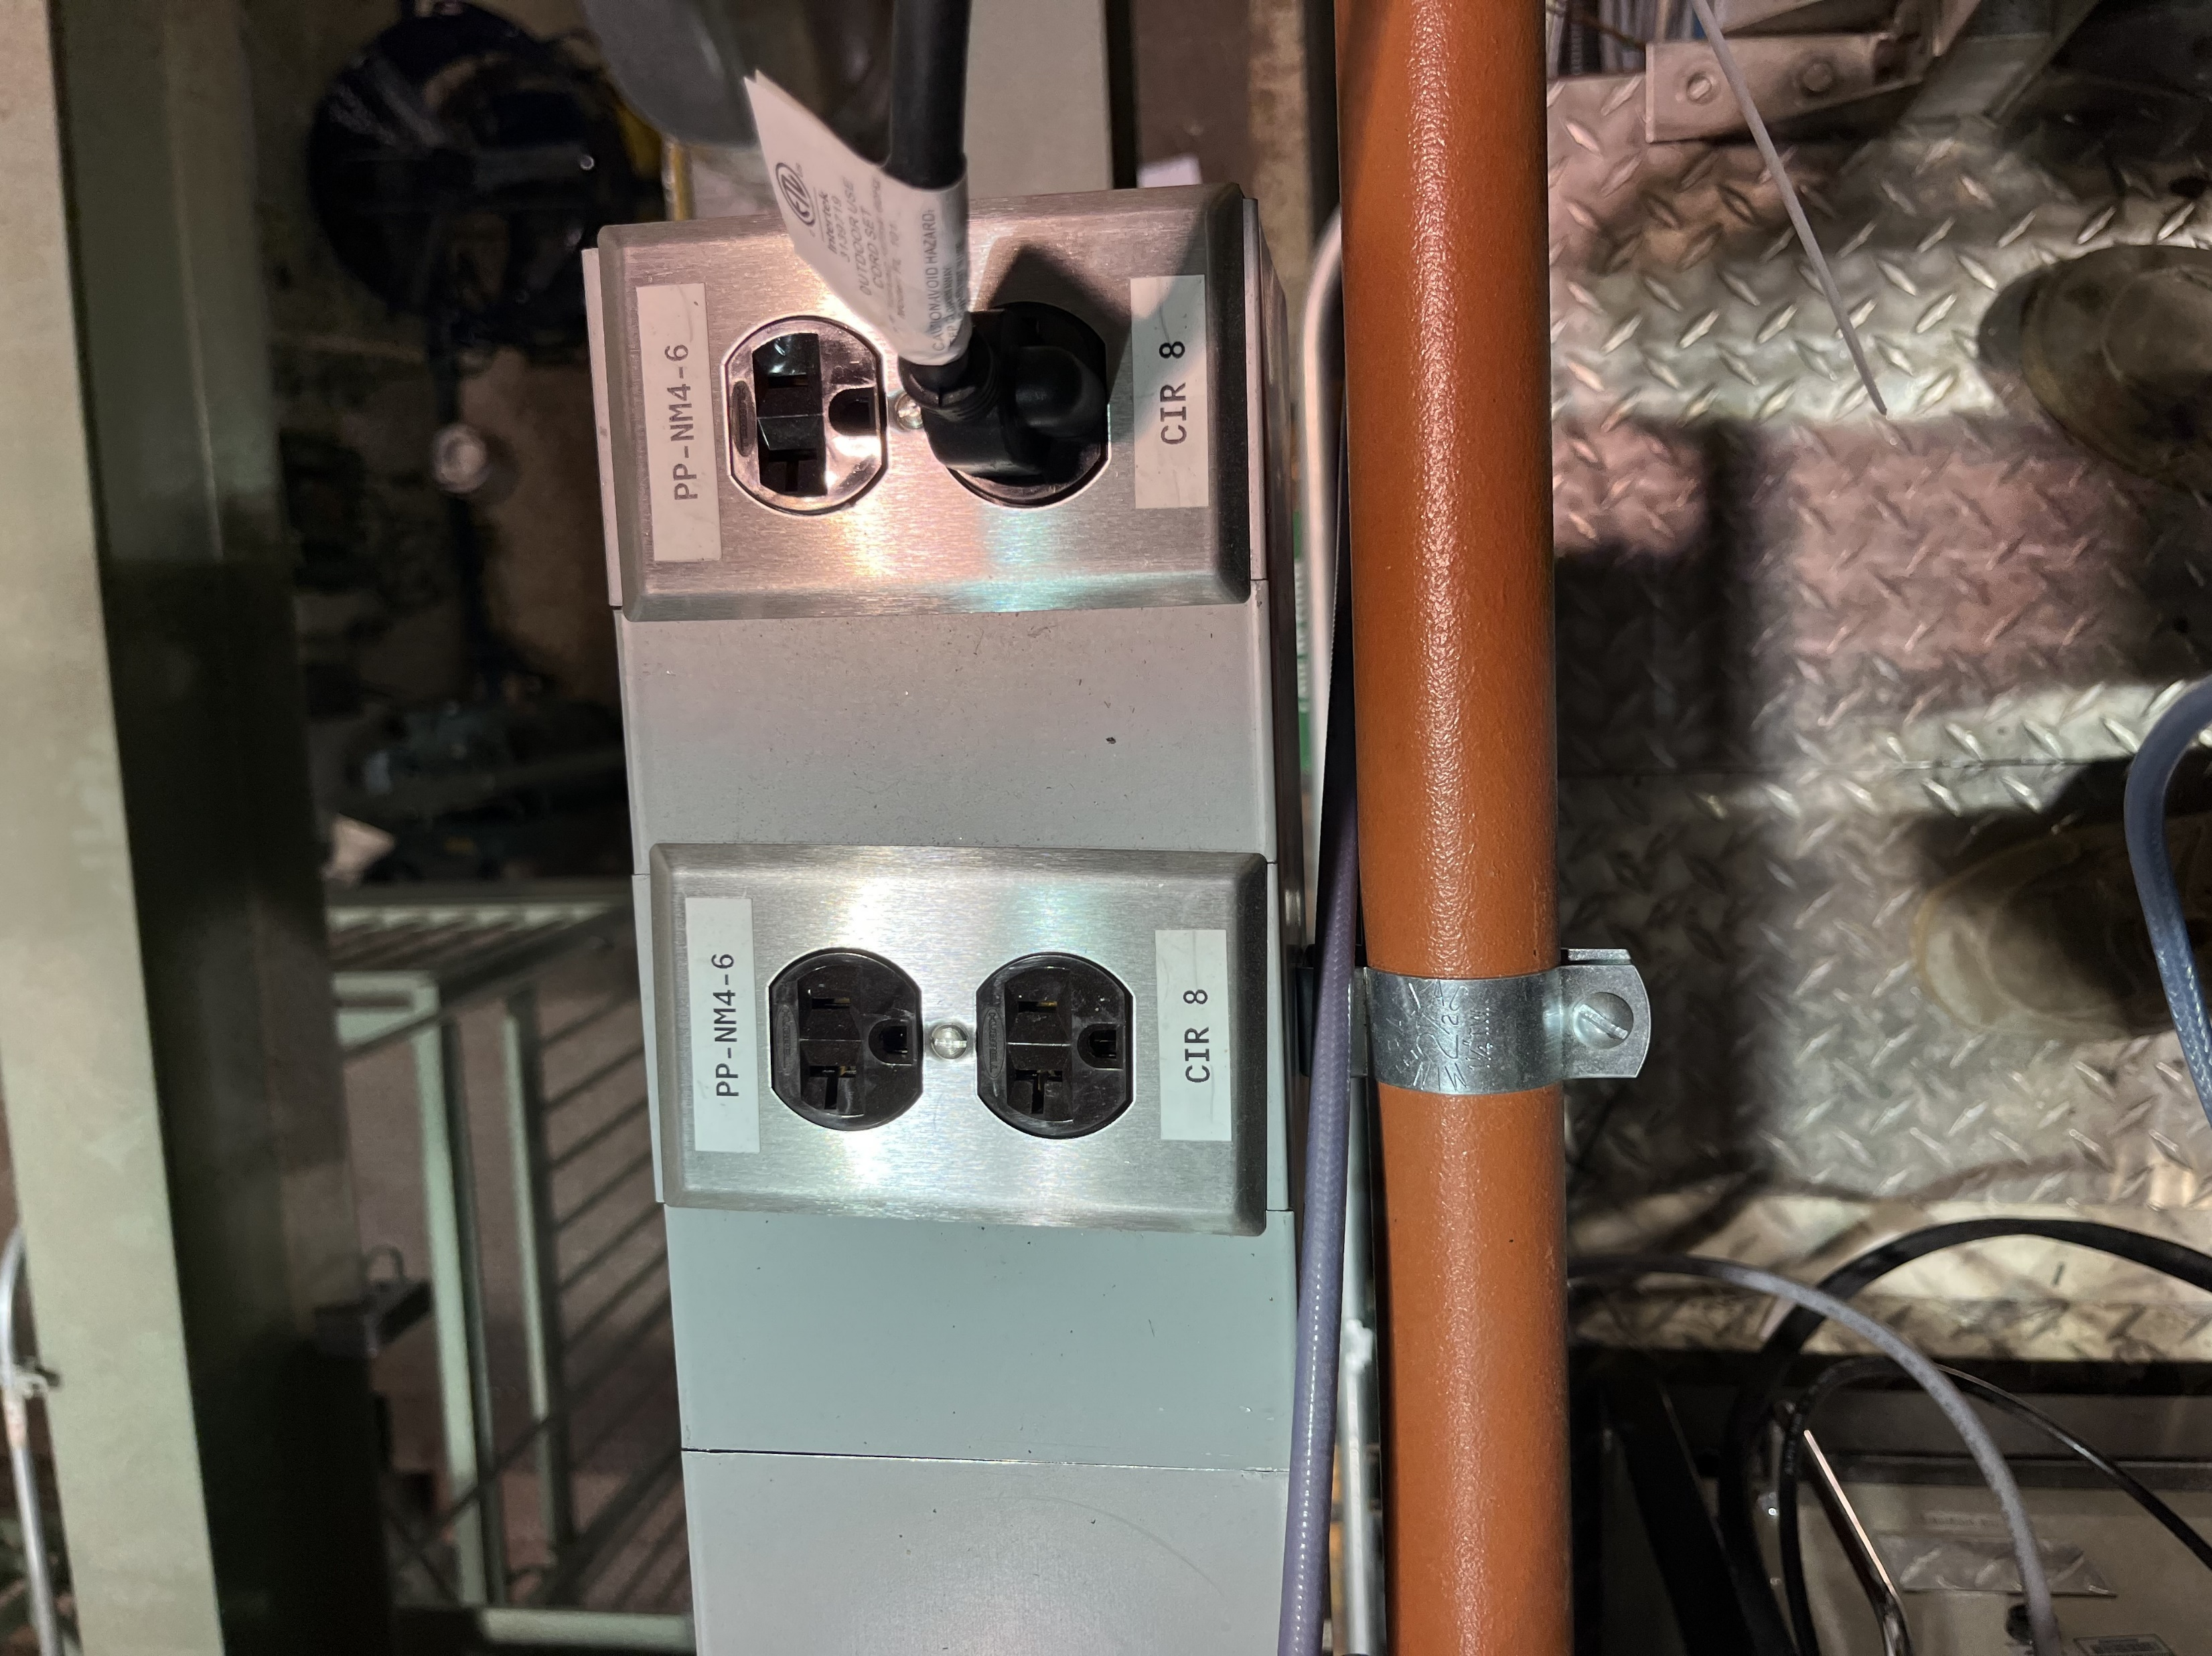
120V circuits
20A
These receptacles are not rated for more than 20A
PP-NM4-6
CIR 8
Place for UPS

Slide 7
