Slide 1
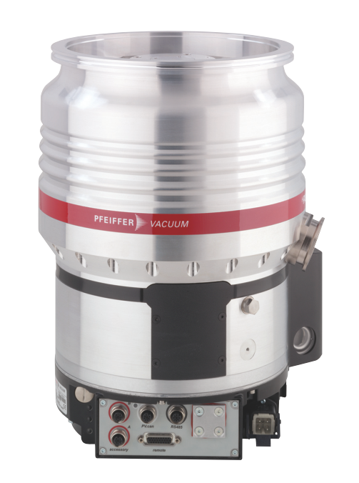
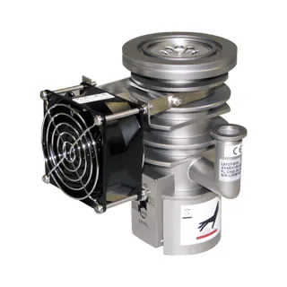
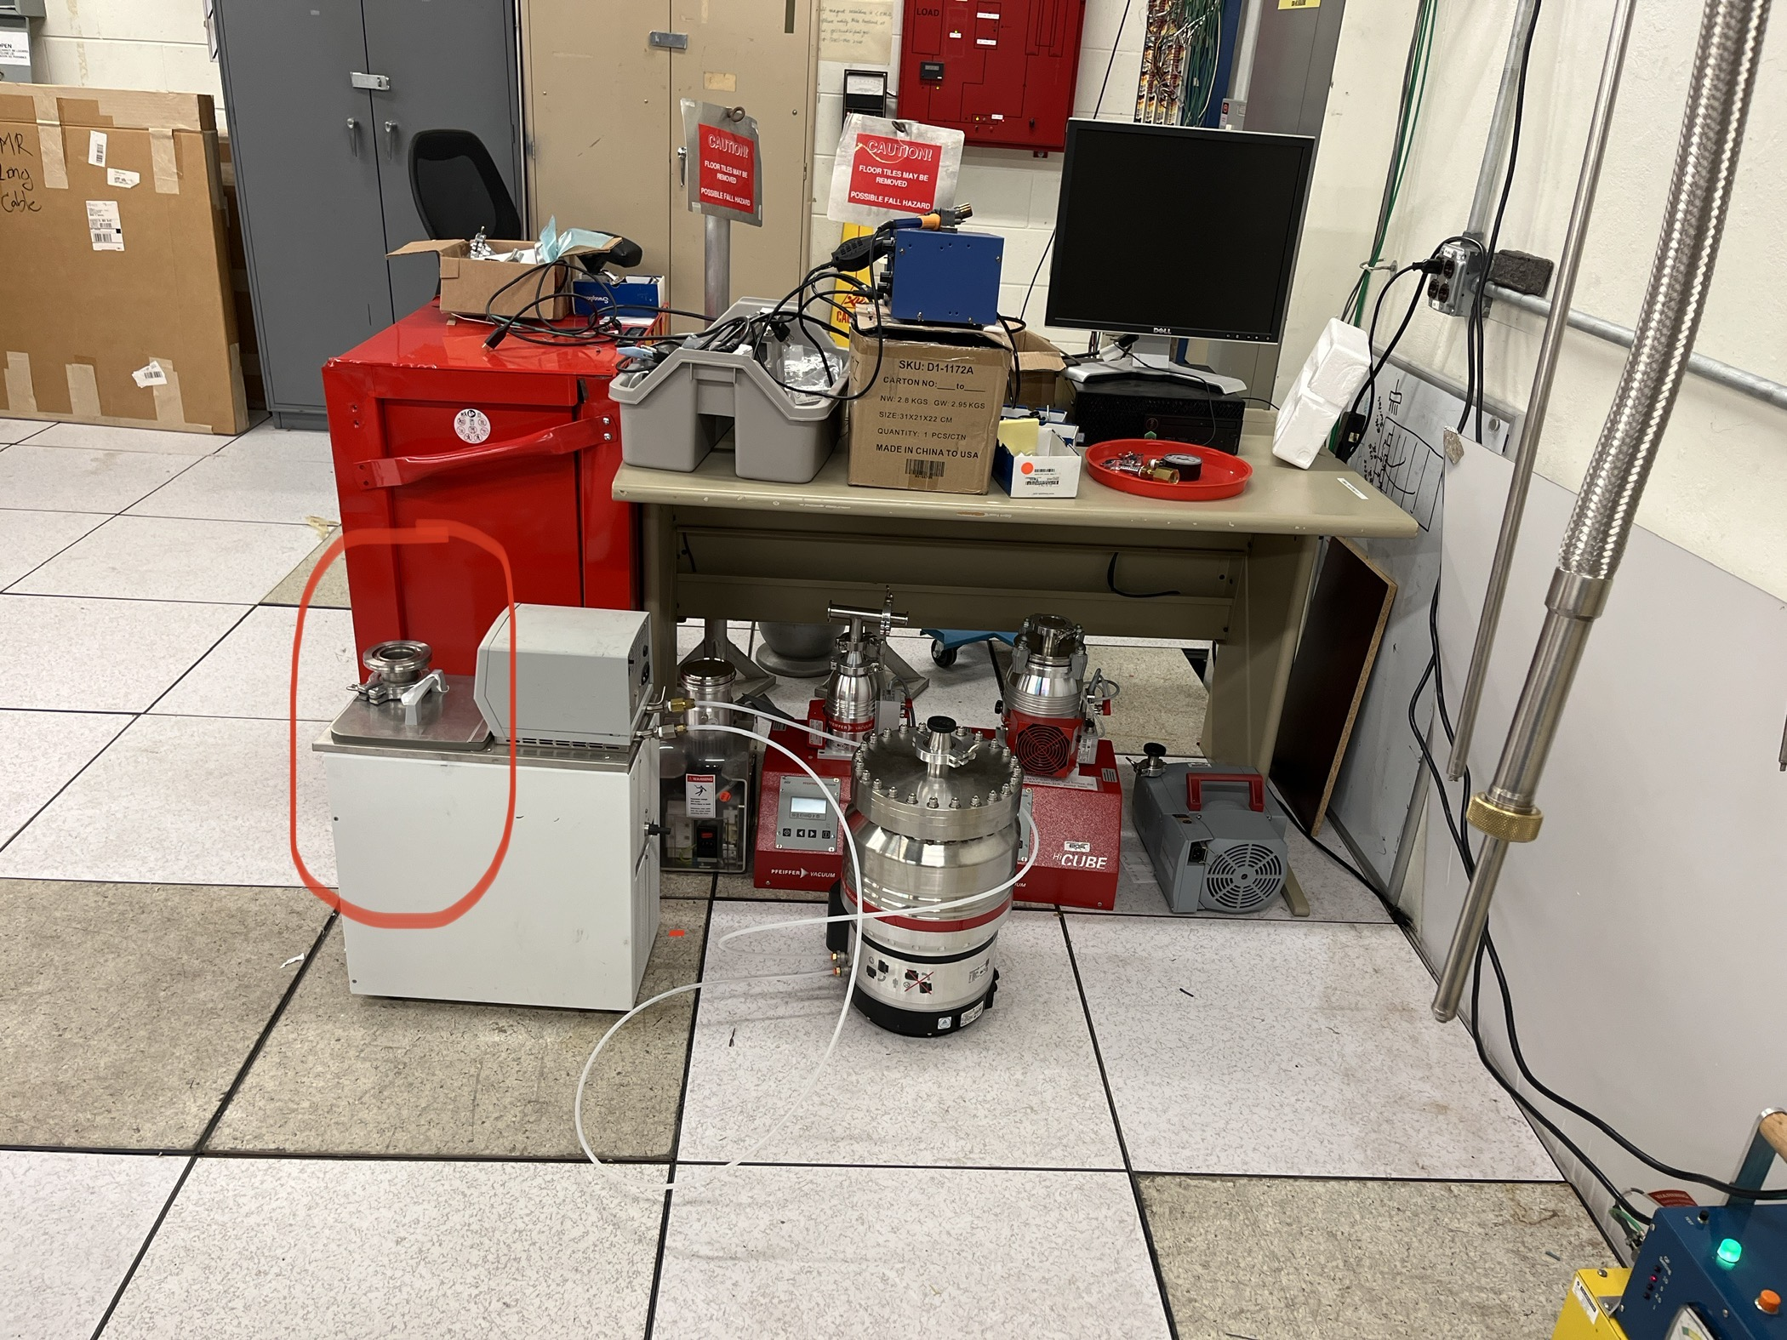
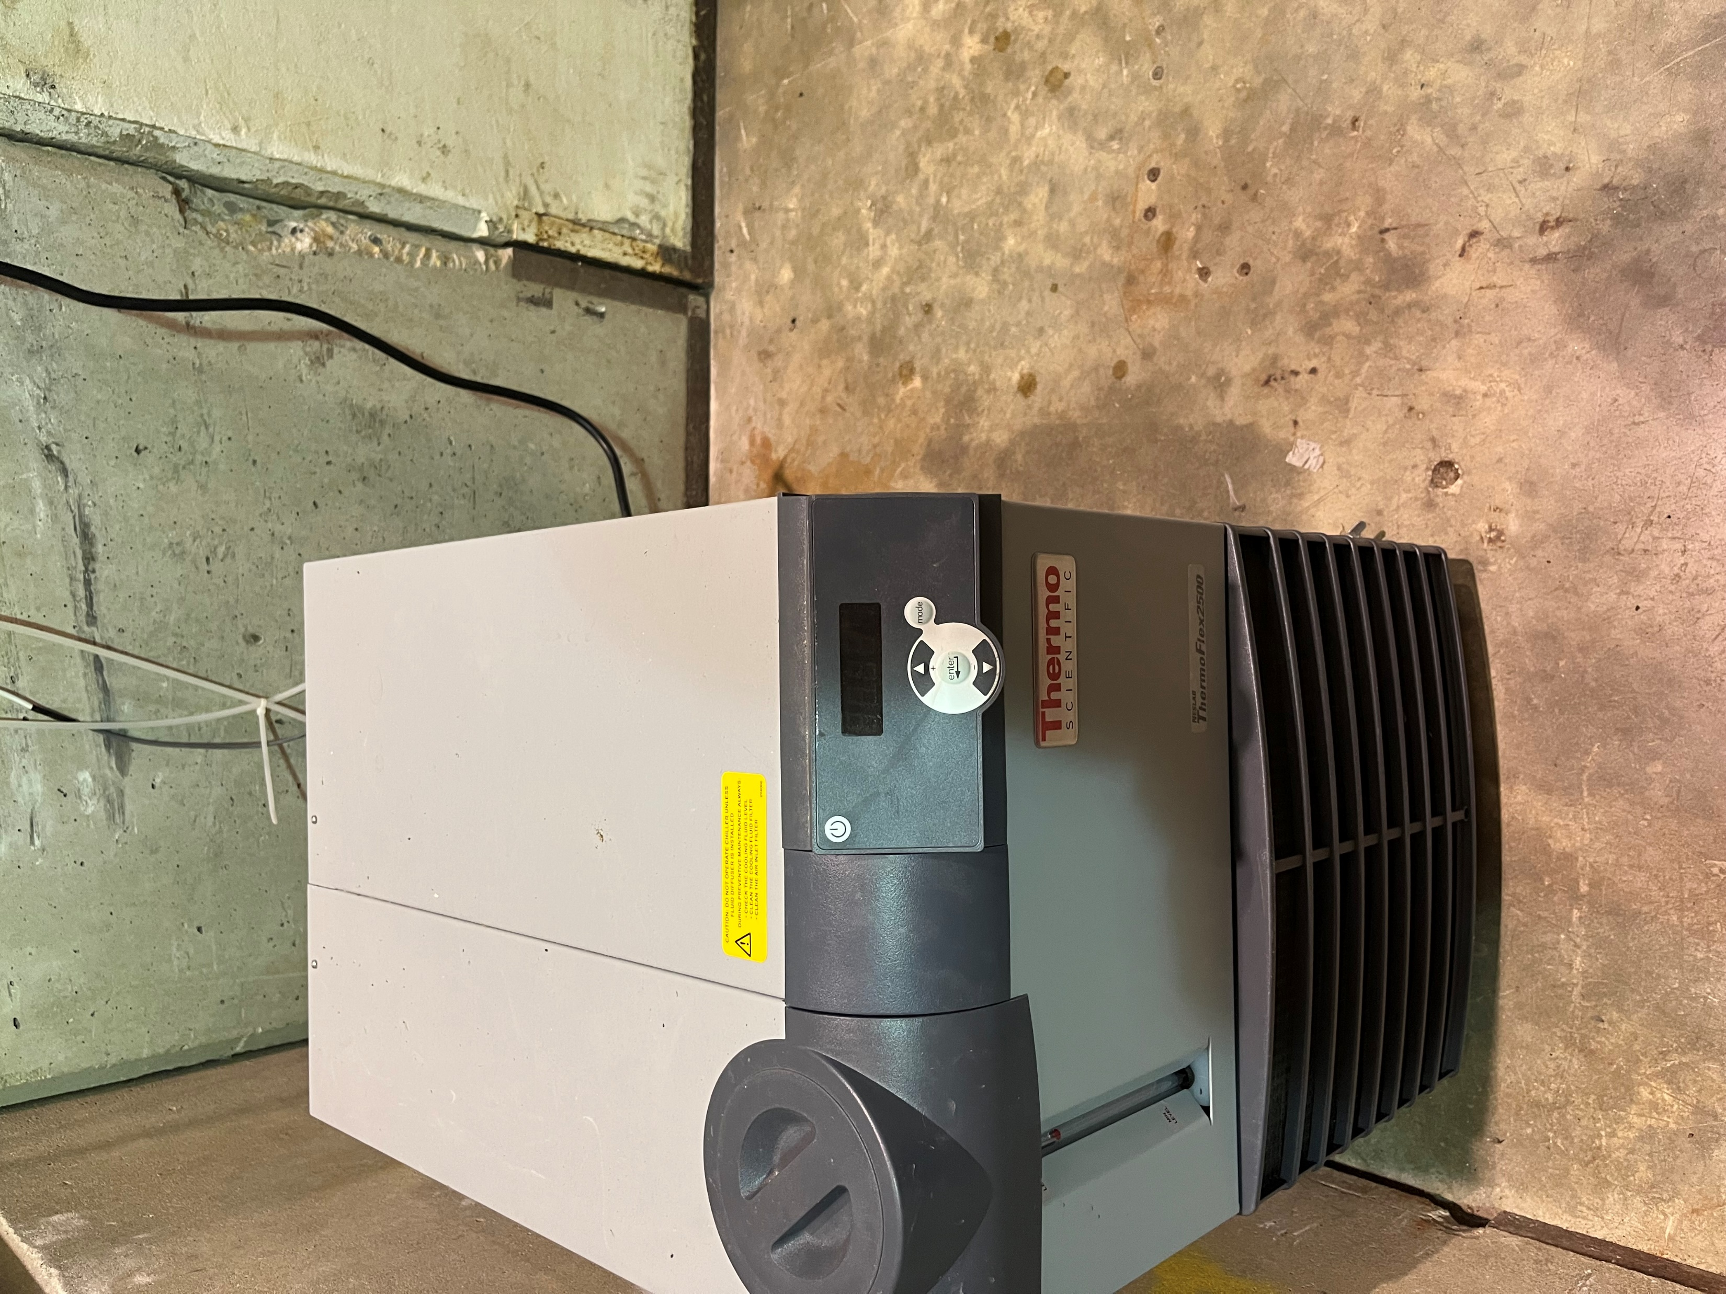
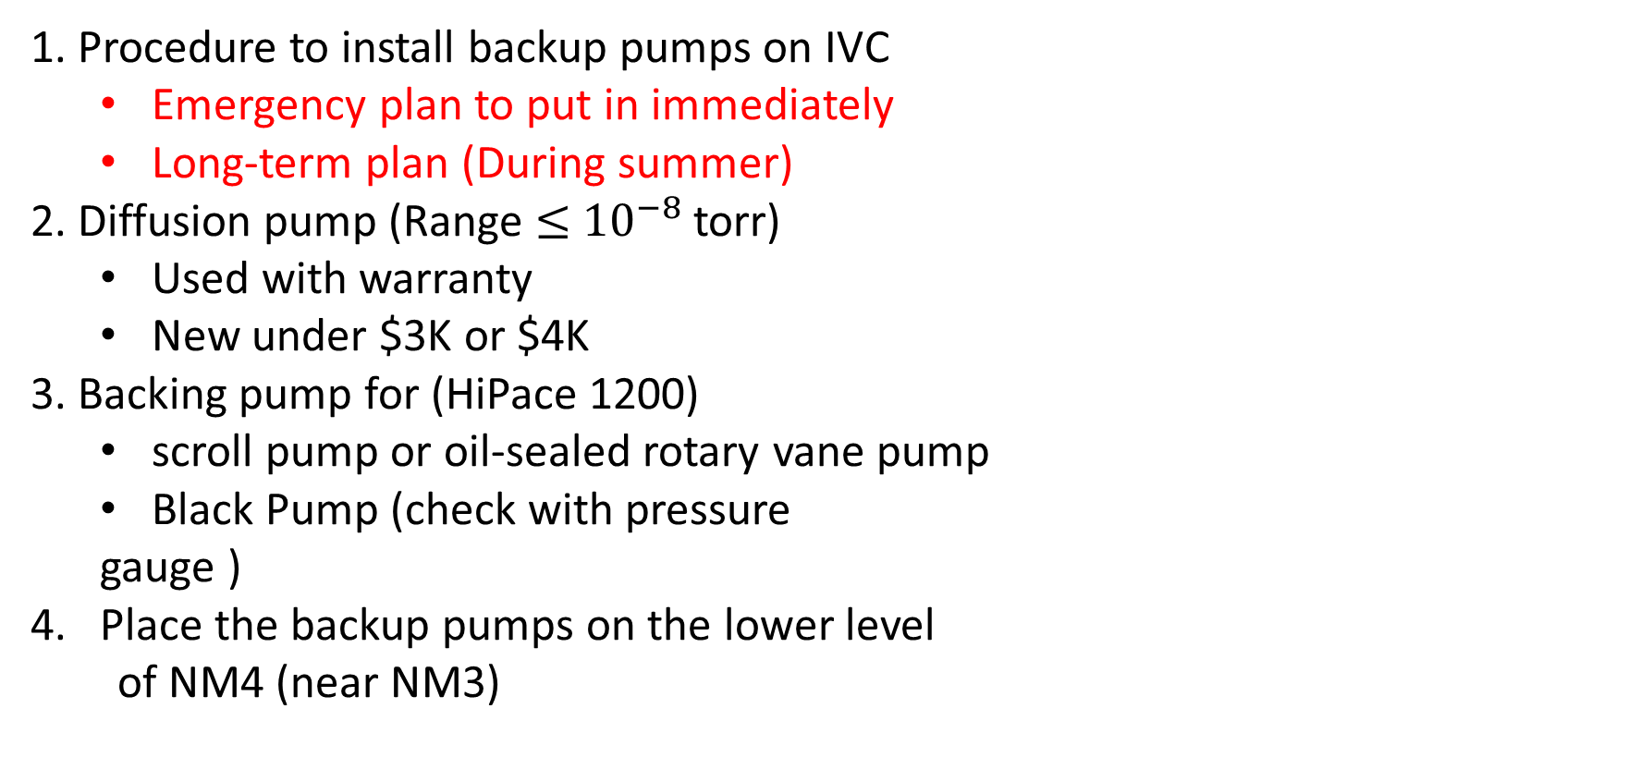
Back-up plan
Procedure to install backup pumps on IVC
  Emergency plan to put in immediately
  Long-term plan (During summer)
Diffusion pump (Range $≤$ ${10}^{−8}$ torr)
  Used with warranty
  New under $3K or $4K
Backing pump for (HiPace 1200)
  scroll pump or oil-sealed rotary vane pump
  Black Pump (check with pressure
  gauge )
Place the backup pumps on the lower level
of NM4 (near NM3)

Slide 2
Procedure to install back-up pumps
Bring back-up pumps from NM4 to NM3
Close the white Pfeiffer-angled hand valve in the IVC (Insulation Vacuum Chamber).
Remove the blank on the KF-25 Tee underneath the white Pfeiffer angled hand valve.
Connect the KF-25 flex hose between the High Vacuum flange of the turbo pump and the KF-25 Tee side.
Connect the KF-25 flex hose between the Fore-Vacuum flange of the turbo pump and the backing pump.
Ensuring that all connections are tight and leak-free.
Turn on the backing pump to provide the necessary backing pressure to the turbo pump.
Start the turbo pump and allow it to reach its operating speed.
Open the white Pfeiffer-angled hand valve using the turbo pump to recover the IVC pressure.
Monitor the vacuum level inside the target magnet and ensure it stays within the desired range.

Slide 3
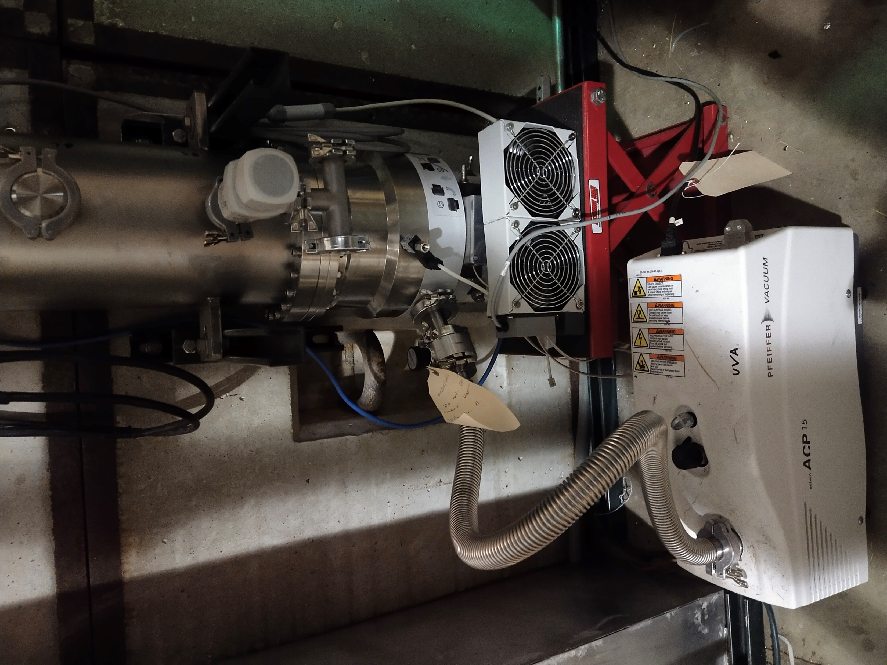
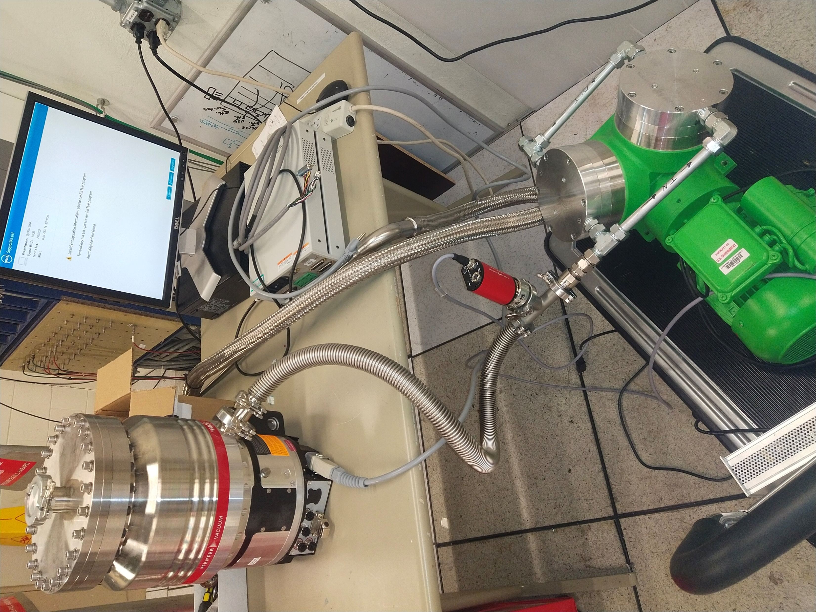
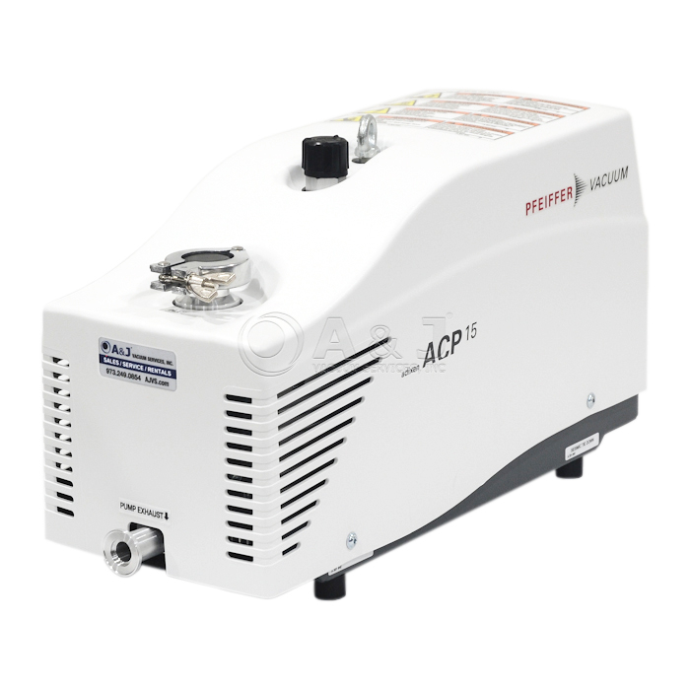




HiPace 1200 back-up turbo
Backing pump
Tee-Connection

Slide 4
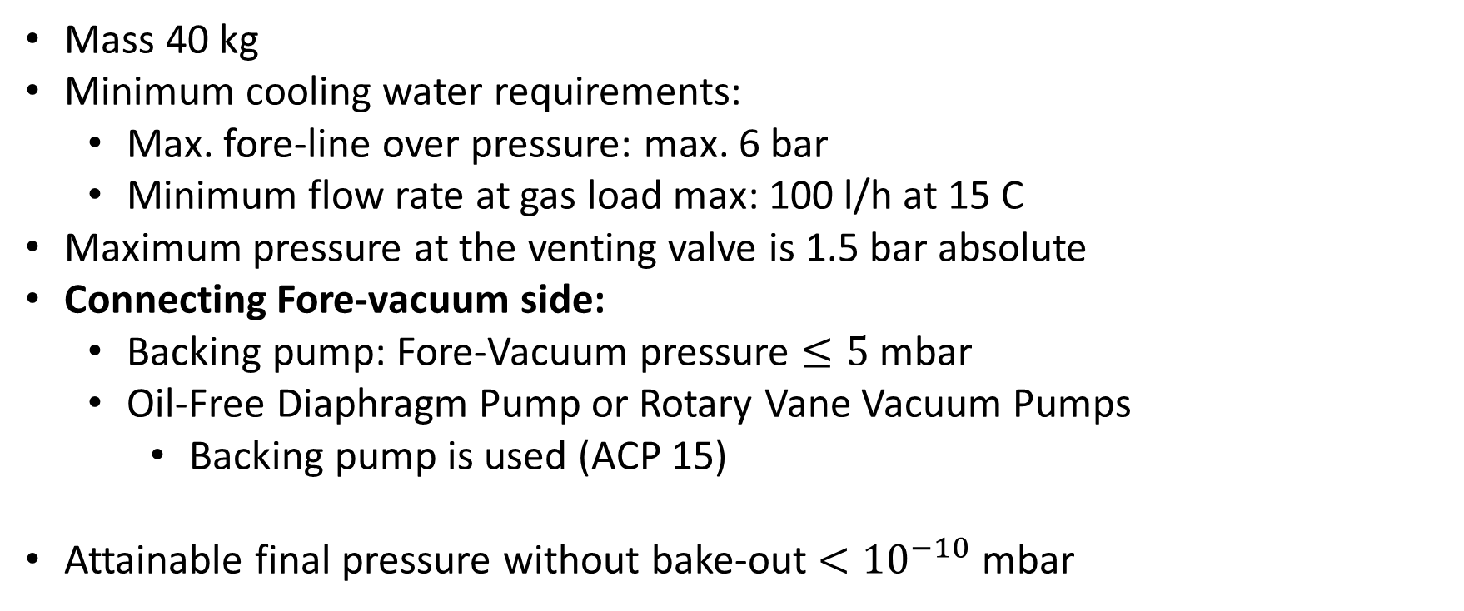
Pump TMU 1001 P
Mass 40 kg
Minimum cooling water requirements:
  Max. fore-line over pressure: max. 6 bar
  Minimum flow rate at gas load max: 100 l/h at 15 C
Maximum pressure at the venting valve is 1.5 bar absolute
Connecting Fore-vacuum side:
  Backing pump: Fore-Vacuum pressure $≤5$ mbar
  Oil-Free Diaphragm Pump or Rotary Vane Vacuum Pumps
    Backing pump is used (ACP 15)
Attainable final pressure without bake-out $<{10}^{−10}$ mbar

