Slide 1
HiPace 1200
Turbo Pump (back-up)
Muhammad Farooq

Slide 2
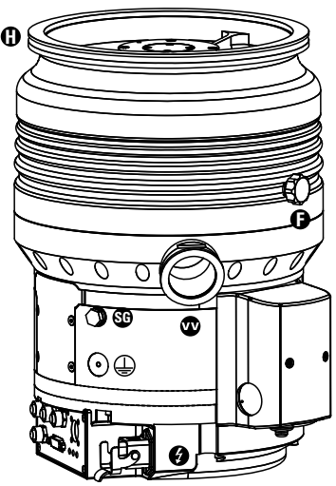
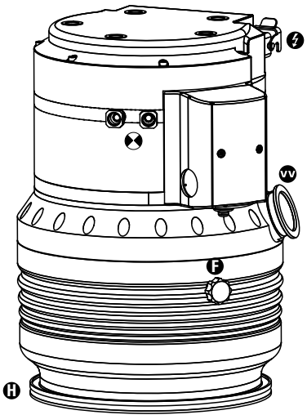






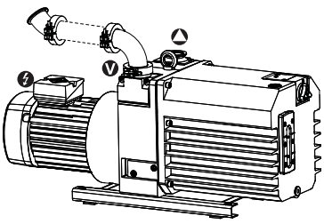


Abbreviations & Symbols
Abbreviations:
DCU: Display Control Unit
HPU: Handed Programming Unit
TC: Electronic drive unit for turbopump
PB: Profibus version
DN: DeviceNet version
Symbols
High vacuum flange
Fore-vacuum flange
Vacuum flange of the backing pump
Exhaust flange of the backing pump
Electrical connection
Sealing gas connection
Venting connection
Cooling water connection

Slide 3
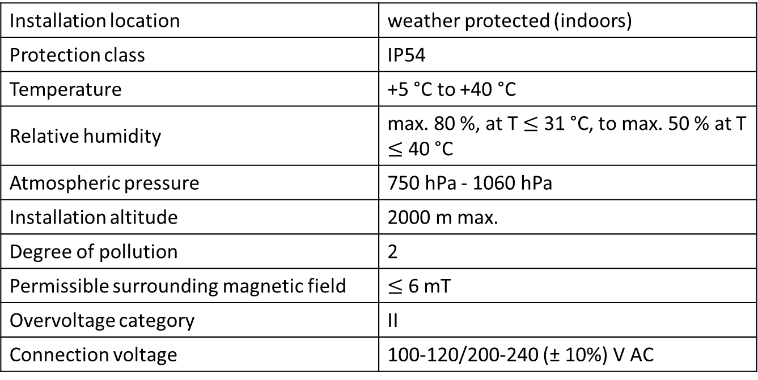
Range of Applications
Installation location | weather protected (indoors)
Protection class | IP54
Temperature | +5 °C to +40 °C
Relative humidity | max. 80 %, at T $≤$ 31 °C, to max. 50 % at T $≤$ 40 °C
Atmospheric pressure | 750 hPa - 1060 hPa
Installation altitude | 2000 m max.
Degree of pollution | 2
Permissible surrounding magnetic field | $≤$ 6 mT
Overvoltage category | II
Connection voltage | 100-120/200-240 (± 10%) V AC

Slide 4
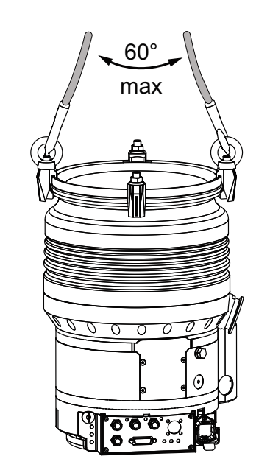
Transport of turbo pump
Information regarding transport of the turbopump without packaging
2 eye bolts are included in the shipment and are firmly bolted to the turbopump ex works.
1. Attach suitable lifting tools to both eye bolts.
2. Pay attention to the correct use and fastening of the lifting equipment.
3. Lift the turbopump vertically (e.g. out of the packaging).
4. Only transport the turbopump in its valid spatial position and with the rotor axis vertically aligned.

Slide 5
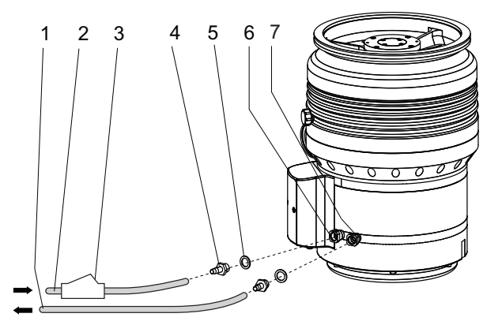
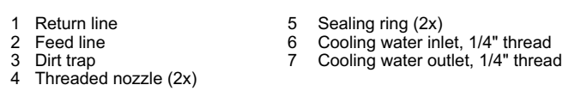
Connecting to Cooling system
Procedure:
1. Screw one hose nozzle with sealing ring onto each of the turbopump's cooling water connections.
– Tightening torque: max. 15 Nm
2. Connect the cooling water supply line to the hose nozzle at the designated cooling water inlet of
the turbopump.
3. Connect the cooling water return line to the hose nozzle at the designated cooling water outlet of
the turbopump.
4. Secure the hose lines on the turbopump with hose clamps.

Slide 6
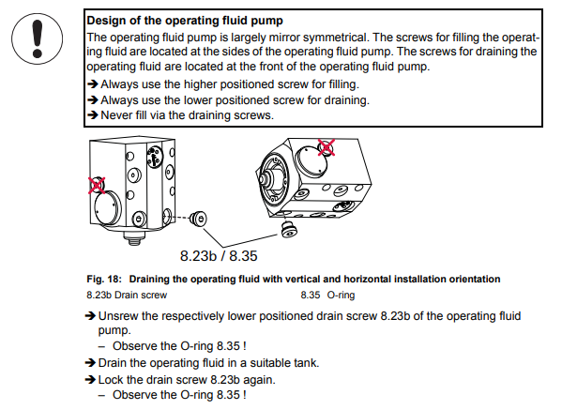
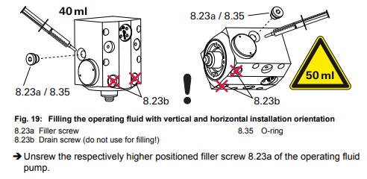

Filling up the Operating Fluid
Notes: There are two bottles of oil. Use the one with model number “ PM 006 336 T“ Fomblin oil F3 50 ml. The other bottle is backup for the old turbo
Draining the oil:
Fill the oil:

Slide 7
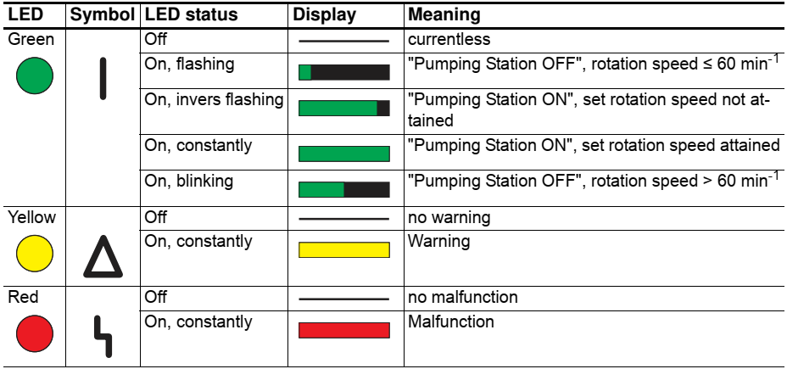
Operation display Via LED

Slide 8
Switching off and venting
Switching off
Notes for switching off the turbopump
1. Shut down the turbopump via the control unit or remote control.
2. Close the fore-vacuum line.
3. Switch off the backing pump, if necessary.
4. Vent the turbopump (options see below).
5. Close the supply lines (e.g. for cooling water or sealing gas).
Manually Venting
Manual venting describes the standard process for venting the turbo pumping station.
1. Ensure that the vacuum system is shut down.
2. Open the black venting screw on the turbopump by one revolution maximum.
3. Wait for pressure equalization to atmospheric pressure in the vacuum system.
4. Close the venting screw again.

Slide 9
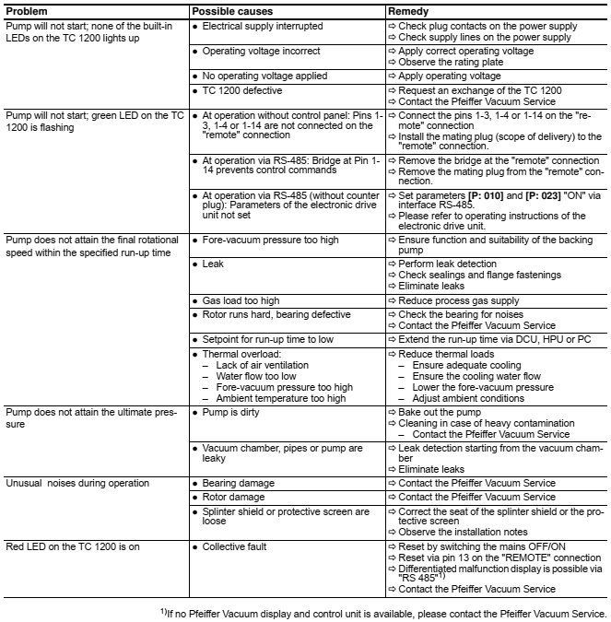
Rectifying malfunctions

Slide 10
Backup Slides

Slide 11
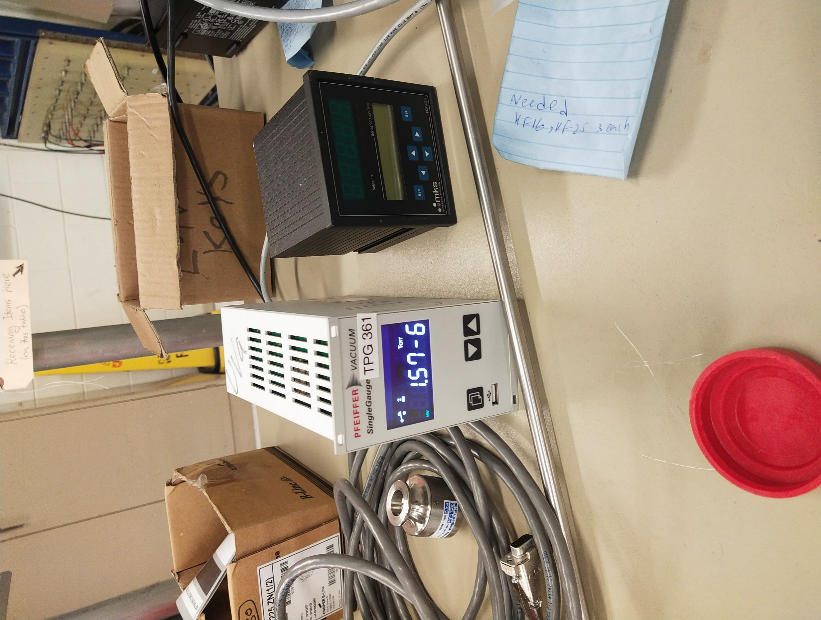
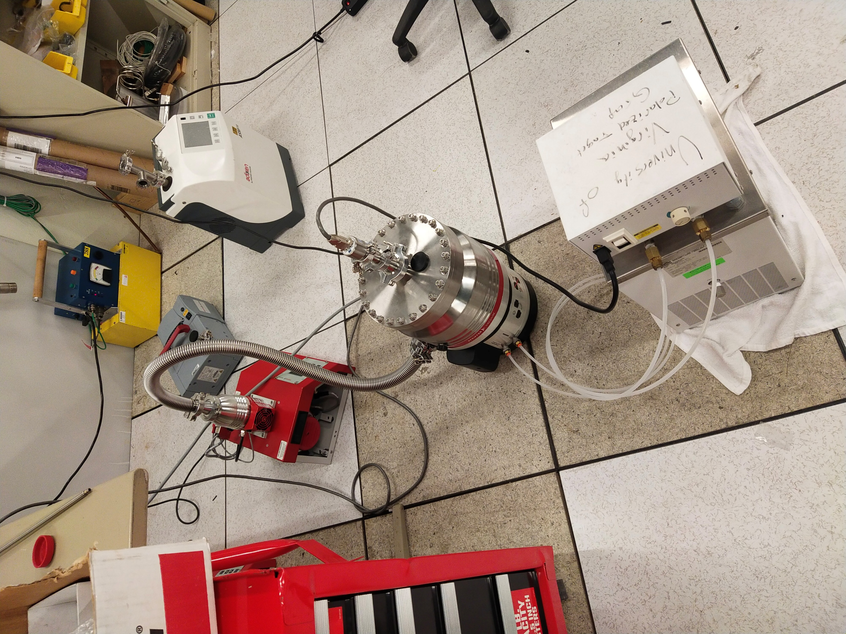
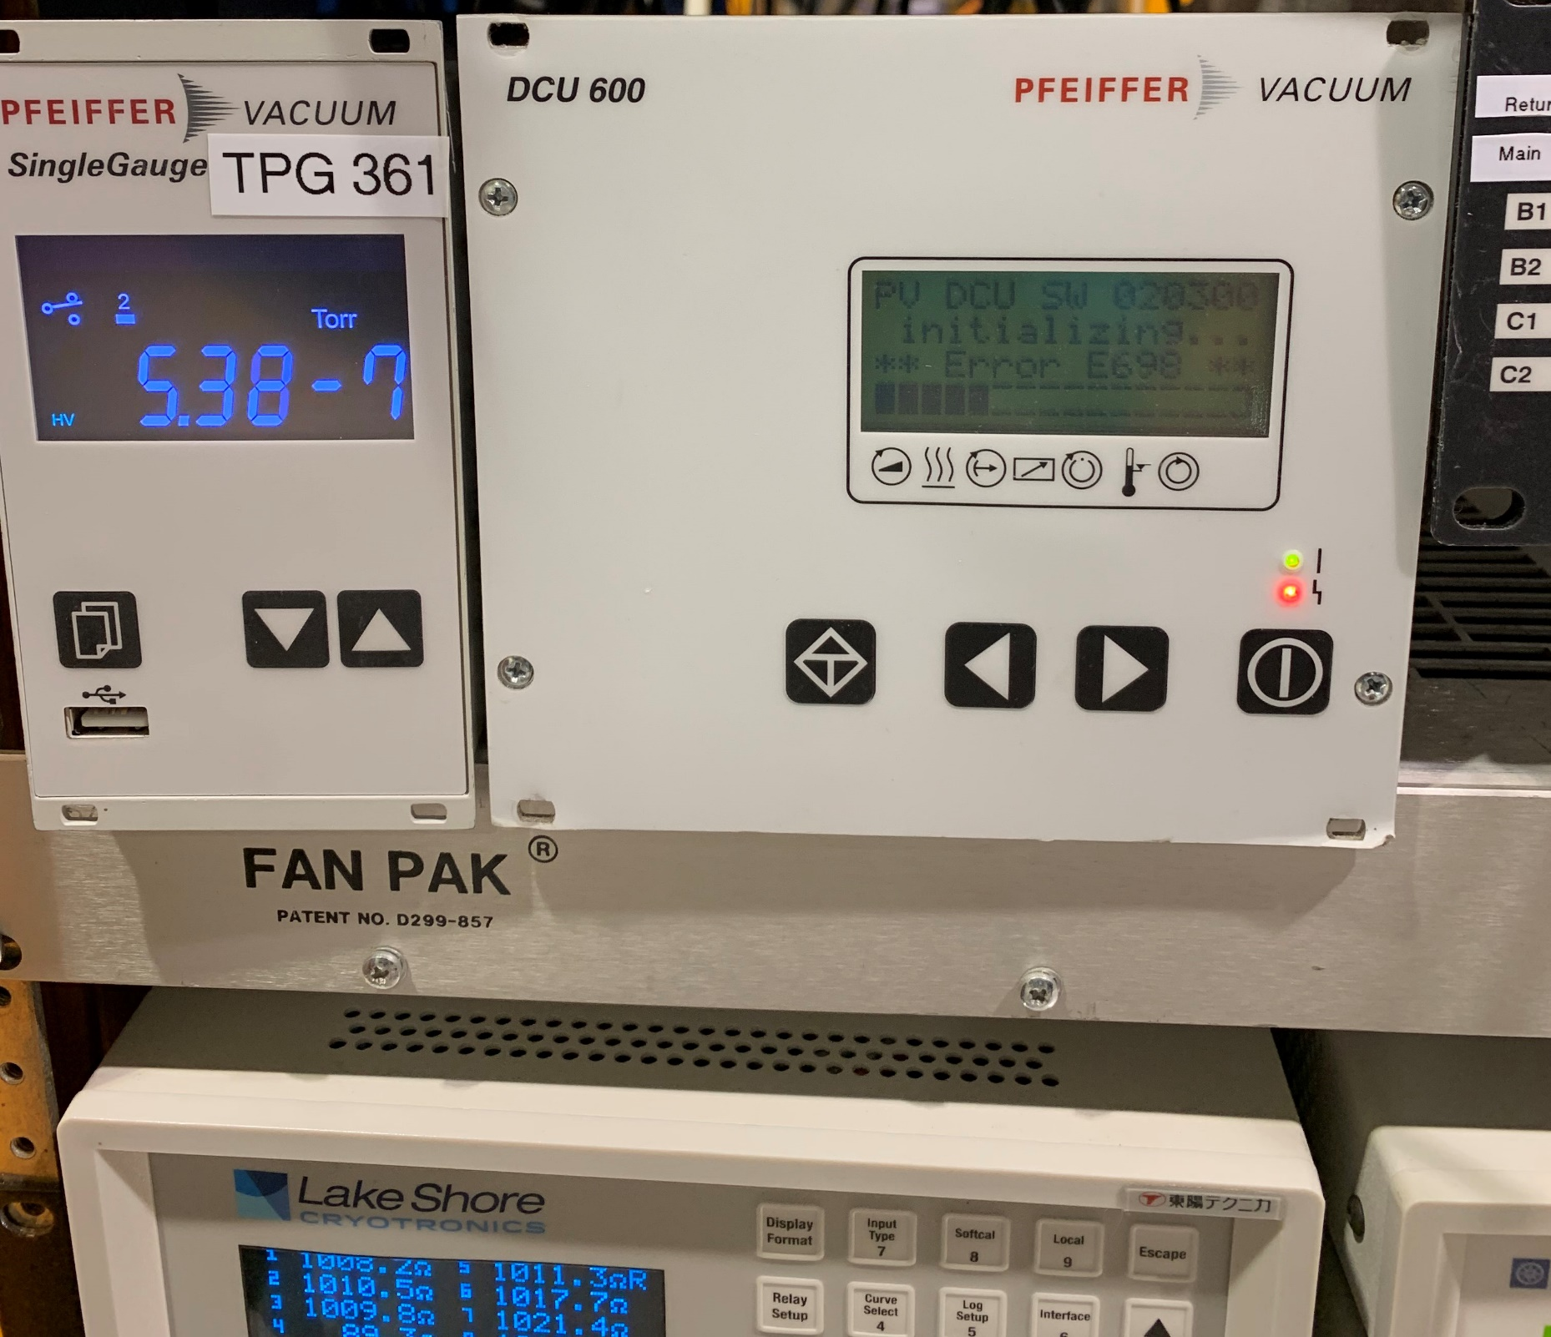
Running turbo pump

Slide 12
