Slide 1
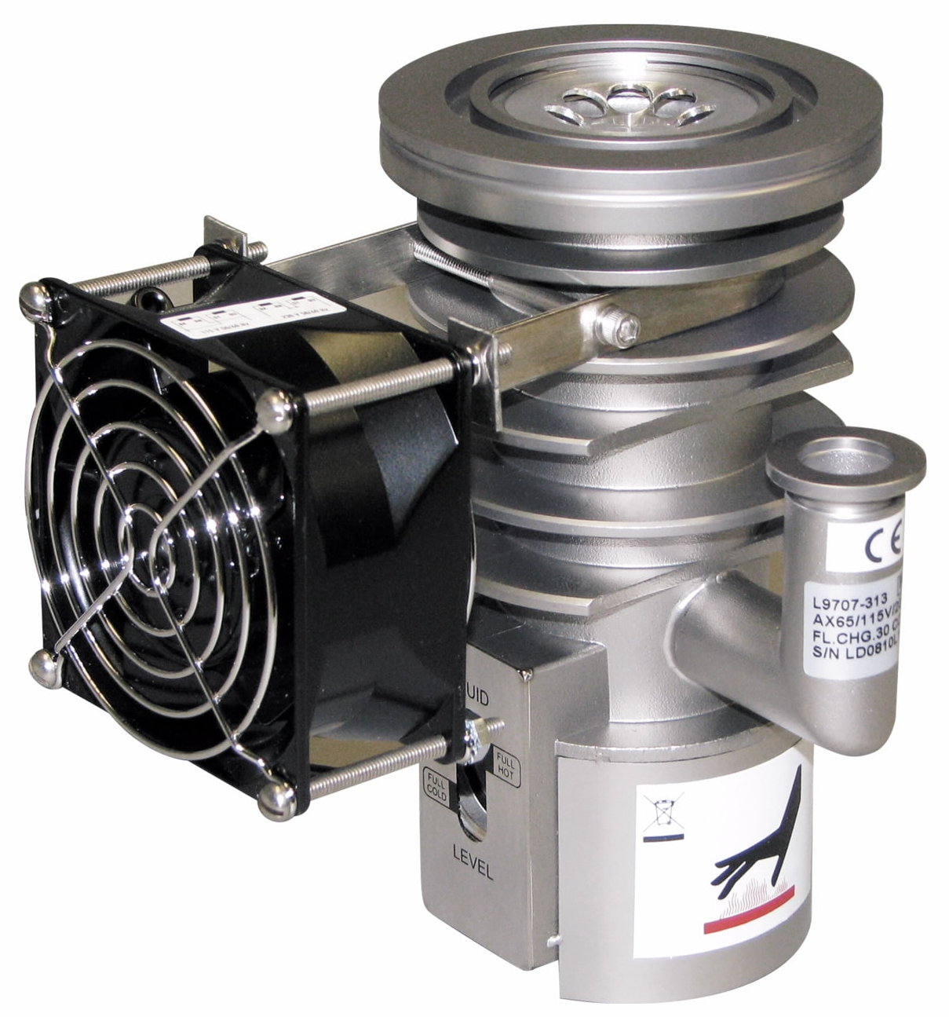
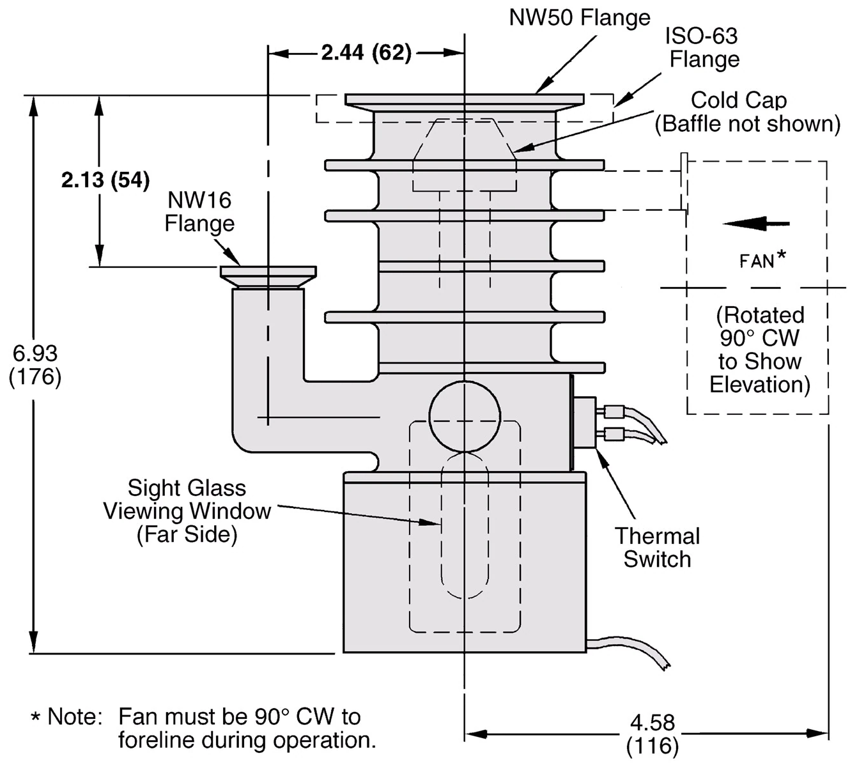
AX-65 Diffusion Pump

Slide 2
AX-65 Diffusion Pump
Manual: https://www.agilent.com/cs/library/usermanuals/public/AX-65%20Diffusion%20Pump.pdf
Pump page: https://www.agilent.com/en/product/vacuum-technologies/diffusion-pumps/small-diffusion-pumps/ax-65-diffusion-pump
Datasheet: https://www.agilent.com/cs/library/datasheets/public/datasheet-ax-65-oil-diffusion-pump-5994-3465en-agilent.pdf
Oil, SantoVac5 (250W)
https://www.agilent.com/cs/library/msds/Oil,%20Santovac5_NAEnglish.pdf
MSDS (Safety datasheet): https://www.idealvac.com/files/brochures/MSDS-SANTOVAC-5aa.pdf
Oil, SantoVac5 40 cc: https://www.agilent.com/store/en_US/Prod-695405001/695405001
Links from IdealVac:
https://www.idealvac.com/Agilent-Varian-AX-65-Diffusion-Pump/pp/P106573
https://www.idealvac.com/pp/P102288

Slide 3
Features
High-performance specifications mean higher, cleaner vacuum levels
Fluid-level sight glass provides a quick indication of pump fluid status at all times
The wide range of available pump configurations and flange combinations optimizes pump performance and fit for your application
Compact design makes integration into space-limited equipment easy
Full thermal protection guards against all over-temperature conditions
Optional 'pump-ready' thermal switch indicates when the pump is operational
Finned, vertical boiler promotes stable pumping, especially of light gases
Three-stage jet with ejector stage purifies pumping fluid and gives higher fore pressure tolerance
Fast warm up and cool down: 7-minute warmup time and 10-minute cool down time
Air cooling system simplifies utility requirements
Source [https://www.agilent.com/en/product/vacuum-technologies/diffusion-pumps/small-diffusion-pumps/ax-65-diffusion-pump#specifications]

Slide 4
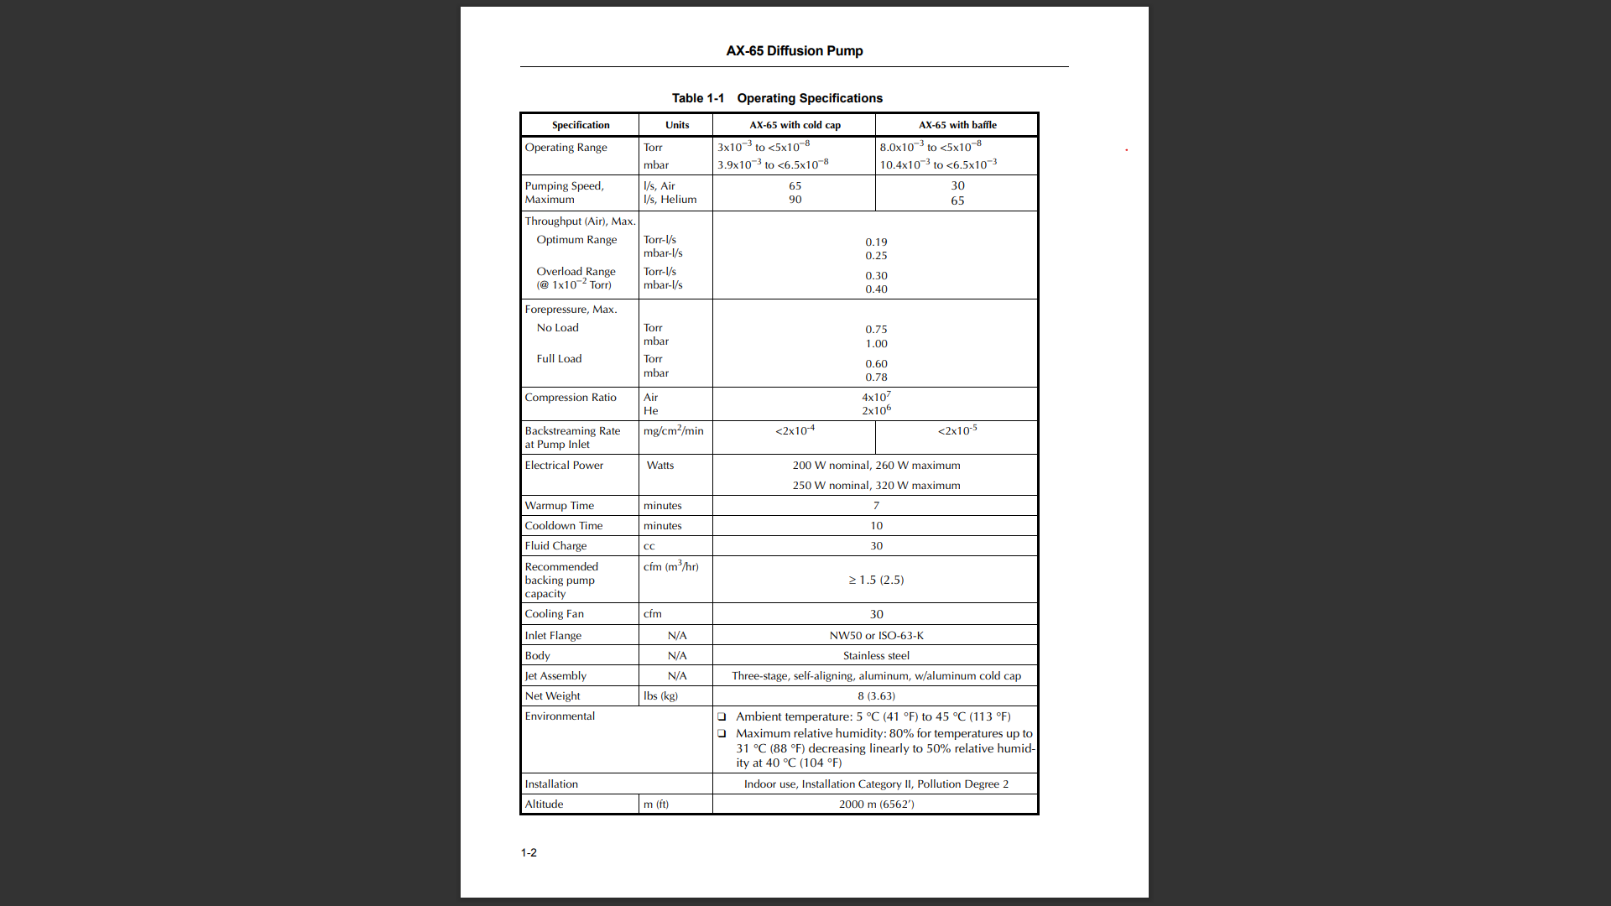

Slide 5
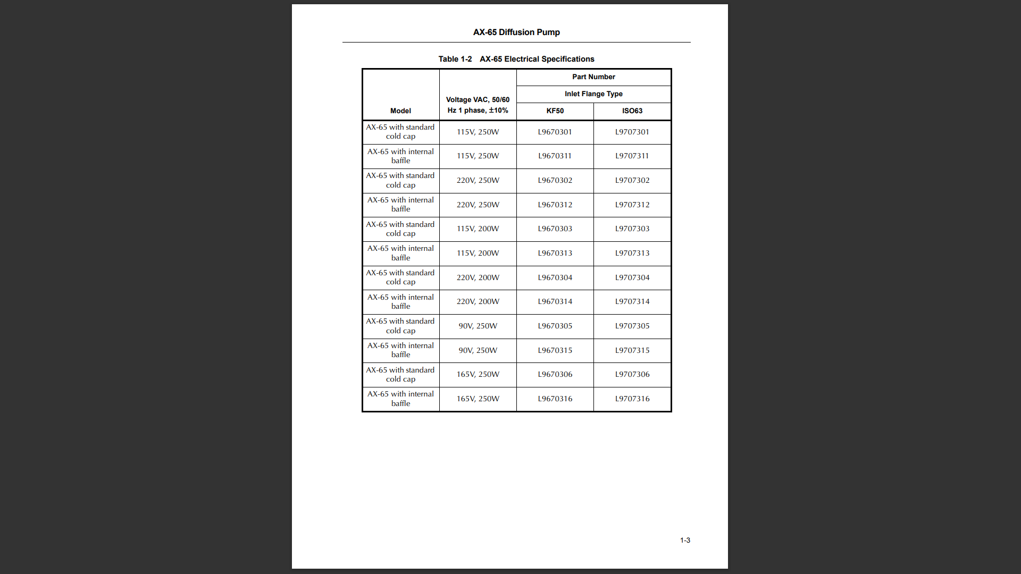

Slide 6
Backstreaming Rate | 2 x 10⁻⁴ mg/cm²/min
Cooldown Time | 10 min
Electrical Requirements | 1 ph 50/60 Hz 90/115/165/220 V
Fluid Charge | 30 CC
Fluid Type | Oil
Input Voltage | 90, 115, 165, 220 V
Maximum Forepressure - Full Load | 0.60 Torr 0.78 mbar
Maximum Forepressure - No Load | 0.75 Torr 1.00 mbar
Maximum Throughput | 0.19 T-L/s (0.25 mbar-L/s)
Operating Range | 3.9 x 10⁻³ to 6.5 x 10⁻⁸ mbar 3 x 10⁻³ to <5 x 10⁻⁸ Torr
Pump Weight | 8 lbs 3.63 kg
Pumping Speed - Air | 65 L/s
Pumping Speed - He/H2 | 90 L/s
Recommended Backing Pump | ≥ 0.15 cfm (0.25 m³/hr)
Warmup Time | 7 min
Specifications
Source [https://www.agilent.com/en/product/vacuum-technologies/diffusion-pumps/small-diffusion-pumps/ax-65-diffusion-pump#specifications]

Slide 7
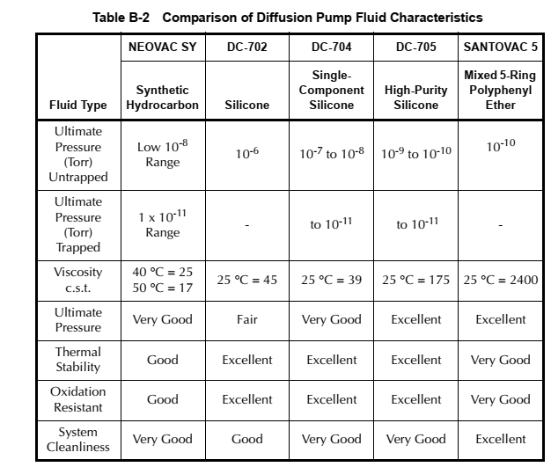
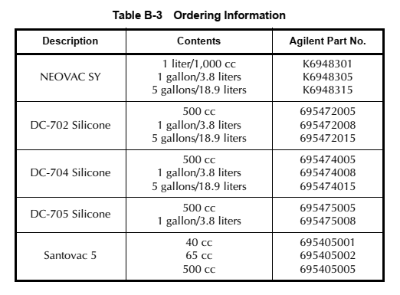
Pump Oil choice and Installation
250 Watts heaters
  Santovac 5 (polyphynyl ether)
200 Watts heaters
  DC-704
Recommended oil level 30 cc
  Sidewall window to check the oil level

Slide 8
Back up Slides

