Slide 1
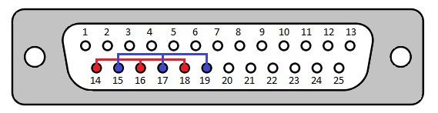
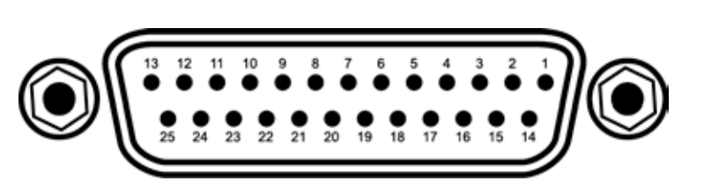
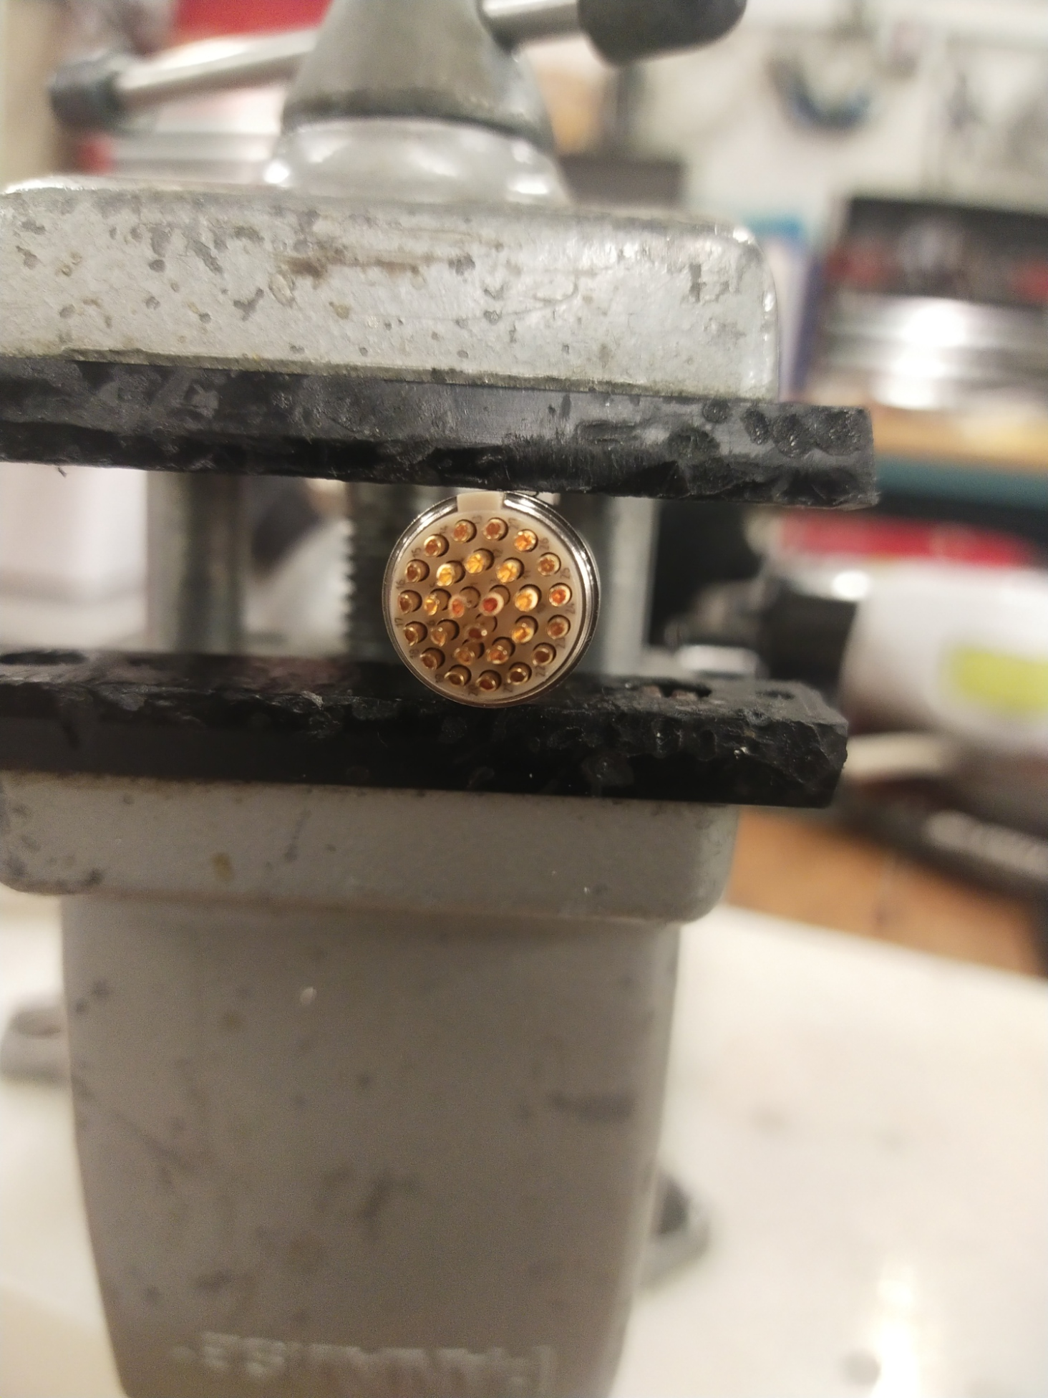
Front View of DS 25
Front View of Lake Shore Device
Don’t consider the colored lines (Red + Blue)
Use Soldering wire
Soldering tool
Soldering stand
Lamp
Heat sleeves
Fluke Multimeter
Strippers
Short cable
Connectivity check
Make labels on the channels
Back View of Fischer Connector

Slide 2
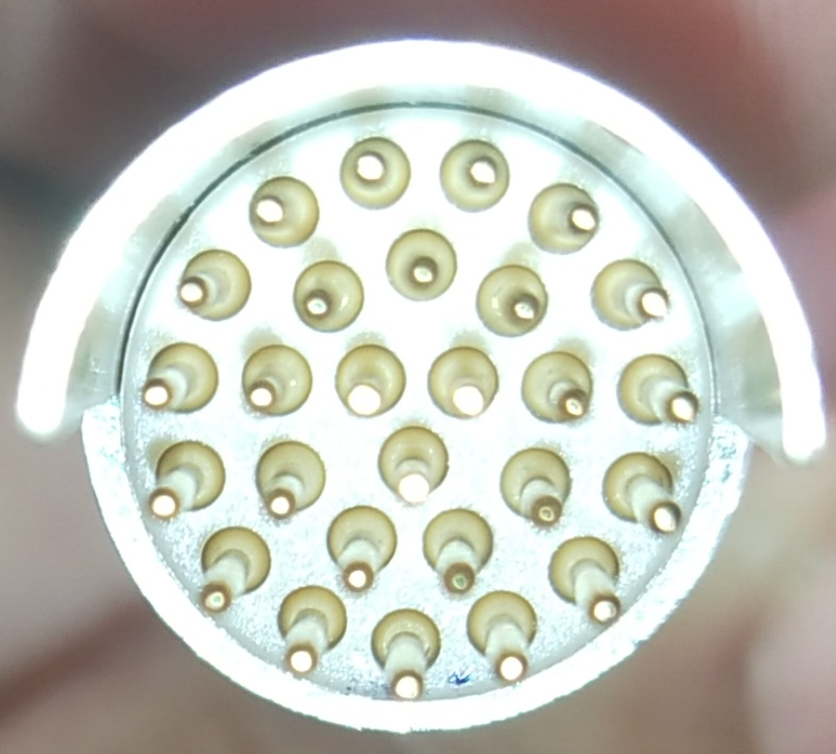
Target New Configuration Insert
1 | 1+ in (1) Red (D3,4) | 15
2 | 1- in (1) Grn (D15,16) | 16 | 6- in (2) Brn(D18,19)
3 | 8I+ in (2) Red(DS 12) | 17
4 | 2+ in (1) blk (D6,7) | 18 | 7I+ in (2) Red(DS 9)
5 | 2- in (1) blu (D18,19) | 19 | 7V+ in (2) Whte(DS 10)
6 | 8V+ in (2)Yelw(DS13) | 20 | 7I- in (2) Blk(DS 21)
7 | 3+ in (1) blk (D9,10) | 21 | 7V- in (2) Grn(DS 22)
8 | 3- in (1) yel (D21,22) | 22
9 | 8I- in (2) Blck (DS 24) | 23
10 | 4+ in (1) blk (D12,13) | 24 | 6+ in (2) Red (D6,7)
11 | 4- in (1) wht(D24,25) | 25
12 | 8V- in (2) Orn(DS 25) | 26
13 | 5+ in (2) Red (D3,4) | 27
14 | 5- in (2) Org (D15,16)
12
13
14
11
23
15
24
22
10
1
16
25
27
21
9
17
26
2
20
8
18
19
3
7
4
6
5
Front View of Fischer Connector

Slide 3
12
13
14
11
23
15
24
22
10
1
16
25
27
21
9
17
26
2
20
8
18
19
3
7
4
6
5

Slide 4
Readout
These eight sensors are read out by one of LakeShore 218 through
One Fischer connector (27 pins) at the insert side and
Two D25 connectors at the LakeShore 218 side.
The readout cable is of 20 conductors at min (2 wires * 6 sensors + 4 wires * 2 sensor).
A 26-conductor cable is in place, which goes through the east penetration.
The D25 and Fischer connectors are configured for "2 wires * 6 sensors (resistors) + 4 wires * 2 sensors (cernox)". Thus they have to be re-configured.
The new pin assignment is given below.
A 26-conductor cable will be placed for spare.
https://confluence.its.virginia.edu/display/twist/Target+Insert

